Slide 1
Session 4:
Creating Stress Resilience
Notes:
Welcome to the first session of Breathe: A Stress Resilience Program by Masterpiece Living! Facilitator(s) introduce him/her/themselves.
I’m so glad you made the decision to explore stress with us. Stress affects everyone and each of us responds differently to that stress. We are going to work toward understanding why we have stress in the first place, identifying what stresses you out and what reactions and symptoms come along with that stress. Then, we will begin to discuss and try new strategies and techniques to cope with the inevitable stressors of life. The ability to respond healthfully to stress is called stress resilience. Through the course of this program, we hope you find increased stress resilience in your life.
Before we get started I want to invite all of us to remember that in this group we might be talking about some personal or sensitive topics. In order to make sure everyone feels comfortable, I would like us all to agree to a couple of things: that we will use respectful language, only share what is appropriate, and keep whatever is shared private to those of us in this room.
Now, let’s take a moment to go around the room and introduce ourselves. Please tell us your name and share one word about what’s stressing you out right now.
**Presenter Note: The notes in bold are directions and citations. The script to read is non-bolded text.

Slide 2
Last session…
…we discussed coping strategies and lifestyle choices for increasing stress resilience.
This session…
… we will discuss, in greater detail, how we can incorporate these techniques into our daily lives and what this means for our organization.
Notes:
Last week we discussed how lifestyle impacts the way we experience stress.
This week we will review what we’ve learned about increasing stress resilience and discuss how we can incorporate these techniques into our daily lives.

Slide 3
Notes:
Just as we’ve done in the last three sessions, let’s take time to stop and check in with our bodies and breathe together.
Play/read the breathing exercise from Week 1

Slide 4
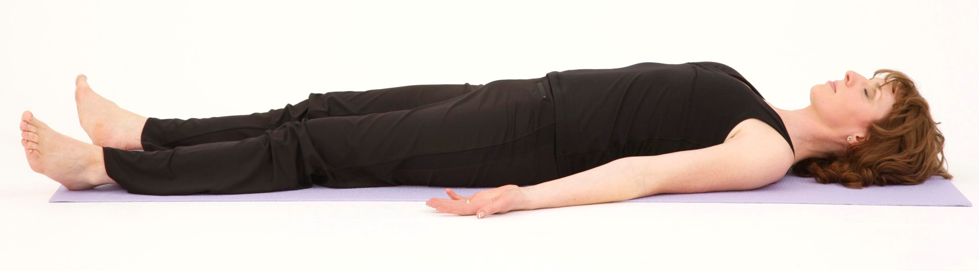
Invitation from last week
Notes:
Before we go any further, I would like to check in with everyone to see if you had any thoughts come to mind since last week that you’d like to share with the group.
[open for discussion]
Was anyone able to practice the progressive muscle relaxation at home? When did you do it?
What was your experience like?

Slide 5
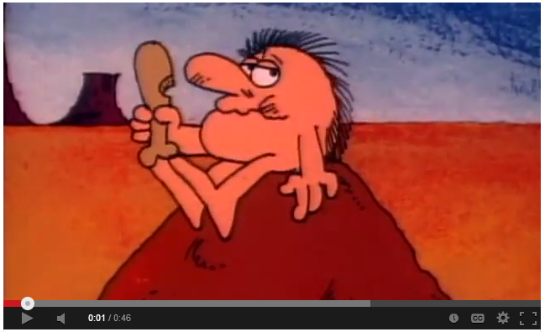
What’s stress, again?
Notes:
Let’s take a moment to review the what happens in our bodies when we are stressed. [play the video]
[open for discussion reviewing concepts from week 1 –select from the following questions]
What is stress?
Why does it happen?
When is it helpful?
When is it harmful?
What is the impact of chronic stress?
Who can describe what’s happening when we have chronic stress?
Chronic stress is repeatedly triggering the stress response without enough time to recover in between. This can result in an oversensitivity to stressors making the stress experience even more challenging.

Slide 6
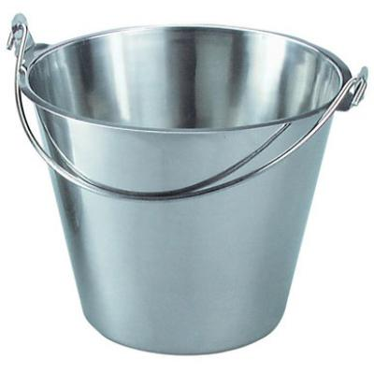
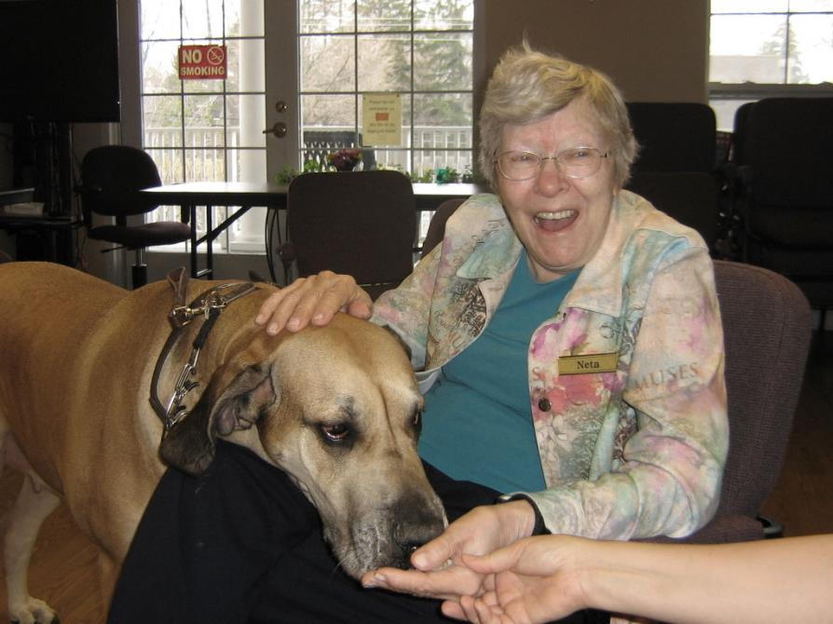
Building Stress Resilience
Ikigai
Notes:
[open discussion reviewing week 2 concepts]
Compassion for others
Attitude
Worry
Meaning and purpose
Laughter

Slide 7
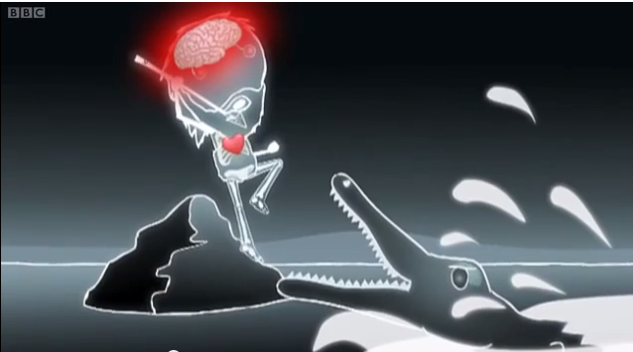
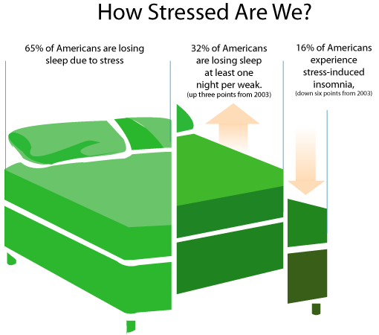
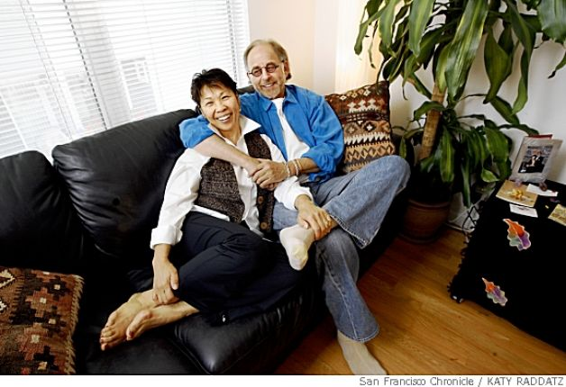
Lifestyle Choices
Notes:
In week 3 we discussed the coping strategies and the impact of lifestyle choices on our stress response
[open discussion reviewing concepts from week 3]
Coping strategies – some are more supportive than others (journaling, talking with a friend, massage, exercise)
Lifestyle choices – environment, healthy and balanced meals, mindful eating, sleep, exercise, social connection

Slide 8
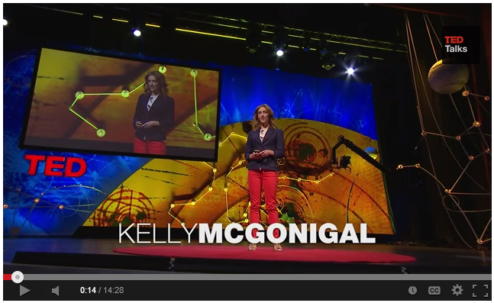
Stress TED talk
Notes:
[Play video]
We chose this video as a summary of how stress works, to remind us that perception is an important contributor to how stress impacts us, and to remind us that we cannot control the stressful things in life, but that we can always choose our response to it. Please ensure the participants take away this message. We are NOT condoning stress as a good thing but simply emphasizing the point that we do have a lot of control over how it impacts our health.
[open discussion – about 1-2 minutes]
What is the message of this video?
How does this apply to what we’ve been learning?

Slide 9
Guided imagery
Notes:
We have learned several techniques for finding a place of relaxation that allows our body to recover from the effects of our stress response. Today we are going to practice one more. Guided imagery can be powerful for increasing stress resilience because by engaging the brain in using all the senses, you actually change your physiology. Just like the brain triggers the same stress response whether you are experiencing, watching, remembering, or anticipating something stressful. The same happens when we envision something peaceful and relaxing, thanks to mirror neurons in the brain.
Again, I invite you to practice this here, then try it at home. Remember, regular practice builds our stress resilience over time. The more we access that place of calm and give our body a chance to recover between stressors, the more easily your body will be able to find balance in the future, because it is familiar. This is part of our process to increase stress resilience.
Play/read guided imagery script
Image Resource: http://www.webstockpro.com/Fancy/FAN2015082.Senior-man-eyes-closed-Photo/

Slide 10
Successful Aging Research
Notes:
Remember, successful aging research tells us that 70% of the way we age is due to lifestyle choices, that growth is possible at any age, and it’s never too late to make changes that will increase our quality of life!
So, it’s time to take what we’ve learned and create a personalized plan for implementing lifestyle choices to increase stress resilience. No amount of learning about the research will translate into successful aging without proper action behind it!

Slide 11
Sustainable Stress Resilience
What does this mean for me?
What triggers can I reduce or eliminate?
What technique will I use during times of acute stress?
Which relaxation technique will I practice daily?
Which lifestyle choice do I want to focus on for supporting my overall stress resilience?
Notes:
Throughout the course of this program we have learned techniques for responding healthfully to stress (breathe, exercise, journal, seek social support). We learned ways to practice relaxation on a regular basis to provide an opportunity for our bodies to recover from stress (breathing, compassion training, PMR, guided imagery). We discussed lifestyle choices that impact the way we experience stress (nutrition, sleep, exercise, environment). And we talked about our perception of stress, our attitude, and our perception of choice and control as being factors for impacting stress.
Let’s take some time now, to decide what you might want to take with you from this program into your daily life. There are a lot of options to choose from, and it may be helpful to consider first what has been most enjoyable for you or what has resonated the most.
[Handout week 4 worksheet and encourage participants to consider each of the questions as you read them from the slide and write them on their paper to take home with them]
What does this mean for me?
What triggers can I reduce or eliminate?
What technique will I use during times of acute stress?
Which relaxation technique will I practice daily?
Which lifestyle choice do I want to focus on for supporting my overall stress resilience?
[open for discussion]
We’ve learned what we can do for stress resilience, we’ve identified what we would like to try, and now we can increase our chances of success by sharing our plan and gaining the support of others.
Who would like to share their plan for increasing stress resilience in their life?
Now that you have identified a few things to focus on for supporting your stress resilience, I invite you to check in with one another and remember that each of your interactions has the possibility to fill or deplete another person’s bucket. So, let’s all work together to create a culture of positivity in each of our interactions.

Slide 12
Summary
Stress resilience is our ability to recover from the “curve balls” of life
Daily relaxation practice increases stress resilience
We can choose how we respond to any given situation
How we respond impacts those around us, as well as our own health
Putting a plan into action is easier when we share it with a supportive group of people

Slide 13
Thank you…
… please stay for just a few moments to complete the post-test.
Notes:
Before we finish today, I invite each of you to share one word that summarizes your takeaway from participating in Breathe these last 4 weeks.
Thank you all for sharing. And now, to complete today’s session let’s all breathe together one last time. Inhale, and exhale. Have a good week!

