Slide 1
Africa
Exploring Kenya
Notes:
1
Jambo! Or “hello” as you will learn today in Swahili. Thank you joining us as we take a trip to Kenya, Africa. During our trip, we will be exploring the unique culture of the Kenyan lifestyle and how the four Masterpiece components help to shape Kenya’s unique and rich culture. All you need for this trip is an open mind and a spirit of adventure.
http://www.youtube.com/watch?v=_VWBND1ggF8
If you have internet access please copy and paste the following link into your internet browser to get people warmed up for their visit to Kenya, Africa. The following is a popular Kenyan Song, “Jambo Bwana”, that welcomes visitors and tourists.

Slide 2
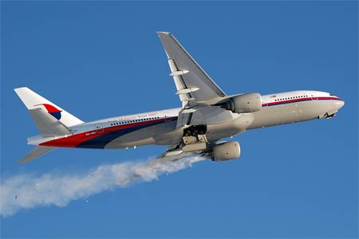
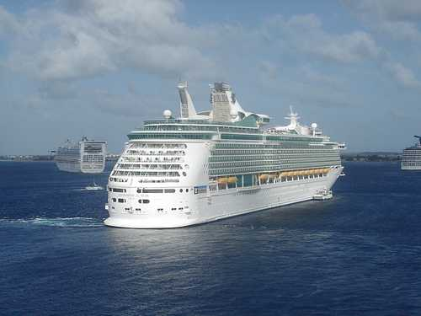
Before We Begin
Has anyone travelled to Africa?
What do you know about Africa?
What interests you about Kenya?
Notes:
Before we begin, has anyone ever traveled to Kenya before? What do you already know about Kenya or Africa? What are you most interested in learning about today?

Slide 3
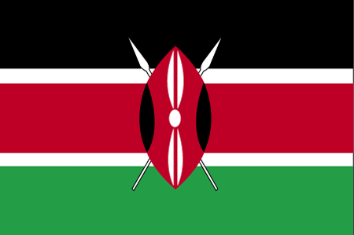
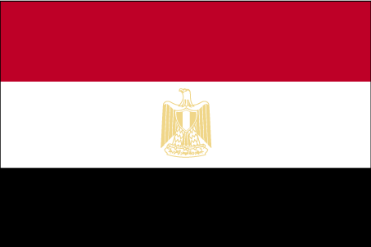
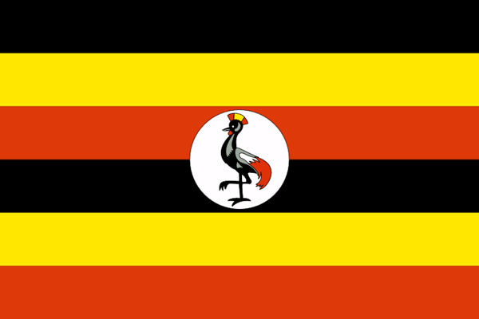
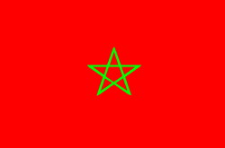
Flag Game
A.
C.
B.
D.
Notes:
To start our safari we have a quiz question for you. Which of the flags shown represents the country of Kenya?
(Answer on next slide)
1. Wikimedia. Kenya. 4 May 2011. <http://commons.wikimedia.org/wiki/Kenya>

Slide 4
Decoding the Kenyan Flag
Black: population Red: bloodshed Green: wealth White: peace
Shield & Spears: Defense/Freedom
Notes:
If you guessed “A” you’re correct! Kenya adopted this as their national flag on December 12th, 1963. The black over red over green is based on the Kenya Africa National Union, which is the political party that led the fight for freedom and independence in Kenya. Each color and symbol on the Kenyan flag represents something different.
The black represents the majority population living in Kenya, which is black.
The red represents the bloodshed in their struggle for freedom and independence from Britain.
The green represents the natural wealth of land in Kenya, specifically the agricultural resources.
The white represents the peace and unity of the country.
In the middle of the flag is a shield and two spears. The traditional Massai shield and spears symbolize the defense of all the things mentioned that the colors represent.
All information retrieved from:
The World Factbook. Central Intelligence Agency. 24 Jan 2011 <https://www.cia.gov/library/publications/the-world-factbook/flags/flagtemplate_ke.html.>
Flagspot. Kenya Flag. 29 Jan 2011. http://flagspot.net/flags/ke.html#exp

Slide 5
Kenya
Africa
Notes:
During this presentation we will look at factual and cultural items of Kenya as they pertain to the four Masterpiece components of successful aging.
We will begin by focusing on some intriguing demographics and facts about Kenya. In this section, we will be learning about the geography, the demographic makeup of Kenya, and popular regional activities.

Slide 6
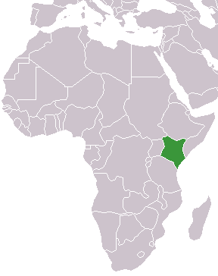
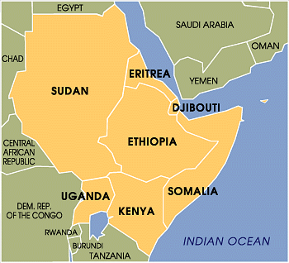
Do you Know your Geography?
Notes:
Kenya is located in east-central Africa. The climate is variable depending on the location of the country- ranging from arid in the north, to tropical towards the ocean coast. Bodies of water near Kenya include the Indian Ocean and Lake Victoria. The rainy season occurs between the months of March and June and the temperature remains high throughout these months. The country receives a great deal of sunshine all year round. The Kenyan Highlands comprise one of the most successful agricultural production regions in Africa. The unique physical makeup of the geography supports the abundant and varied wildlife of Kenya for both scientific purposes and economic value.
The World Factbook. Central Intelligence Agency. 24 Jan 2011 <https://www.cia.gov/library/publications/the-world-factbook/geos/ke.html>
Wikimedia. Kenya, Africa. 4 May 2011 <http://commons.wikimedia.org/wiki/File:Kenya_in_africa.png>

Slide 7
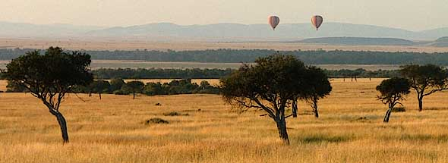
Kenya: Facts and Figures
Capital: Nairobi
Area: 360,623 mi. (Twice the size of Nevada)
Population: ~41,070,900 (est. 2011)
Official languages: English and Swahili
Notes:
It is estimated that some 41.1 million people live in Kenya. The largest city and capital, Nairobi, is home to over 3.3 million people making it the most populous city in eastern Africa and the 12th largest city in Africa. The total area of Kenya is roughly 360,623 miles or twice the size of Nevada. While English and Swahili are both the official languages of Kenya, there are a host of other indigenous languages found in the less populated areas.
All facts retrieved from: The World Factbook. Central Intelligence Agency. 24 Jan 2011 <https://www.cia.gov/library/publications/the-world-factbook/geos/ke.html>

Slide 8
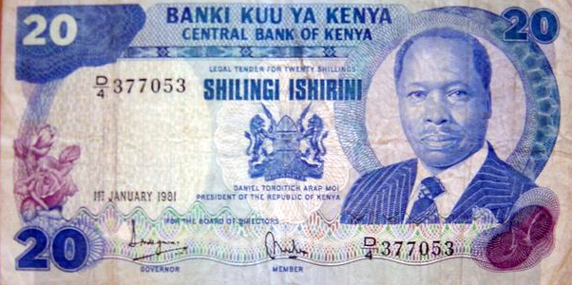
Kenya: Facts and Figures
Religions: Protestant-45%, Catholic-33%, Islam-10%, indigenous beliefs-10%
Adult Literacy: 85%
Life expectancy: ~59 y/o
HIV / AIDS: 6.7% pop/1.2 mil.
Currency: Kenyan Shilling (KES)
Notes:
The dominant religion in Kenya is Christianity with 45% affiliated with the Protestant denomination and 33% affiliated with the Catholic church. While a large majority of Kenyans are Christians, the proportion of those adhering to Islam or indigenous beliefs varies widely.
85% of Kenyans age 15 and older can read and write. In comparison, the American/Canadian literacy rate is 99%.
Kenya’s life expectancy is roughly 59.5 years old. The average male can expect to live to 58.9 years old and the average female can expect to live to 60 years old. Kenya ranks 189th out of 222 countries in the world for life expectancy. Life expectancy is also an indicator of overall quality of life.
The World Factbook. Central Intelligence Agency. 24 Jan 2011 <https://www.cia.gov/library/publications/the-world-factbook/geos/us.html>
Infoplease. “Kenya More Facts & Figures”. 24 Jan. 2011 <http://www.infoplease.com/ipa/A0107678.html?pageno=6>
Picture from: http://commons.wikimedia.org/wiki/File:Kenya-20Shilling.jpg

Slide 9
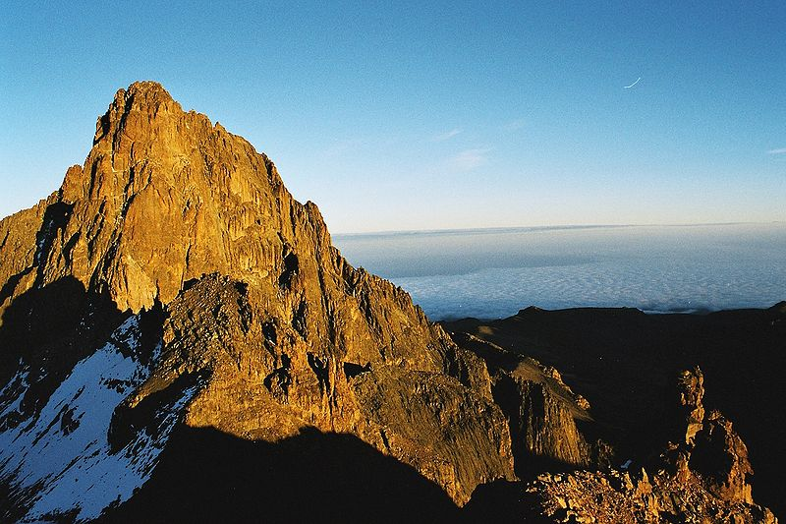
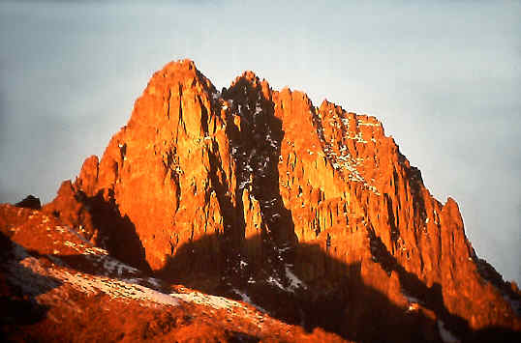
Mount Kenya
Mount Kenya is the highest point in Kenya and the second highest point in Africa
This mountain stands at (~17,000 feet)
Attracts mountain climbers from all over the world
Now an extinct volcano
Notes:
Mount Kenya is the highest mountain in Kenya and the second highest in Africa-first being Mount Kilimanjaro. It is also one of the only places near the equator in Africa with glaciers. This mountain rises to 17,000 feet, where Mount Kilimanjaro stands at 19,300 feet. Mount Kenya is also an extinct volcano that was formed by layers of hardened lava several million years following the east African rift. Since that time, Mount Kenya has experienced harsh erosion from the glaciation that took place which has made its slopes very steep and treacherous for climbers.
Compared to Mount Kenya, Mount Kilimanjaro is a relatively easy climb and the main summit can be reached by most climbers. It is said that Mount Kilimanjaro is a rather uninteresting climb as the scenery and change in landscape is limited. Mount Kenya, on the other hand, has several peaks that only experienced climbers should attempt. There are also walking routes that do not require technical climbing.
Mount Kenya Cleanup 1998. 26 Jul. 2011 <http://www.mountkenya.org/>
African Sermon Safaris. 26 Jul. 2011 <http://www.africansermonsafaris.com/climbing-mt-kenya.html>
Photos accessed from: Cosley & Houston Alpine Guides <http://www.cosleyhouston.com/kenya.htm>
Photo accessed from: http://commons.wikimedia.org/wiki/File:Mount_Kenya.jpg

Slide 10
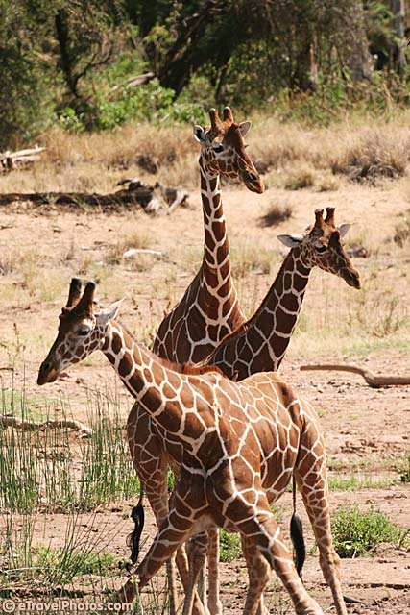
Kenya: Home of…
The world’s tallest mammal
The largest land animal
The fastest land mammal
Notes:
Kenya is home to hundreds of different species of animals that include large plain herbivores, aquatic herbivores, small herbivores, predators, birds and reptiles. Kenya is home to the tallest, largest and fastest land animals.
The giraffe is the tallest mammal in the world. Giraffes have advantages & disadvantages that come with their height, which normally ranges from 14 to 19 feet tall. Advantages include looking out for predators and having the ability to access the treetops for leaves that other animals cannot reach. This is essential for survival since a giraffe must consume hundreds of pounds of leaves weekly. A disadvantage giraffes’ face is shown in this photo- difficulty with simply drinking water. This position is not only strenuous on their bodies, but it also makes them vulnerable to predators.
Although the African Elephant is the largest land animal, these creatures are herbivores that can consume up to 300 pounds of grass, bark, and fruit daily. These elephants mainly use their two finger-like projections at the end of their trunk to pick up small food items. Here’s a fun fact: An African Elephant’s trunk alone has over 100,000 muscles!
Cheetahs are the world’s fastest land mammal and can accelerate at an incredible speed. They can reach 60 mph in roughly 3 seconds-can your car do that? Cheetahs are day-hunters, but are able to stay hidden amongst the grasses with their special coat and spot out prey with their keen eyesight.
Not only is Kenya home to the tallest, largest and fastest land animals in the world, but it is also home to the “Big Five”
(Does anybody know what animals are included in the Big 5?) Answer: lions, leopards, elephants, rhinos and buffalo.
African Elephant. National Geographic. 24 Jan 2011. http://animals.nationalgeographic.com/animals/mammals/african-elephant/?source=A-to-Z>
Cheetah. National Geographic. 24 Jan 2011. <http://animals.nationalgeographic.com/animals/mammals/cheetah/?source=A-to-Z>
Giraffe. National Geographic. 24 Jan 2011. <http://animals.nationalgeographic.com/animals/mammals/giraffe/>
The Big 5 Animals. E-gnu.com
26 Jul. 2011 <http://www.e-gnu.com/safari/big_five.html>
Photos Courtesy of Etravelphotos.com
Elephant:<http://www.etravelphotos.com/photo.php?pid=2150>
Giraffe: <http://www.etravelphotos.com/photo.php?pid=2188>
Cheetah: <http://www.etravelphotos.com/photo.php?pid=2481>

Slide 11
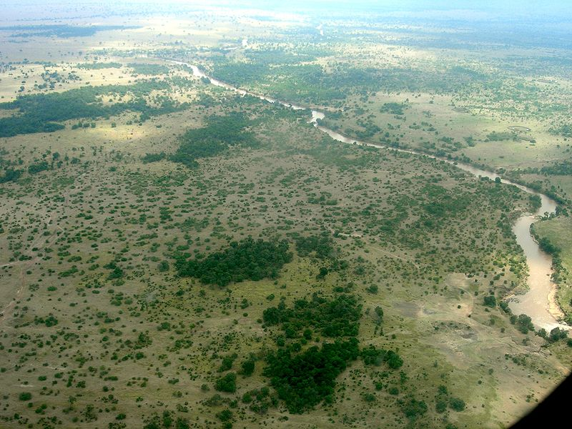
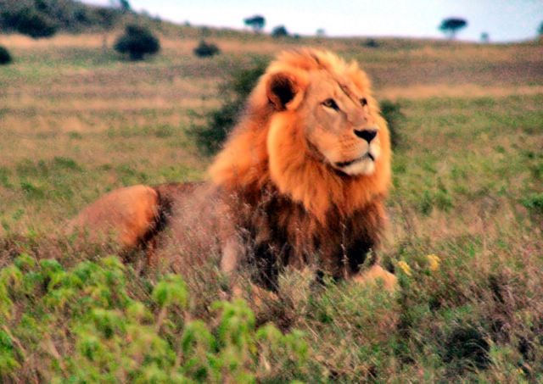
Kenya: Massai Mara
National Reserve:
Home to many big game animals
Animals:
Lions, Leopard, Elephant, Rhinos, Leopards, Hippopotami, Wildebeests, Zebras, and Gazelle can all be found in the Massai Mara
Notes:
The Massai Mara is a wildlife preserve in the southwestern part of Kenya named after the Massai people who called the area the “Mara” which means “spotted” in Massai language. When you look at the area from high above (left picture on the slide) it has the appearance that it is spotted due to the trees and other vegetation that marks the area. It is said that the Massai Mara is home to the richest concentration of wildlife in Africa. It’s also where “The Great Migration” takes place, which is an extraordinary migration of over 2 million wildebeest from the Serengeti to the Massai Mara. These animals trek for nearly four months (July through October).
The Massai Mara is also well-known for their birdlife as over 450 different species of birds have been identified in the park-57 of them being birds of prey.
Wild Watch. The Great Migration. 26 Jul. 2011 <http://www.wildwatch.com/content/great_migration/migration.php>
Kenya Information Guide. The Massai Mara National Reserve. 26 Jul. 2011 <http://www.kenya-information-guide.com/masai-mara.html>
Guide for Africa. Masai Mara National Reserve. 26 Jul. 2011 <http://www.guideforafrica.com/kenya/masai-mara.html>
Wikimedia. Massai Mara. 8 Aug 2011. http://commons.wikimedia.org/wiki/File:Mara_River_Massai_Mara.jpg
Wikimedia. Lion. 8 Aug 2011. http://commons.wikimedia.org/wiki/File:Lion_in_Kenya.jpg

Slide 12
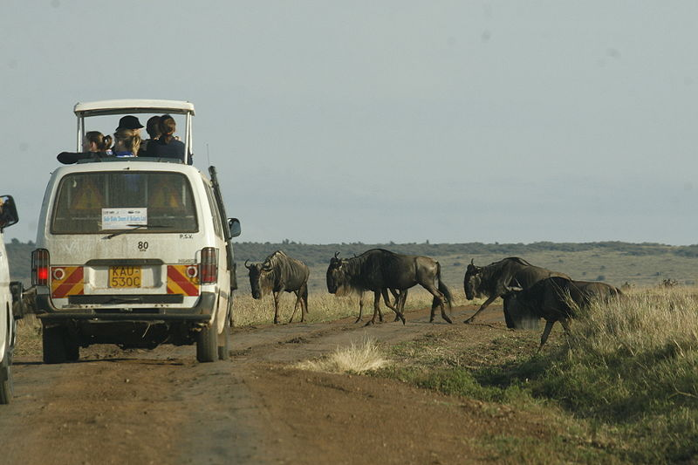
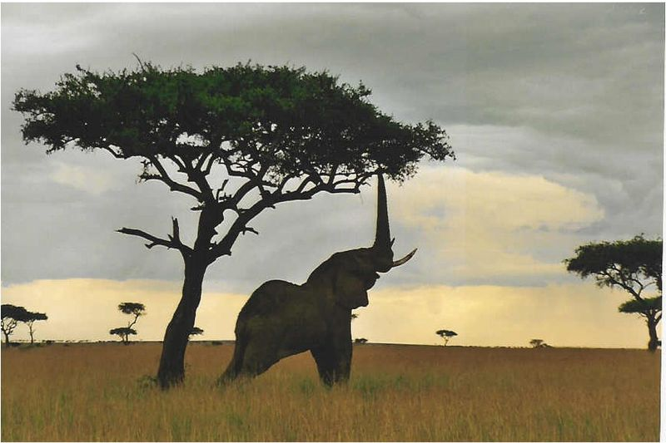
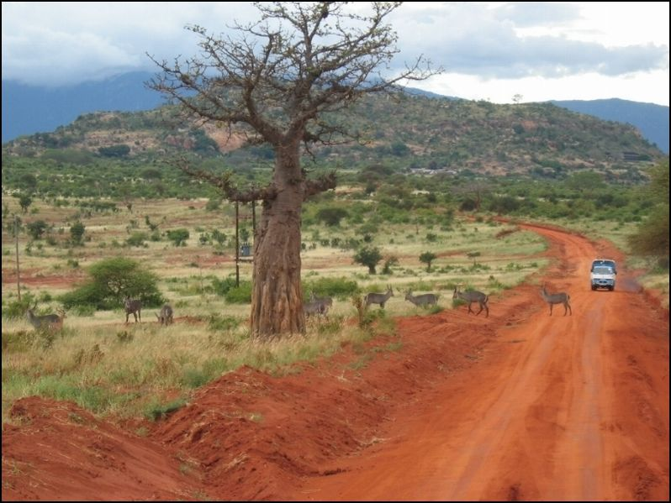
Kenya: Home of the Safari
Safari/Kusafiri (Swahili)= “Long Journey”
Notes:
Because Kenya is home to a very diverse population of wildlife, many make the journey to Kenya in hopes of viewing as many of these animals as possible. Very few places in the world offer trips that will take you through the natural habitats of the animals one could observe in Kenya. These trips are commonly called Safaris, which means “long journey” in Swahili. Years ago, safaris were associated with hunting trips. Now, they are mostly associated with observing and photographing land terrain and animals.
Many believe that safaris are only in Africa, however, any place where one can observe animals in their true habitats can be a safari destination including India, Australia, Alaska and Brazil. Most safari trips are done mainly by motor transport for two reasons:
(Can anyone guess what those two reasons are?)
Answer: More land can be covered and people can travel greater distances away in attempt to observe animals. Second, it may be too dangerous to view animals such as lions, leopards and other deadly animals by simply traveling on foot.
Safari. 26 Jul. 2011 <http://www.wisegeek.com/what-is-a-safari.htm>
Wikimedia. Car/wildebeest safari. http://commons.wikimedia.org/wiki/File:Kenya_safari.jpg
Wikimedia. Landscape safari. http://commons.wikimedia.org/wiki/File:African_safari_route_noir.jpg
Wikimedia. Elephant safari. http://commons.wikimedia.org/wiki/File:Elephantreaching.jpg

Slide 13
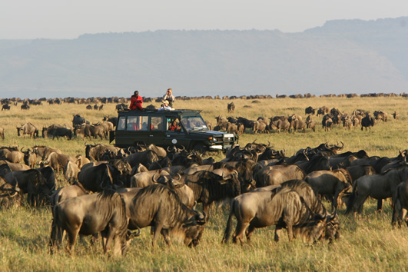
Kenya: Home of the Safari
Variety of Safaris & Activities:
Bird-watching
Camping
Cycling
Fishing
Game-viewing
Hiking
Rock climbing
Mountain climbing
Horseback riding
Beaches & Coastline
Snorkeling & scuba diving
Notes:
There are a variety of tourism activities available in Kenya. If you enjoy spending time outdoors, then it’s likely that Kenya would be an attractive place for you to visit.
The tourism industry is by far the largest single export earner in Kenya. Tourism has exhibited steady growth over the years since gaining their independence. In fact, Kenya’s service sector comprises 63% of the country’s GDP and tourism is the major contributor to that figure. In fact, tourism is now Kenya’s largest foreign exchange earning sector bringing in over $800 million US Dollars annually. Tourists are particularly drawn to Kenya’s coastal beaches and game-viewing reserves.
We mentioned earlier that Kenya offers safaris of all kinds. Whether you want to take a day-long safari or a two week safari. The game viewing in Kenya has been called one of the most magnificent views in the world. There are multiple sites and parks to view Kenya’s abundance of unique animals. Even as little as 20 miles out of the capital city-Nairobi, lions, leopards, hippos, gazelles, and most animals can be seen.
We just mentioned and will go into more detail soon, that Kenya offers mountain climbers and hikers of all backgrounds the opportunity to trek up Mount Kenya. If you’re an advanced climber, you can journey up the steep slopes of the mountain. If you prefer a leisurely, outdoor walk, Mount Kenya offers hiking trails as well.
Africa Guide. Kenya, Africa: National Parks and Game Reserves. 27 Jul. 2011 <http://www.africaguide.com/country/kenya/parks.htm>
Kenya Wildlife Service. Tourism Activities. 27 Jul. 2011 <http://www.kws.org/tourism/activities.html>
Jambo Kenya. Tourism. 27 Jul. 2011 <http://www.jambokenya.com/jambo/kenya/econ05.htm>
All Africa. Kenya: Country Scoops Top Tourism Award. 27 Jul. 2011 <http://allafrica.com/stories/200804212006.html>
Okavango. African Safari. 27 Jul 2011. <http://www.okavango.com/where-we-go.htm>

Slide 14
Kenya
Africa
Notes:
Now that we have summarized some of the unique features of the land in Kenya, let’s move onto discussing some of the practices, activities and foods that comprise the physical component. In this section we will look at some of the most common ways Kenyan’s stay healthy and well through physical activity and traditional meals that are ingrained in the culture.

Slide 15
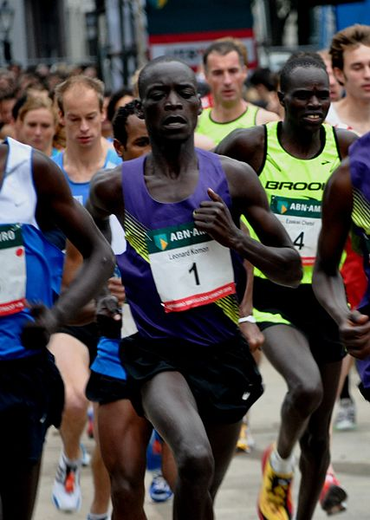
Health & Wellness: Running
A Tradition of Success:
Since 1968 Kenya has produced more Olympic medals in long distance running than any other country
Notes:
For decades, Kenyans have been known as being dominant runners. It has been said that running is a way of life for many Kenyans. Research has also suggested that Kenyans have genes that allow them to not feel the effects of fatigue as quickly as other ethnic groups. A supporting study compared Kenyan runners to Danish runners and found that a difference in the slimness of Kenyans’ calf muscles allows them to use less energy compared to their Danish counterparts. Another theory revolving the Kenyan-Runner phenomenon is that they generally come from poverty, often training barefoot. Training barefoot is believed to develop muscles within the feet that may give them an upper-hand to their already genetic advantage. Regardless of the scientific research, Kenya has had great success in long distance running in the Olympic games, producing more medals in this area than any other country in the world.
Magical Kenya. Kenya’s Secret to Long Distance Running. 27 Jul 2011. <http://old.magicalkenya.com/default.nsf/features1/E3B5D01C0867E8C54325726C0038AC54?opendocument&l=1>
Kenya Page. Kenya’s World Beaters. 8 Aug 2011. <http://kenyapage.net>
The Inside Lane. East Africa: Distance Running’s Ground Zero. 8 Aug 2011. <http://theinsidelane.blogspot.com/2008/11/east-africa-distance-runnings-ground.html>
Wikimedia. Singelloop Runner. 8 Aug 2011. http://commons.wikimedia.org/wiki/File:Singelloop_Utrecht_2010_-_Komon.jpg

Slide 16
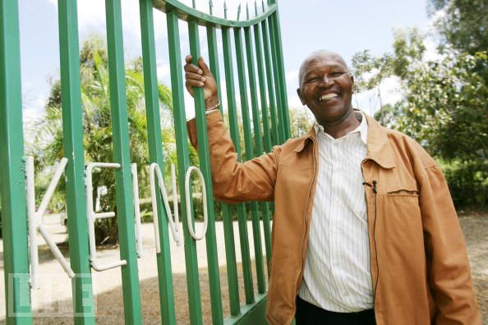
Health & Wellness: Running
Kip Keino High Performance Training Camp:
Developed by Kip Keino, the first Kenyan gold-medalist in 1968. It is a state-of-the-art training camp approved by the International Olympic Committee. Track athletes from all over Africa and Europe have trained at this facility.
Notes:
Kip Keino is one of Kenya’s most notable Olympic athletes who won a gold and silver medal in the 1968 Olympics, despite suffering from a gallbladder infection.
Since his Olympic running days, Kip Keino has opened a training camp for runners called the “Kip Keino Training Camp” located 8,000 feet above sea level in the small farming city of Iten. Up to 150 athletes can train at one time there. It is a popular place for athletes from all over the world to train during the winter due to Kenya’s temperate climate. This camp helped to introduce high-altitude training as a technique to improve running at any altitude. Runners from all over the world come to train at this state of the art camp complete with hospitable accommodations, conference facilities, a modern gym, good training grounds, library and well-managed diets suitable to the individual athlete.
Laureus. Kip Keino. 1 Aug. 2011. <http://www.laureus.com/members/154>
Magical Kenya. Kenya’s Secret to Long Distance Running. 1 Aug. 2011. <http://www.tourism.go.ke/default.nsf/features1/E3B5D01C0867E8C54325726C0038AC54?opendocument&l=1>
Africa Safaris Destinations. Kenya High Altitude Training Camp. 1 Aug 2011. <http://www.africasafarisdestinations.com/tours/kenya/great_rift_valley/great_rift_valley_camps_lodges/kenya_athletic_training_camp.html
Kenya Page Online. Kenya’s World Beaters. 1 Aug 2011. <http://kenyapage.net>
The Inside Lane. East Africa: Distance Running’s Ground Zero. 1 Aug 2011. <http://theinsidelane.blogspot.com/2008/11/east-africa-distance-runnings-ground.html>
Life Magazine (Gichigi, J.). Athletics in Kenya. June 2007. http://www.life.com/image/75544755

Slide 17
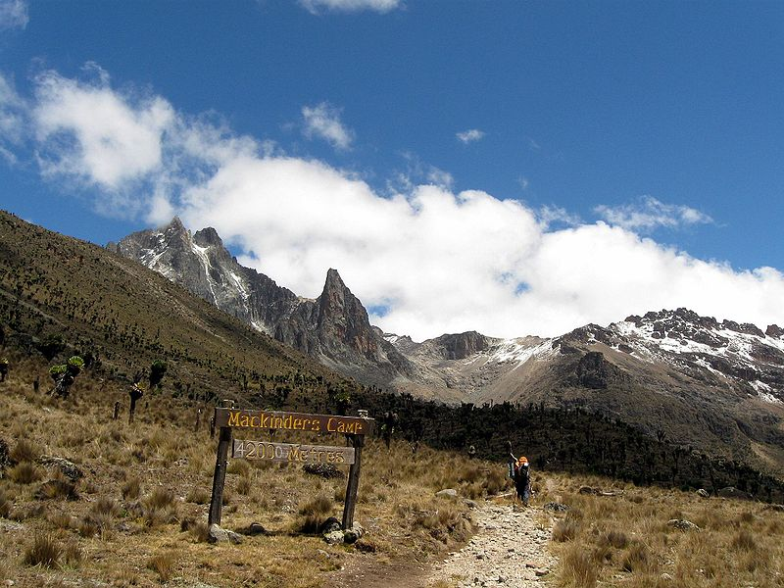
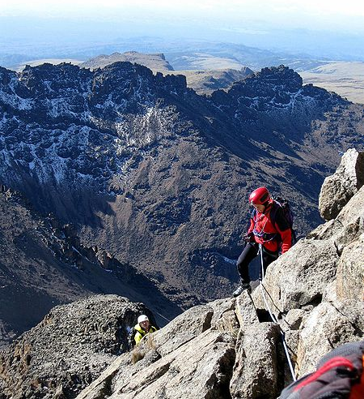
Hiking and Climbing
Mount Kenya
Mount Kenya National Park
Notes:
Mount Kenya is the highest mountain in Kenya and the second highest in Africa (1st being Mount Kilimanjaro). You do not need to be a professional climber to trek most of the routes up Mount Kenya, however, you do need to be in good physical condition. The two highest and steepest peaks of Mount Kenya, Batian and Nelion, can only be reached by professional climbers with technical skills. The third highest point, Lenana, is the target for most climbers as no technical skill is needed. Trekkers need to be accompanied by a guide or someone with knowledge and experience with the routes.
Climbers often will cross paths with safe, Sykes monkeys, buffalo and chirping birds. There are several locations where “bandas”, or huts, are available for spending the night. They provide shade and cover from the evening rains and cold night winds. As many climbers leave the lower bamboo forest behind and ascend into the alpine plants of the mountain which become thicker and take over, you must refrain from the urge to climb the mountain quickly as many do and miss out on all the beauty and enjoyment the mountain has to offer.
Trekking Mount Kenya. Natural Track Safaris. 1 Aug. 2011. <http://www.natural-track.com/mt-kenya.html>
Wikimedia. Climbing Nelion. 1 Aug 2011. http://commons.wikimedia.org/wiki/File:Climbing_Nelion.jpg
Wikimedia. Approaching Mackinders Camp. 1 Aug 2011. http://commons.wikimedia.org/wiki/File:Approaching_Mackinders_Camp.jpg

Slide 18
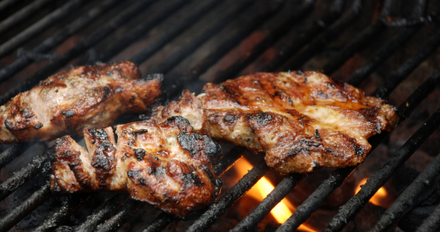
Kenya: Cuisine
Nyama Choma
Chargrilled Beef or Goat meat marinated in spices
Notes:
Cooking styles vary in accordance to the different regions of Kenya. Different tribes have different traditional dishes. The Portuguese arrived in the late 1400’s on the coast of Kenya and with them they brought foods from newly discovered Brazil, such as maize, bananas, chilies, pineapple, peppers and sweet potatoes. When the Europeans arrived in Kenya they brought with them white potatoes, cucumbers and tomatoes. When the British imported thousands of Indians for labor, with them came Indian cuisine, including spicy dishes and flat bread.
Kenyan staple foods consist of mainly corn, maize, potatoes, and beans. Coastal people eat a varied diet and those living inland eat meals consisting of the staple foods and meat. The Massai, who are cattle-herding people rely heavily on foods coming from the animals they raise, mainly cow and goat. The Massai do not eat wild game or fish, but only eat foods from which they have raised. Most Kenyan meals are filling and inexpensive to make.
Nyama choma, as shown on the slide, is referred to as “Kenya’s National dish”. Nyama choma is an authentic dish made for special celebrations. It is typically char-grilled beef or goat. This meat is not prepared by the same process of barbequing meat typically used in America, as herbs and other seasonings are not used on authentic nyama choma. Some like to use salted water to baste the meat while it grills.
A down side to consuming nyama choma is the effect it has on people’s health, particularly men, who tend to over indulge in nyama choma. Gout is a common condition caused by eating too much of this traditional food, especially when a person drinks beer with this meal. What will surprise you is that, unlike other ailments in Kenya, suffering from Gout is treated almost like an accomplishment and is grounds for bragging rights. The reason for this is that most Kenyan’s are aware that gout develops mainly from the overconsumption of nyama choma and the general rule is that only the wealthy can afford to eat it regularly. This is why gout has been deemed “The rich man’s disease”.
Susan Kamau’s Kenyan Kitchen. Nyama Choma Culture. 1 Aug. 2011. <http://www.kenyankitchen.co.ke/kenyan-kitchen-features2.php>
Foods in Every Culture. Kenya. 1 Aug. 2011. <http://www.foodbycountry.com/Kazakhstan-to-South-Africa/Kenya.html>
Kenya Information Guide. Kenya Culture. 24 Jan 2011. <http://www.kenya-information-guide.com/kenya-culture.html>
Kenya Embassy Ireland. Tusker Lager. 24 Jan 2011. <http://commons.wikimedia.org/wiki/File:Tusker_Beer.jpg> <http://www.kenyaembassyireland.net/index.php?page=shop.product_details&category_id=3&flypage=shop.flypage&product_id=6&option=com_virtuemart&Itemid=88><http://www.superbrandseastafrica.com/assets/Featured-Brands/PDFs/153-tusker.pdf>
Encyclopedia. Swahili food. 24 Jan. 2011. <http://www.encyclopedia.com/topic/Swahili.aspx>
Wikimedia. Chai Tea. 4 May 2011. <http://commons.wikimedia.org/wiki/File:Masala_Chai.JPG>

Slide 19
Kenya: Cuisine
Ugali
Staple food made of maize (complements main dish)
Notes:
As we mentioned earlier, maize is one of the common staple foods of Kenya. A popular food that complements the main dish, usually a meat, is called ugali, which is a porridge made from maize. A common way that Kenyan’s enjoy this food is by taking small pieces of the ugali and either dip it in vegetable gravies (as seen in picture on slide) or use it to pick up meats. This is very similar to how the Indian culture uses naan bread or chappatis to soak up gravy or pick up meat and rice.
To prepare this dish you must mash up the maize and cook in water until the ugali reaches a porridge or doughy consistency. Ugali is very filling and is an important food in the diet of millions of Africans.
Foods in Every Culture. Kenya. 1 Aug. 2011. <http://www.foodbycountry.com/Kazakhstan-to-South-Africa/Kenya.html>

Slide 20
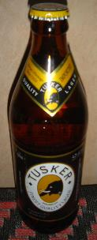
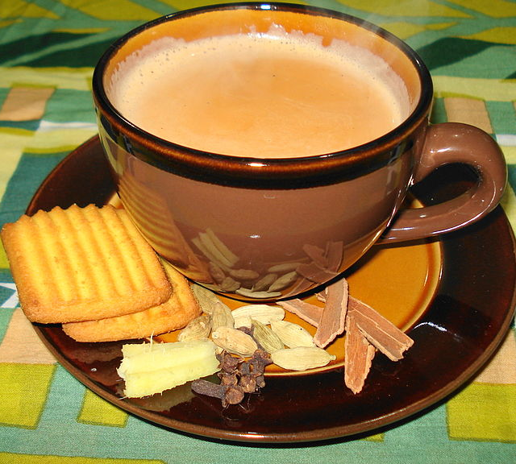
Kenya: Cuisine
Tusker
Beer brewed in Kenya
Chai
Spiced tea
Notes:
Chai tea or Masala Tea, meaning “spiced tea” is very popular within the Kenyan culture. Since being ruled by Britain until 1963, “tea-time” is still quite popular in Kenya. Tea is also served at regular meal time, and is very popular with breakfast.
If you prefer a stronger drink, Kenya also brews its own beer. Tusker is a popular beer founded by white settlers in Kenya. It has been brewed in Kenya since 1922, making it East Africa’s first traditional lager. It is brewed from tropical barley collected near the basin of Mount Kenya. Today, Tusker is a very successful company and still a very popular beer as it controls a large portion of the beer market in Kenya. Tusker can also be found in the United States at specialty stores.
BevMO. Tusker Beer. 24 Jan. 2011. <http://www.bevmo.com/Shop/ProductDetail.aspx?ProductID=22865>
East African Breweries Limited. History. 1 Aug. 2011. <http://www.eabl.com/inner.asp?cat=twenties&subcat=ourbusiness&3rd=true>
Wikimedia. Chai Tea. 1 Aug 2011. http://commons.wikimedia.org/wiki/File:Masala_Chai.JPG
Wikimedia. Tusker Beer. 1 Aug 2011. http://commons.wikimedia.org/w/index.php?title=Special%3ASearch&search=tusker+beer

Slide 21
Kenya
Africa
Notes:
Let’s turn our attention to the spiritual component and take a look at how spirituality is ingrained into Kenya’s culture.

Slide 22
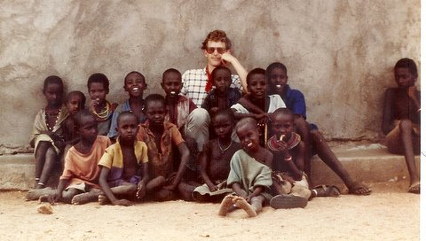
Kenya: Religion
Due to British rule, Kenya has a strong Christian background
The two largest denominations are Roman Catholic (45%) and Protestant (33%)
Notes:
Although Christianity is the largest religious sect in Kenya, their constitution grants its people free worship. So although Christianity is the largest religious group with 78% of the population affiliated with the Christian faith, Kenyans are still allowed to practice other religions. For example, the Swahili people practice Islam and many individual tribes choose traditional worship methods. Other common religions found in Kenya include animist and Islam. Disagreement between some Kenyan’s and the Christian churches has been ongoing, because many Kenyan’s incorporate their personal lifestyle into the practice of Christianity. Polygamy has been a major source of conflict, however, it is becoming less common for a man to have several wives.
The practices of different ethnic groups vary, however, one common element of many religions in Kenya is the belief in a spirit world inhabited by the souls of ancestors. The Kikuyu and several other tribes worship the god Ngai, who is believed to reside on the top of Mount Kenya. These traditional religions have special people called “diviners”, who are believed to have power to communicate with the spirit world, and they use their powers to cure people of disease and evil. On the opposite end, sorcerers are believed to have powers comparable to the diviners, however, their efforts seek to cause harm. It is also the job of the diviners to counter the evil doings of the sorcerers.
Central Intelligence Agency. The World Factbook. 24 Jan 2011 <https://www.cia.gov/library/publications/the-world-factbook/geos/ke.html>
Countries and their Cultures. Kenya. 2 Aug. 2011. <http://www.everyculture.com/Ja-Ma/Kenya.html>
Photo from resident in the MPL Network. Used with permission.

Slide 23
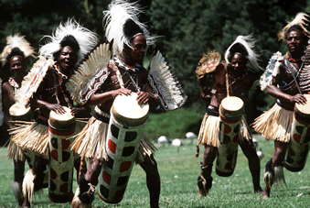
Kenya: Spirituality
Tribal Dances
Heavily depend on drumming music
Dances and chants are performed for rituals and festivals
Dances can be performed by males, females or both
Bomas- homesteads that promote Kenyan culture
Notes:
Tribal dances are key in maintaining the Kenyan culture. If any of the 40 tribes stopped passing their tribal dances and traditions down, their rich history and culture would slowly become extinct and lost to the world. Dance is usually an element of religious ceremonies, such as marriages, rites of passage and marking the beginning of special seasons. Costumes are a very important part of many traditional dances and we’ll touch briefly on some of the common props that are used in dance.
Bomas of Kenya was started by the Government of Kenya in the 1970’s by the Kenya Tourist Development Cooperation. The Company was established to preserve, maintain and promote the rich diverse cultural values of various ethnic groups of Kenya and to act as a tourist attraction center thus Bomas of Kenya is expected to preserve the authenticity of the Kenya’s Cultural values and to portray them in the purest form.
Bomas of Kenya Ltd. Karibu of Bomas. 2 Aug. 2011. <http://www.bomasofkenya.co.ke/>
Countries and their Cultures. Kenya. 2 Aug. 2011. <http://www.everyculture.com/Ja-Ma/Kenya.html>
Triabal Dance. 4 May 2011. <http://www.cheetah-tours.com/nairobi-excursions.html>

Slide 24
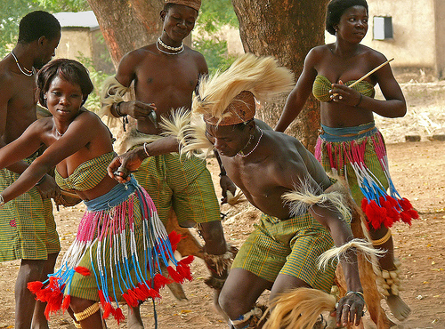
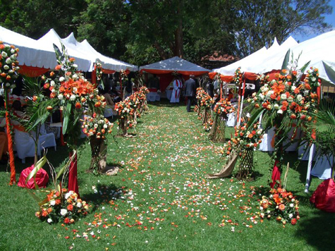
Kenya: Spiritual Rituals
Rituals
Rain Season Rituals
Rites of Passage
Weddings
Death/Afterlife
Notes:
Among the Massai, the beginning of the rainy season is observed with a celebration which lasts for several days and includes singing, dancing, eating, and praying for the health of their animals-we mentioned earlier that pastoralism is part of their way of life. For ritual dances, the performers die their hair, paint their bodies and don feathered headdresses.
The Kikuyu tribe marks the commencement of the planting season with their own festivities. Ceremonial dances are often performed by warriors wearing leopard or zebra skin robes and carry spears and shields.
Weddings are treated as special occasions as they are celebrated over several days and are filled with special foods, music, dancing and gathering of families.
Another occasion where dancing and celebrating takes place are rites of passage and initiation ceremonies. Both males and females have their own separate rituals and after the special ceremony takes place they are then considered to be of marriageable age. Kikuyu males are initiated at age 18. Their ears are pierced, their heads are shaved and their faces are marked with white earth.
Countries and their Cultures. Kenya. 2 Aug. 2011. <http://www.everyculture.com/Ja-Ma/Kenya.html>
Ritual Dance-Krishna. African tribal dance. Looney Doctor. June 2011. http://www.loonydoctor.com/2010/08/african-tribal-dance-togo.html
The Human Flower Project. Kenyan Wedding. Lagat, June 2011. http://www.humanflowerproject.com/index.php/weblog/comments/1343

Slide 25
Kenya
Africa
Notes:
The last component we’ll talk about today is the social component and how it ties into Kenyan culture. Let’s now turn our attention to how the family structure and social classes operate. We’ll also take a look at social interaction patterns of tribes and learn some common words in Swahili.

Slide 26
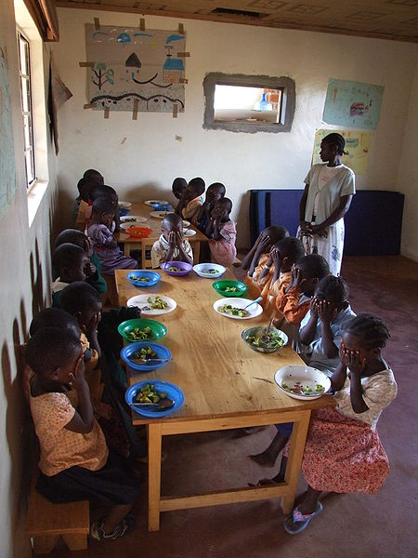
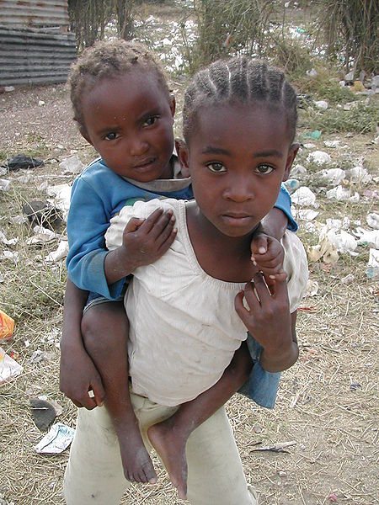
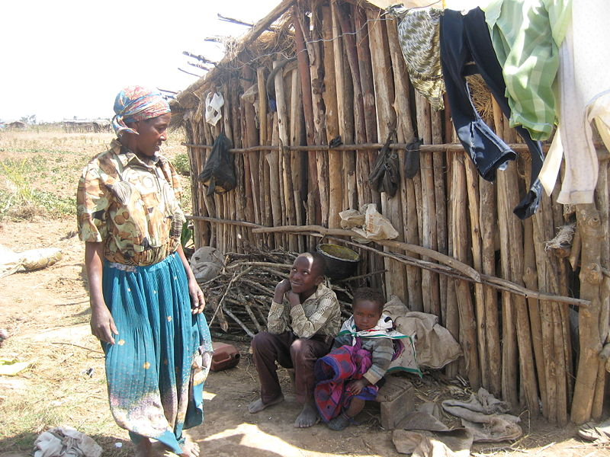
Kenya: Family Structure
Close-Knit Family
Child Socialization
Notes:
Kenya maintains a traditional structure of family that includes close ties with both the immediate and extended family. Not only are close ties kept between the bloodlines, but they are also kept for families joined together by marriage. It is believed that the Kenyan family is predominately paternalistic or run by the male, however, there is actually a great deal of communication between the husband and wife and both are involved in family decision-making.
The immediate family, with a husband and one wife, live together in the same house. Their children will live with them in the house while they are young, however, as boys become older they will leave the family’s house and move into their own, which is usually close to the family’s house. Girls are generally expected to begin caring for younger children and siblings at a very young age. However, the rearing of children in the Kenyan culture is a shared responsibility as both the immediate and extended family are expected to help with the upbringing of children.
Boys and girls are brought up apart from each other as both must learn how to fulfill their gender roles. Girls will be expected to fulfill the responsibilities of taking care of their families. This includes caring for children and doing daily house chores such as carrying water and cooking meals. Boys venture out into the fields and learn how to herd the animals and bring back food.
As the parents age, it is expected that the youngest male of the immediate family take care of his parents.
Kenya. Countries and their Cultures.
2 Aug. 2011. <http://www.everyculture.com/Ja-Ma/Kenya.html>
Wikimedia. Kenyan Family and House. 2 Aug 2011. http://commons.wikimedia.org/wiki/File:Solio_Settlement-2.jpg
Wikimedia. Sibling Children. 2 Aug 2011. http://commons.wikimedia.org/wiki/File:Two_girls_in_slum_-_Kenya.jpg
Wikimedia. Kenyan Class. 2 Aug 2011. http://commons.wikimedia.org/wiki/File:Nyota,_Kenya_01.jpg

Slide 27
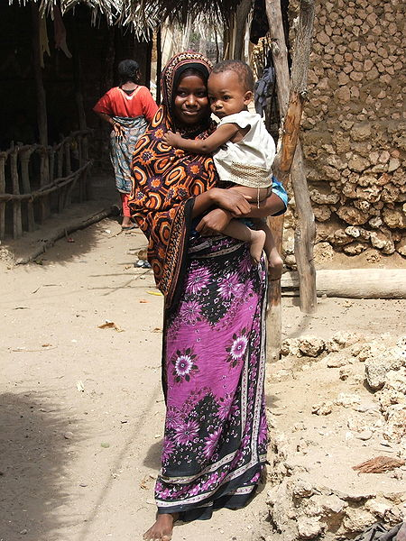
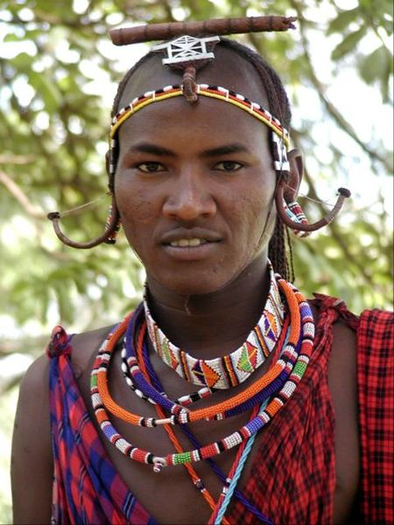
Kenya: Social Classes
Castes
Status Symbols
Clothing
Notes:
While most of Kenya is poor, the wealthy people tend to be more westernized in terms of the clothes they wear and how they live their lives. For those who are westernized, they measure wealth in terms of the amount of money they possess. Herders measure wealth by how many animals they possess. The Kikuyu hold most of the highest ranking positions in Kenya as they make up a large majority of the business workers, educators and government officials.
Kenyans also showcase their wealth by the clothing they wear, particularly expensive name brand clothing. Women will wear brightly colored “kangas” (as shown on the slide) which are wide pieces of cloth that wrap around the body, usually worn with a long skirt. The Kikuyu and Luo are the wealthier ethnic groups and have assimilated into the western culture and way of life.
Other signs and displays of class, marital status or social standing include hairstyles, headdresses and how many bands a woman wears around her neck.
(How are social class and symbols of wealth the same or different in America?)
Kanga. African Travel Association. 3 Aug. 2011. <http://www.africa-ata.org/kanga_story.htm>
Kenya. Countries and their Cultures. 3 Aug. 2011. <http://www.everyculture.com/Ja-Ma/Kenya.html>
Kenyan Woman in Kanga Photo accessed from: http://commons.wikimedia.org/wiki/File:KangaSiyu1.jpg
Kenyan Jewelry Photo accessed from: http://commons.wikimedia.org/wiki/File:Kenyan_man.jpg

Slide 28
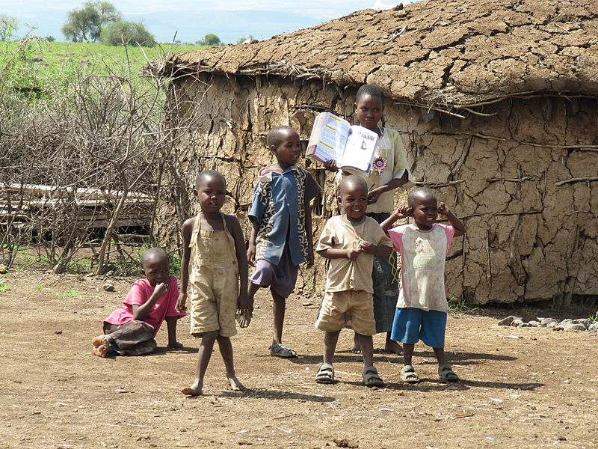
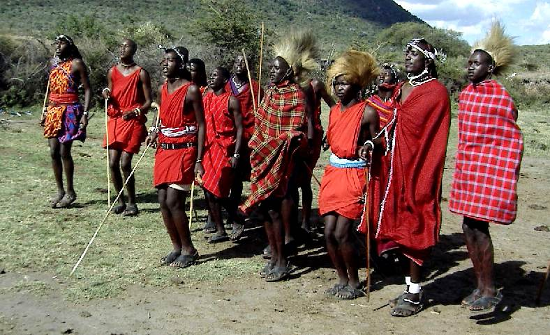
The Massai People
Well-known African ethnic group
Semi-Nomadic
840,000 in Kenya
Distinct Customs and Dress
Notes:
The Massai people mainly live in southern Kenya and have roughly 840,000 people that affiliate with their tribe. The Massai are well-known for their herding and rely heavily on their livestock for food. Due to the region they live in, they must live within fences made from thorny bushes and plants to keep predators from attacking their animals. It is the man’s responsibility to construct these fences or “kraals” as they are called and the women are generally the ones in charge of building the huts families live in. Huts are made entirely out of natural earth material such as mud, sticks and cow dung.
The Massai people are semi-nomadic and live in different regions based on the movement of their animals generally influenced by the weather season. As we mentioned earlier, the Massai people place a great emphasis on the number of livestock one possesses. Those who have more livestock are considered to be wealthier than those with fewer livestock. In fact, the Massai even have a prayer they say in hopes of obtaining more livestock. The English translation of this prayer goes: “May, you, Creator give us cattle and children”.
With the great emphasis the Massai people place on livestock it is only fitting that their diets consist of mostly food that is provided by the animals for energy and protein. However, recently the Massai have been growing dependent on other staple plant foods grown by cultivation such as maize, rice and potatoes. Many Massai disagree with the practice of cultivating the land and see it as a crime against nature. They believe that once the land has been cultivated, it is no longer suitable for grazing.
Today, the biggest threat to the Massai people is globalization. New land management systems restrict the Massai people’s access to natural resources such as water and also limit their livestock’s access to food as they’re not allowed to graze on privately owned land.
The Maasai People. The Maasai Association. 3 Aug. 2011. <http://www.maasai-association.org/maasai.html>
Maasai Children. Wikimedia. 3 Aug 2011. http://commons.wikimedia.org/wiki/File:Masai_village,_Amboseli_National_Park_2010_12.JPG
Maasai Warriors. Wikimedia. 3 Aug 2011. http://commons.wikimedia.org/wiki/File:Masai01.jpg

Slide 29
Learn to Speak Swahili!
Hello Jambo
Friend Rafiki
How are you? Habari?
Where are you from? Unatoka wapi?
Thank you Asante
Goodbye Kwaheria
Notes:
The Swahili language has traditional roots that dates back centuries. It’s important to emphasize that currently only 10% of the Kenyan population speaks Swahili, as the majority speak English. The following are common Swahili words. Go ahead and practice saying a few of the words and phrases to your neighbor!
http://www.masai-mara.com/mmsw.htm
Quran Photo source <http://t1.gstatic.com/images?q=tbn:ANd9GcRBt79JNtinIJusZFrTbgHsM6qvyf92nyopX65ti0GtMpEqFVGHBw>
1. The World Factbook. Central Intelligence Agency. 24 Jan 2011 <https://www.cia.gov/library/publications/the-world-factbook/geos/ke.html>

Slide 30
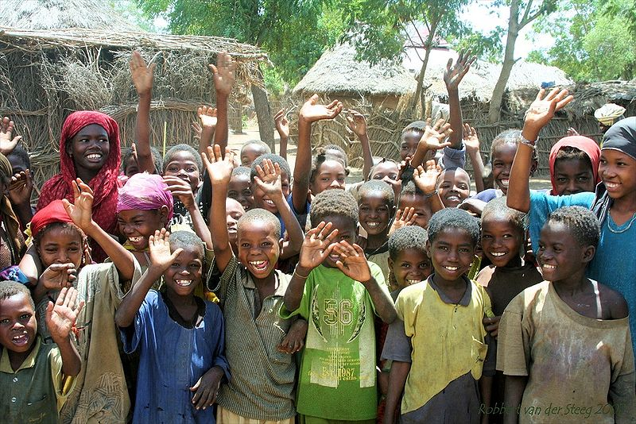
Kwaheria!
Thank you for visiting Kenya!
Notes:
This concludes our safari of Kenya, Africa-we hope you had fun and learned something new about this unique culture. We challenge you to complete some of the activities and materials we have put together based on what you learned today. See if you can solve all of the word scrambles and see who absorbed the most by challenging others in the quiz game!
Kwaheria! “Good-bye”
Wikimedia. Children Waving. 3 Aug 2011. http://commons.wikimedia.org/wiki/File:Children_in_Somalia.JPG

