Slide 1
The masterpiece Living core experience
Successful Aging & Me
Notes:
Welcome to the Masterpiece Living Core Experience. Thank you for being here. This is the 3rd of a 4-part series for earning the MPL Core Experience Certification. [Facilitator add your own introduction and welcome message]

Slide 2
Welcomes Masterpiece Living
Insert Organizational Logo Here
A Masterpiece Living Partner
Notes:
You may be wondering, “Why are we here?” We’ve made a commitment to enhance the lives of the people working and living here (non-residential organization: people who come into contact with and are a part of our organization) through a partnership with Masterpiece Living. You are all here today because you play an important role in this commitment, without you, we won’t be able to be successful.

Slide 3
Today we will explore
Experience the 4 components of successful aging
Apply successful aging principles to customer service/hospitality
Consider what successful aging means in my personal life
Notes:
Today we will experience the four components of successful aging, apply successful aging principles to customer service/hospitality, and consider our own successful aging journeys. Today is about taking everything you know about successful aging and applying it – both personally and professionally.

Slide 4
High Standards
What are some ways that we demonstrate exceptional customer service?
Notes:
Customer service and hospitality are an important part of how we support residents (non-residential organization: members of our organization). [Discussion: What are some of the ways we demonstrate exceptional customer service? Answers may include eye contact, smiling, language, doing what is asked, going above and beyond to complete a request, etc.] Of course, we always want to be helpful, polite, and respectful. We do this through eye contact, smiling, and following through with our job tasks [summarize elements of customer service/hospitality specific to your organization].

Slide 5
Raise the Bar
What are the key points that define successful aging?
Notes:
Masterpiece Living and the principles of successful aging can help us raise the bar in the way that we provide customer service. [CLICK] [Discussion: What are the key points that define successful aging?]

Slide 6
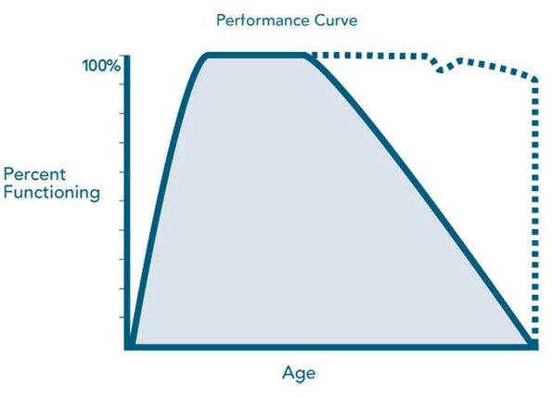
What do we know?
Successful Aging
Prevention of Risk (chronic illness)
Engagement in Life (SIPS)
Lifestyle Choices Impact Long-term Health
It’s Never Too Late!
Growth at Every Stage in Life
Usual aging
Notes:
Let’s see how we did! Remember, this successful aging curve tells us a lot! Remember, the solid line is what we think of as “usual” aging. We want to encourage each of you and all of the residents (non-residential organization: people who are a part of our organization) to consider how to keep moving toward or remaining on the dotted line [CLICK]. The dotted line represents successful aging. This is where we are maintaining function and enjoying the highest quality of life available to us. Remember, [CLICK] growth is possible at any age or stage of life, [CLICK] the choices we make today and everyday impact our health tomorrow and influences how we age, [CLICK] it’s never too late to start making different choices, even if a person is on the solid line, they can work toward being on the dotted line again, [CLICK] we do this through being engaged in life – we will talk about this more in just a moment, [CLICK] by making good choices each day and seeing the doctor regularly we can reduce our risk of chronic illness.

Slide 7
S.I.P.S.: The Four Components
Notes:
We’ve mentioned the four components of successful aging and now it’s time for you to experience them for yourselves. For each of the components we will do an activity, then discuss what this component means, and consider what this looks like in our own lives as well as in the lives of the older adults we support.

Slide 8
Fostering a wide range of meaningful relationships with family, friends and others
Includes giving and receiving social support
Contributing one’s skills and talents for the benefit of others.
Social connections improve immune function and lower the risks of many chronic conditions.
Notes:
The first component we are going to explore is the social components. For the next 5 minutes we are going to play social bingo. See how many different people you can learn a new fact about! [Hand out social bingo to each participant and keep time. After 5 minutes bring group together to discuss. Invite participants to share one new thing they learned about another team member.] Many of us take for granted the social component of our lives, with the numerous ways we connect through social media. But, the social component really is about creating meaningful relationships with people, face to face whenever possible, and going beyond small talk. Take a moment to consider one thing you might do differently in your interactions with residents (non-residential organization: people who are a part of our organization) that can support them in the social component. [Discussion: Invite 2-3 participants to share how they can be more meaningful in interactions to support the social component.]

Slide 9
Comprised of complex, new and continually challenging activities in an individual or group setting
Puzzles, games, computer brain training, learning new languages, dancing and other structured learning activities
Can help challenge and improve brain function
Notes:
The intellectual component might be considered “boring” until you think creatively about how we can learn new things in a way that is fun! For this component we are going to play a game called [facilitator may choose to play “Buzz” or “Ping, Pang, Pong”. Choose whether to play as one large group or as 2-3 smaller groups and direct participants accordingly. After 3-4 minutes, bring the group back together for a discussion about the intellectual component.]
Instructions: Ping, Pang, Pong
Always go clockwise. The first person says Ping, the second person says Pang, and the third person simultaneously says Pong and points to someone. The person who has been pointed to starts over and says Ping…
This game is very fun and always challenging. You may want to begin by replacing "ping, pang, and pong" with "one, two, three." After participants are familiar with the game you can encourage them to try to be deceptive. For example, if they are going to say "pong" (that is when they have to point to someone) they should look at one person and point to someone else.
Instructions: Buzz
Have participants count, beginning in a clockwise direction such that the first person says “one”, the second person say “two” and so on. Instruct people to say “buzz” instead of the number if the number is a multiple of seven (e.g., 7, 14, 21, 28, 35, 42, 49, 56, 63 and so one) or if the number has a seven in the number (e.g., 17, 27, 37, etc.). The direction reverses when someone says buzz in place of the number. Even participants with moderate memory problems can learn this activity, if they do it during every session. This activity requires attention and used the frontal lobes and the right parietal lobe. To make the activity more challenging, split a large group into smaller groups; the noise of the adjacent groups require even greater use of attentional resources.
[Group discussion]
The intellectual component can be fun, especially as a group! It means challenging your brain to learn something new or try something you’ve never done before. How many of you found that you had to concentrate while we were playing that game in order to keep up? That’s what intellectual challenge should be – requires all of your concentration so that you cannot think about anything else while doing it. Take a moment to consider one thing you might do differently in your interactions with residents (non-residential organization: people who are a part of our organization) that can support them in the intellectual component. [Discussion: Invite 2-3 participants to share how they can be more meaningful in interactions to support the intellectual component.]

Slide 10
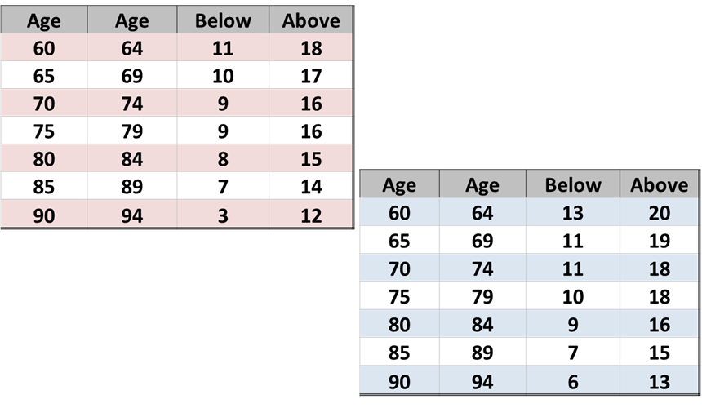
Physical Health is the continual growth of physical function
Includes actions that limit or prevent disease and disability
Aerobic activity, strength, balance, flexibility, nutrition, sleep and taking part in preventive screenings
Being active in these areas may help lower risk for acute and chronic diseases
Male
Female
Notes:
We all know the importance of staying physically active. But the physical component is more than just staying fit. It’s also about preventing physical illness, maintaining function and strength to do everything we want to do in our lives. The Masterpiece Living Mobility Review includes a series of exercises designed to help a person learn about their physical functioning and compare that to national norms. We are going to try one now. [Read the instructions for the 30 second chair stand and keep time while participants count their own repetitions:]
Sit toward the front edge of the chair with back straight, feet flat on the floor with arms crossed at the wrists and held against the chest.
On my signal of “go”, rise to a full stand, then return to a fully seated position.
Repeat this movement as many times as possible within 30 seconds.
Ready, begin.
[CLICK]
How did you do? This exercise was designed with older adults in mind, so the lowest comparative age group we have is in the 60’s, but look at the age closest to your own to see how you did. Is anyone surprised by their result? It’s never too late to be improving physical function, regardless of your age. [CLICK]
Take a moment to consider one thing you might do differently in your interactions with residents (non-residential organization: people who are a part of our organization) that can support them in the physical component. [Discussion: Invite 2-3 participants to share how they can be more meaningful in interactions to support the physical component.]

Slide 11
Broadly defined as our search for purpose and meaning
Having a meaningful role and being engaged in productive pursuits
Helps to cope with worries, concerns and grief
Includes, but are not limited to, religious and faith-based involvement, volunteerism or service, appreciation of nature and meaningful pastimes.
Notes:
Spirituality often means something different to each individual. For many people, religion might be an important part of spirituality. For others, it might be closely tied to nature, music, or meditation. Regardless of how you get there, spirituality includes having a sense of meaning and purpose, feeling connected to something greater than yourself, and it can provide a way of coping with worry or stress. Many people use meditation as a tool to support their spiritual journey. Research shows tremendous physical and emotional benefits from sitting quietly for just a few minutes a day. Let’s take a moment now to experience a short meditation from Breathe: A Stress Resilience Program by Masterpiece Living.
[Read the Breathing Meditation script:]
Take a moment to adjust yourself so that you are sitting comfortably in your chair, feeling as supported as possible.
Now, I invite you to close your eyes, if you feel comfortable doing so. Or you may choose to just gently gaze downward toward the floor.
Gently bring your attention to your breath. Not changing anything about it but simply “watch” or notice your breath. Letting go of thoughts and emotions for just a moment, using the breath as a focal point for the mind.
Pay attention to the inhale and the exhale.
Follow the breath as it moves in through your nostrils, past your throat, into your lungs, and toward the stomach.
Follow your breath as it releases from your stomach, through the lungs, past the throat, and out of your nostrils.
Simply follow the breath. Maybe you “name” it as it occurs.
Inhale [pause several seconds]
Exhale [pause several seconds]
Inhale [pause several seconds]
Exhale [pause several seconds]
Now see if you can allow yourself to relax with each exhale, releasing tension, feeling yourself become more supported by the chair at each point of contact.
Now I am going to let you simply sit in silence with your breath for 2 minutes. Simply “be” with the pattern of your own breathing, without changing it or doing anything. I’ll gently remind you when the minute is complete.
[Sit silently for 2 minutes while participants observe their breath]
Now gently bring your attention back to the sound of my voice.
I invite you to begin deepening your breath.
Slowly and gently bring attention back to your body by gently wiggling fingers and toes, slowly and gently stretching as you feel inspired.
And when you’re ready, slowly shift your attention back to this room by blinking your eyes, softly gazing at the floor at first, then gradually bringing your attention back to the group.
[Allow another minute for the group to transition from breathing exercise back to the group.]
Take a moment to consider one thing you might do differently in your interactions with residents (non-residential organization: people who are a part of our organization) that can support them in the spiritual component. [Discussion: Invite 2-3 participants to share how they can be more meaningful in interactions to support the spiritual component.]

Slide 12
Notes:
The point of the four components is that if we are actively growing in all four components we are reducing risk of disease. Another way of helping to reduce risk is to have regular preventive screenings from your doctor and to know your numbers. Through our partnership with Masterpiece Living you and your family have access to the Mayo Clinic Health portal, where you can take the Mayo Clinic Health Assessment to find out more details regarding your personal health strengths and risks. We will provide you instructions for accessing this before we conclude today.

Slide 13
What’s My Role?
Notes:
Let’s take a moment now to put all of this together. We started by talking about customer service, hospitality, and how the principles of successful aging can help us raise the bar. We’ve had some discussion about what that looks like for each of the components. Together, we are a team, and everyone plays an important role. Beyond your specific job title – dining room server, CNA, housekeeper, concierge, etc. - you have a role in contributing to the successful aging culture here at (organization name). Let’s find out how team members at other MPL organizations describe their role in a successful aging culture.

Slide 14
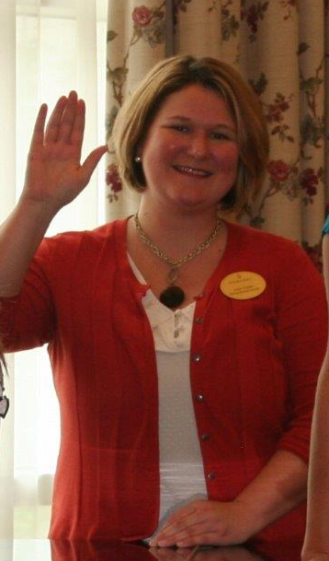
A Director of Dining Services
My job description extends far past those of a Dining Services Director. On a daily basis, I focus not only on the meals that we serve, but the overall wellness of our residents and associates.
Nourish a Program by Masterpiece Living
Interactive “Eat This, Not That”
Wii Zumba Class
Guest Speaker on an MPL Network Call
Attended Masterpiece Living’s Lyceum
Notes:
This is a quote from a Director of Dining Services. [Pause, allowing time for participants to read the quote.] While the job itself is what you might expect – meal planning, overseeing the dining room, food safety, etc. – this person understands that in a successful aging culture it is EVERYONE’S role to support one another in successful aging. This means perhaps leading a Program by Masterpiece Living, or teaching a class on a topic you have a particular interest in, or getting involved directly with the Masterpiece Living network.

Slide 15
A Concierge
I make it my mission to get to know every resident personally and commit to share strength and good cheer to all of them…
It is rewarding to me to be a part of such an awe-inspiring community that gives me the opportunity to improve myself and the foundation to support the enhancement of others.
Notes:
Here’s a quote from a concierge. [Pause, allowing time for participants to read the quote.] You can see this team member understands customer service by knowing residents and bringing cheer. The second statement raises the bar by improving self and supporting others. That’s what it looks like to use successful aging concepts and raise the bar in our daily jobs.

Slide 16
Walking the talk
Where do you want to grow?
Notes:
As we’ve discussed, successful aging is for everyone – for each of you in this room as well as the residents we support. The best way to share what we’ve learned today is to make sure that each of us is leading by example. [Hand out Successful Aging & Me Worksheets to participants.] Take a moment now, to consider what you know about successful aging, the four components, and risk prevention. Then, please choose one area of growth you would like to focus on in your successful aging journey, and write it down on your goal setting sheet. These are for you to keep so don’t worry about anyone else seeing your response. [Allow 1-2 minutes for participants to reflect and write.] Then, think of one small thing you can do today to that will move you closer to your goal, and write that down. [Allow 1-2 minutes for participants to reflect and write.] Next, think of one thing you can do differently at work that to support our culture of successful aging. This could be something you identified earlier when we discussed the four components, or maybe you thought of something else when we talked about job versus role. How are you going to take your customer service to the next level, knowing what you know now about supporting others in successful aging? [Allow 1-2 minutes for participants to reflect and write.]
[Optional activity: Goal launching – invite participants to write either their personal or professional goal or both on a card attached to a helium balloon and launch them together, or write them on a parachute and launch, or some other option to symbolize launching goals with intention as a group.]

Slide 17
An Open Invitation
Campaigns & Programs by Masterpiece Living
Notes:
There are many ways to be a part of the culture here at (organization name). Some of you may like to be more directly involved with Masterpiece Living you may choose to be a part of our Champion Team or lead a Program by Masterpiece Living. If so, please contact (contact person) for additional opportunities.

Slide 18
What’s Next?
Take part in your own wellness story!
Support friends, family, and residents in successful aging
Attend Session 4 with your department manager to complete certification of the MPL Core Experience
Notes:
[Hand out Mayo Clinic Health Assessment Instructions and Employee Interest Survey to each participant.] We invite each of you to complete the Mayo Clinic Health Assessment to support your own successful aging journey. We also invite you to complete the Staff Interest Survey and return to (contact person) so we can learn more about you and the ways in which you might like to bring some of your interests to others in our organization. And, in order to complete your MPL Core Experience Certification please attend the 4th and final session MPL Everyday with your department manager. MPL Everyday focuses on how Masterpiece Living applies to your specific department.

Slide 19
Thank you
Notes:
Does anyone have any questions? Does anyone have any questions? The next session is the 4th and final session of the MPL Core Experience. Each department will meet individually to explore how to put what we’ve learned into action every day. Once that’s completed you will have earned the MPL Core Experience Certification, giving you the knowledge and the responsibility to share the complete successful aging message and make a difference in the lives of the older adults we support, your peers, yourself, and your family members.

