Slide 1

The masterpiece Living core experience
Successful Aging & Our Organization
Notes:
Welcome to the Masterpiece Living Core Experience. Thank you for being here. This is the 2nd of a 4-part series for earning the MPL Core Experience Certification. [Facilitator add your own introduction and welcome message]

Slide 2

Welcomes Masterpiece Living
Insert Organizational Logo Here
A Masterpiece Living Partner
Notes:
You may be wondering, “Why are we here?” We’ve made a commitment to enhance the lives of the people working and living here (non-residential organization: people who come into contact with and are a part of our organization) through a partnership with Masterpiece Living. You are all here today because you play an important role in this commitment, without you, we won’t be able to be successful.

Slide 3
Today we will explore
What is culture and what does it mean for our community/organization?
What is inclusivity?
How does language impact our culture?
Notes:
Today we will learn about culture and how important that is for influencing healthy lifestyle choices. We will learn more about specific elements of a successful aging culture including inclusivity and ageism. Finally, we will discover how the language we use impacts our culture here at (organization name).

Slide 4
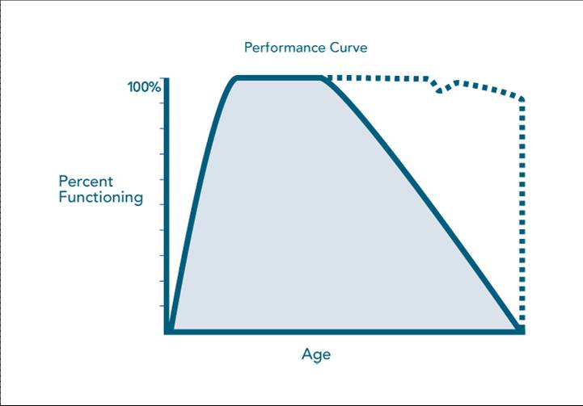
Environment
Successful Aging
Usual aging
Notes:
As you know, our organization has partnered with MPL as a way to support the Successful Aging journeys of all who live and work here. A big part of that is the environment we create here. When you walked in today, what did you notice about the environment? Did you behave a certain way, based on that? The environment around us greatly impacts the way we behave, including the choices we make. If 70% of how we age is determined by lifestyle choices, it makes sense to consider the environment, right?

Slide 5
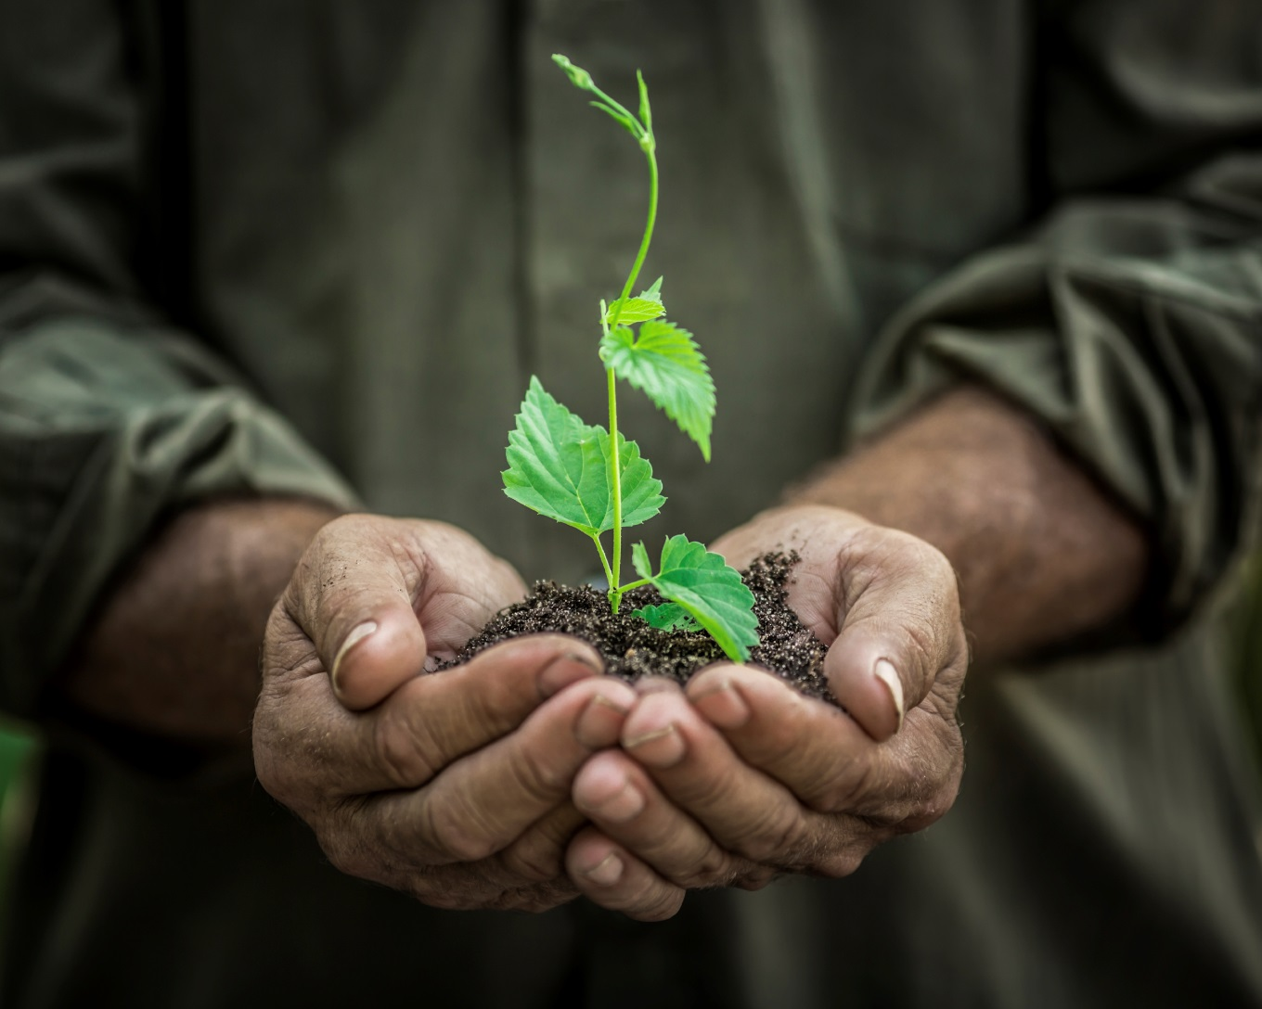
All About Growth!
Notes:
We want to create an environment that promotes growth. Let’s picture each of the individuals who live and work here (non-residential organization: people who come into contact with and are a part of our organization) as a plant and the soil is its environment. The soil greatly impacts the behavior of the plant – whether it grows fast, slow, or not at all. So it’s important to create the soil that will best support the plant’s growth. Sometimes that means adding fertilizer, which is where MPL plays a role.

Slide 6
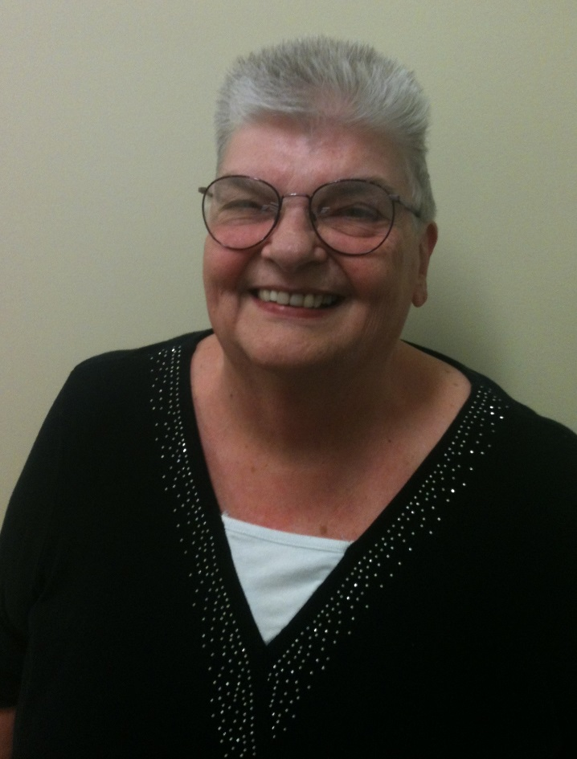
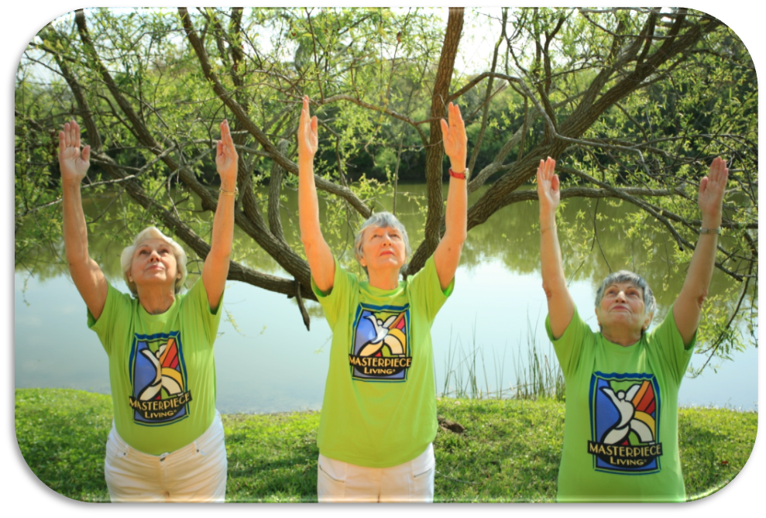
MPL Success Stories
Pat
Joan
Notes:
Let’s look at some examples of how a successful aging culture has supported individuals in making behavior changes that enhanced their successful aging journey. For Pat, on the left, participating in the Masterpiece Living Review process was an eye-opener. She had recently had both knee and hip replacement and also lives with diabetes. She was determined to do everything she could stay physically active and socially connected. Today, Pat has gone from daily doses of insulin and pills to control her diabetes, to no medications at all - at the recommendation of her doctor. Through the insight she gained from the successful aging research about lifestyle choices, she has worked with her doctor to control the disease through diet and exercise alone, and as a result her blood pressure and cholesterol are lower too!
For Joan, pictured in the middle of the 3 ladies with green shirts, it was about recovery from a stroke. As a dancer, experiencing a debilitating stroke was devastating. Through strong social connections and the belief that growth is possible - being immersed in a culture that believes in potential - she now performs double pirouettes again!

Slide 7
Environment Impacts Behavior
Values
CULTURE
Expectations
“Normal”
Notes:
Would you agree that environment impacts behavior? The environment of a place is something you notice when you walk in. It gives you clues about what type of behavior is expected, what is valued, and what is considered “normal”. This is also known as culture. [Open discussion – consider using white board to write characteristics identified in the following questions] What type of environment or culture do we want to create here, at (community name)? How can we create an environment that supports all who live and work here (non-residential organization: people who come into contact with and are a part of our organization) in making healthy lifestyle choices? What behaviors do we want to be considered “normal”?
[Examples might be encouraging growth, trying new things, supporting each other, taking the stairs whenever possible, eating healthy foods, having meaningful conversations, sharing skills and talents with others, etc.]

Slide 8


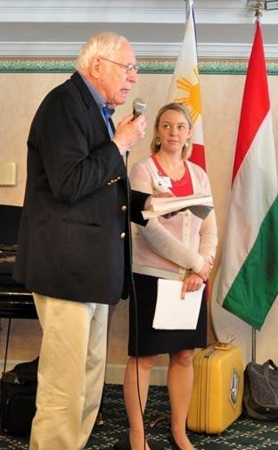

What does this look like?
Notes:
Now that we’ve talked about some of the characteristics, let’s see how some Masterpiece Living partners have put these ideas into action.
Imagine a community where:
Team members and residents make a pledge to commit to successful aging [CLICK]
Or where a leader embraces the “why not?” philosophy and works to change regulations to allow pets in higher levels of living [CLICK]
Imagine an organization that works together to feed hungry older adults in their greater community [CLICK]
Or a community that partners with the surgeon general and the mayor to promote healthy lifestyles and successful aging.
Imagine housekeepers give cooking lessons to residents.
Or a place where Residents train team members in their annual training [CLICK]
Imagine an organization that’s so committed to Successful Aging that in the interview process, it asks applicants what their passions are and makes those passions a part of the team member role [CLICK]
Imagine a corporation that makes a corporate commitment to a successful aging culture [CLICK]

Slide 9

Experience & A Network of Support
The road map and resources to support [organizational name] in achieving our vision for a successful aging environment
Notes:
These are just a few examples of what a successful aging environment or culture can look like and Masterpiece Living, along with the experience of the network partners, has created a road map and the resources to support (organization name) in achieving our own unique vision of a successful aging environment.
We have a lot to be proud of here, with regard to our existing culture, and we want to continue to raise the bar through our partnership with MPL.

Slide 10
Successful Aging Culture
Growth
Possibilities
Trying new things
Meaningful Interactions
Inclusive
Potential
Notes:
We have determined that a successful aging environment or culture is one that encourages growth, focuses on possibilities, offers new challenges, creates opportunities for meaningful engagement, is inclusive of all levels of ability, values all individuals, believes in the unique potential of all individuals, etc. All of these are important, and each of us have many opportunities every day to enrich the soil here at (organization name). The best way to do that is by setting aside our judgments and being curious about others.

Slide 11
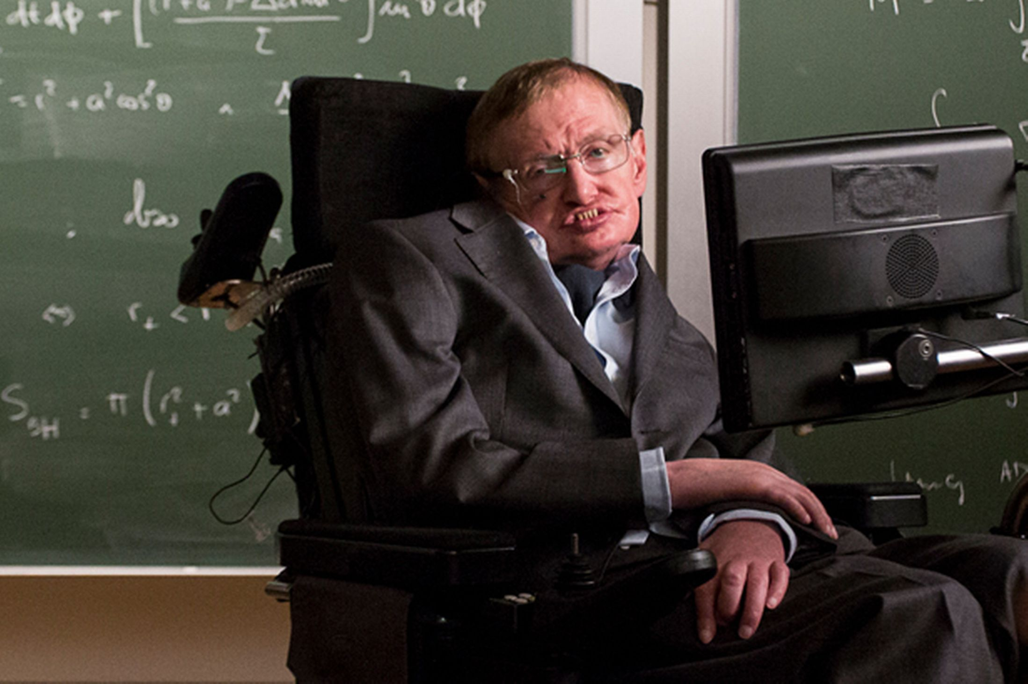
Notes:
As you look at this photo, describe to me what you observe. It’s not so much about judgment but simply what you can see from looking a photo of this man. [Answers may include Stephen Hawking, a man in a wheelchair, paralyzed, limited physical capability, etc.] Who knows this man and what he has accomplished? Stephen Hawking is a best-selling author, distinguished author, and is regarded as one of the most brilliant theoretical physicists since Einstein. He also lives with a debilitating motor neuron disease. He was diagnosed in 1963 and was given 2 years to live. Yet, he went on to achieve great things despite his physical limitations.
When we look at a person, it’s easy to see their physical limitations and it might be tempting to dismiss their other abilities. Without curiosity about the whole person, looking beyond physical limitations, we would not have the chance to learn about his other strengths. And, if Stephen had given up upon being diagnosed, the world would have missed out on his incredible contributions.
[SOURCE: http://www.hawking.org.uk/]
[IMAGE: http://www.mirror.co.uk/news/uk-news/stephen-hawking-backs-assisted-suicide-2280179]

Slide 12
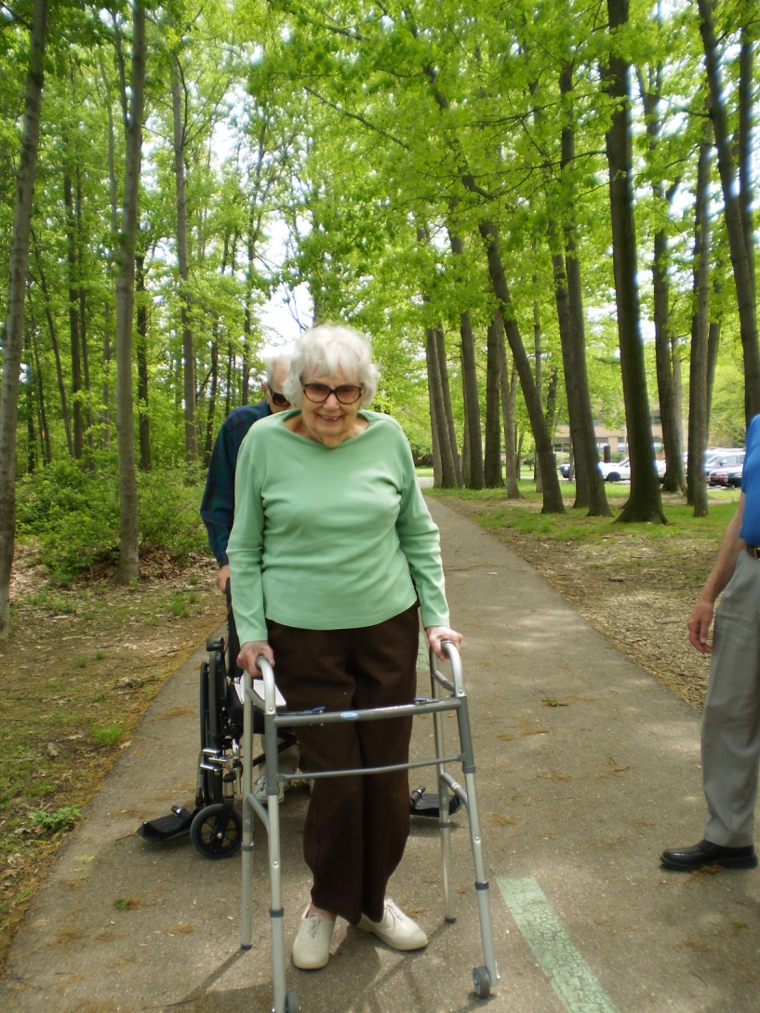
Sue
Notes:
Here’s another example. What do you see here? [Answers may include a woman with a walker, a wheelchair behind her, someone to catch her if she falls, etc.] This is a picture of Sue, a resident at a MPL partner community. She is walking with the assistance of a walker, after getting up out of a wheelchair. This is a picture of growth, and yet it is so easy to see it as a picture of decline. Of course, part of our job is to keep people safe, but in a successful aging culture our job is also to see the potential in every single person, regardless of our perception of their abilities.

Slide 13

Inclusivity
Notes:
Each of us has the ability to contribute to the inclusive culture here at (organization name). Inclusivity is an important part of a successful aging environment, where everyone is supported in reaching their full potential. It means every single person who is a part of our village is honored and valued. Everyone has skills and abilities to contribute to the village. EVERYONE. This sometimes means being curious and looking beyond physical or cognitive capabilities and seeing the unique gifts that a person offers.

Slide 14
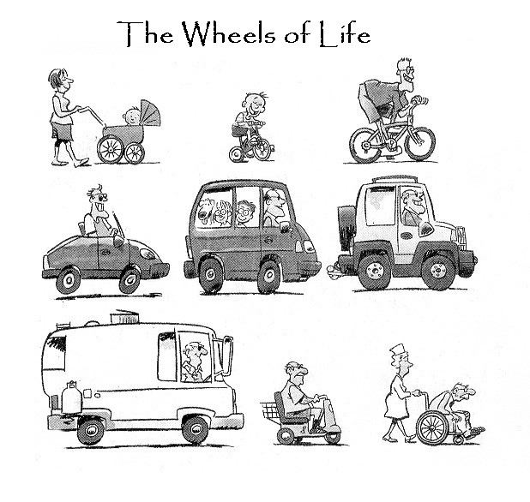
How Does our Society View Aging?
Notes:
Sometimes, our assumptions about a person’s ability might be based on their age. In fact, most of our society today believes that aging means that we lose physical and cognitive function and there’s nothing we can do about it. In fact, we tend to treat older adults much like children, as you see here in the “Wheels of Life” – we start out helpless, being pushed by someone else and end up that way, too. No wonder so many people dread growing older!

Slide 15

ageism (ey-jiz-uh m) n.
1. Discrimination against a person of a certain age group.
2. Prejudice against our feared future self
Notes:
What we’re talking about here, is ageism. Ageism is discrimination against a person of a certain age group and when it’s directed toward older adults, it’s often because we fear growing old, ourselves. Discrimination may sound like a strong word, and it’s easy to think, “I don’t discriminate; I love older adults; this doesn’t apply to me”. Because we live in a society that, in general, fears growing old, we actually tolerate a lot of ageism in our everyday lives that we don’t even think about. As we continue to enrich the soil, we want to be aware of ageism in ourselves and others and be the voice that challenges those beliefs.

Slide 16
Notes:
Dr. Bill Thomas, aging expert, and author of “What Are Old People For?” argues that ageism is the last acceptable form of discrimination in this country. Kay Van Norman, owner of Brilliant Aging agrees. She says the best example of this is in the greeting card aisle. I have some greeting cards here. [Share 2 – 3 greeting cards with ageist messages and with the group and open discussion.] Why are greeting cards filled with negative messages of aging? If these were similar messages about a certain gender, ethnicity, or spiritual faith, would that be considered acceptable in our culture? Absolutely not.

Slide 17
How do you know?
They can’t because they’re ____.
Notes:
Here’s a simple test you can take with you to help increase your awareness of ageism and challenge others in their beliefs. In the following sentence, fill in the blank with a gender, an ethnicity, a spiritual faith. Is that ok? No. Now fill in the blank with “too old”. Is that ok? Unfortunately, it is accepted but it is not ok. In the future, you can fill in any statement you hear with a gender, ethnicity, or spiritual faith and ask yourself, “is that ok?”. If the answer is no, then it’s not ok to use age that way either.

Slide 18
Language
Attitudes
Beliefs
Values
(Culture)
Notes:
Language is important because it is one of the primary ways we express our values and beliefs, which define our culture. It also reinforces our own beliefs and can impact others’ beliefs, as well. Think about the different environments you come into contact with regularly – home, school, work, church, friends, etc. Do you notice how some language is normal or more appropriate in some places than others? What happens when you use a word that’s not the “norm” for that group?

Slide 19
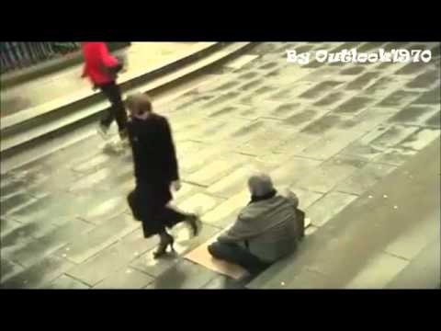
The Power of Words
Notes:
Let’s watch a short video illustrating the power of words. [PLAY VIDEO]
Use the following link in the case that it does not work on the PowerPoint slide:
https://www.youtube.com/watch?v=QYcXTlGLUgE

Slide 20
*Common Language Activity*
Words
Notes:
Going back to our list of traits we want in our environment, let’s consider some of the words we use here and see if they fit our vision for a successful aging culture. Do they inspire growth? Do they empower? Do they encourage meaningful interactions? Do they communicate support for the individual’s unique successful aging journey?
[Invite participants to write words on the board that they would like to see replaced. Then, ask the group to brainstorm about potential replacements.]

Slide 21

Notes:
As we know, words have the power to shape our culture here at [community name]. If we want to create an environment that encourages and supports everyone in growing and reaching their potential, it is important to choose our words carefully. Masterpiece Living has identified some key characteristics of language choices that encourage as successful aging culture – Words that communicate our belief that growth is possible, words that empower others to take action, conversations that are meaningful, and phrases that support others in the actions they choose on their successful aging journeys. We can remember these by the word GEMS! When we use GEMS to guide our language choices we are gifting others with GEMS of meaningful interactions.

Slide 22
What did we learn?
Environment shapes behavior
Each of us contributes to the environment
A Successful Aging environment is inclusive and does not tolerate ageism
Words influence the environment
GEMS can guide language choices
Notes:
What did we learn today? [Invite participants to share takeaways, then show the summary list on the screen]
Environment shapes behavior
Each of us contributes to the environment
A Successful Aging environment is inclusive and does not tolerate ageism
Words influence the environment
GEMS can guide language choices

Slide 23

What Now?
Share the message of growth & potential
Challenge ageism
Use GEMS to choose empowering words
Notes:
What can you do to now?
Share the message of growth and potential. Spread the word! The successful aging research proves that growth is possible at any age.
Challenge ageism. Listen for ageism, and if you hear it, say, “that sounds ageist to me.”
Use GEMS to guide your interactions. Focus on growth, empower others, have meaningful conversations and support them and they do for themselves.
[Optional activity: As a reminder of the plant analogy used throughout the training, participants may each plant a seed or the group may plant a tree on the property together]

Slide 24
Thank you
Notes:
Does anyone have any questions? I look forward to our next session where we will explore what successful aging means to each of us, personally as well as professionally.
Make each day a Masterpiece!

