Slide 1
Your Company logo here

Slide 2
Neurobics
UNIT 4: Memory Strategies

Slide 3
Unit 3 Review
What brain work activities did you try this week?
Dementia is not the normal process of aging. (Alzheimer’s disease is the most common form of dementia)
We must exercise our brains!
Notes:
Last session, we left with ”Brainwork” assignments. How did this go for everyone?
Before we move on, let’s take a few moments to review our last session. Last session, we talked about Alzheimer’s disease and dementia. We learned that it is not a “normal” part of aging, and we talked about the importance of keeping our brains sharp with consistent exercise and stimulation.

Slide 4
Unit 4 Objectives
Identify what memory strategies are.
Distinguish between internal and external memory aids and discover practical strategies.
Practice memory drills.
Notes:
Let’s move on to today’s objectives.
Understanding enough about how our memory operates leads us to the question of how we can improve our memory, whether it’s through the registering, retaining or retrieving process of our memory.
Today our objectives are:
To formally identify what memory strategies are. We all perform some sort of memory strategy everyday; however, it usually happens so automatically that we are not aware of it.
We will introduce two categories of memory strategies: internal and external. Each category has numerous types of strategies that can help us have a more efficient and effective memory. We’ll touch on some common ones today.
As we mentioned before, the five senses play a vital role in our memory. We’ll do an exercise that will challenge us to use as many of the five senses as possible.

Slide 5
What are Memory Strategies?
Memory techniques
Organizational methods
Effective learning behaviors
Requires effort and practice to become automatic
Notes:
Let’s define memory strategies.
What do you think of when you hear the terms “memory strategy” or “memory aid”?
Put simply, a memory strategy is a technique to improve memory. These strategies include organizational methods and effective learning behaviors. Memory strategies or aids help us remember things more efficiently and effectively.
It is important to keep in mind that these techniques may require extra effort now, but with time, they will require less effort.
The saying holds true, “Practice makes perfect.” Or, more realistically, “Practice increases performance!”
For a moment, think of your memory as any other learned behavior, like playing the piano.
Scenario: You begin playing the piano as a child. You take lessons throughout the years, until your busy life takes you away from it. Years later, something sparks your interest in playing the piano again. You sit down to play, and you are a bit surprised that, while you are a little rusty, you can still remember the keys and basics of playing. In comparison to someone who has never played the piano, you are magnificent. Although playing the way you once did will require effort, practice, dedication and confidence, you know you have the skills to do it.
The same theory of effort and practice can be applied to your complicated and comprehensive minds.
QUESTION: Does anyone have an example of a skill or hobby that took great effort, but eventually became automatic, or even mastered?
------------
(Caprio-Prevette & Fry, 1996)
(Nelson, 2005)

Slide 6
Internal &
External Memory Aids
Notes:
As we go through today’s unit, we’ll give examples of both internal and external memory aids.
Internal memory aids are techniques we can perform internally, in our head, without a physical or external reminder.
Conversely, an external memory aid uses something physical/tangible as a way to remember.
Let’s talk about some types of internal memory aids first….

Slide 7
Internal Aids:
Alphabetic Cueing
Using alphabetic letters to trigger information
Useful for organizing information
Notes:
Alphabetic cueing is an example of an internal aid.
Sometimes you may remember certain letters of someone’s name, of a street, or of a store name. By knowing that our minds tend to focus on letters, we can practice using letters to cue our memory.

Slide 8
Brain Boosters!
Animal Activity: Alphabetic Cueing
Notes:
[Facilitator: “Animal Activity: Alphabetic Cueing Part 1” handout.
Round 1:
Instruct the class that they have 30 seconds.
Ask the class to use the first half of the alphabet (A-M) to create a list of animals that begin with those letters.
Example: A, alligator; B, bear; C, cat; D, dog, etc.
Round 2:
Repeat drill; however, they cannot repeat the same animals.
Allow 45 seconds the second time.
Facilitator can note the common things listed and the variety among the group.]
You can probably feel your brain working doing this activity. This activity is an internal exercise you can do individually, with friends, grandchildren, etc. With practice, this will enhance your recall abilities.
Optional: repeat with Part 2 or send it home as Brainwork to do with a friend or family member

Slide 9
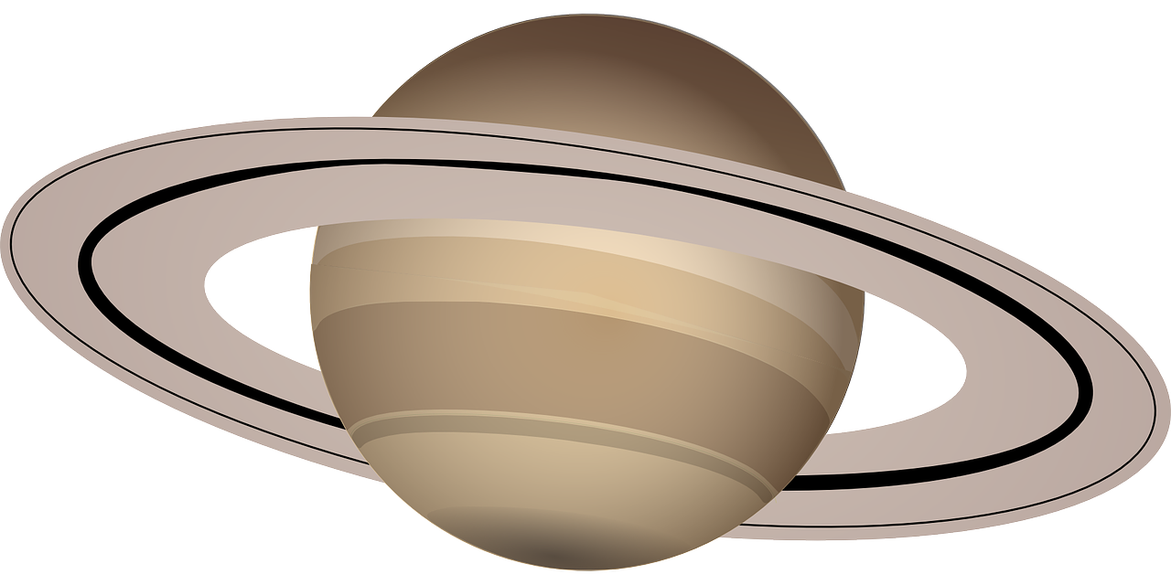
Internal Aids: Mnemonics
Example: order of planets
“My Very Eager Mother Just
Served Us Noodles.”
Can you think of another example of a mnemonic?
Notes:
Using mnemonics (the first M is silent) is another example of a memory aiding device.
The word mnemonic was derived from Mnemosyne, the Greek goddess of memory.
When we are trying to remember the order or sequence of something, using a mnemonic is a good strategy.
For example: the order of the planets in the solar system. Has anyone heard of the saying, “My Very Eager Mother Just Served Us Noodles”?
M-Mercury, V-Venus, E-Earth, M-Mars, J-Jupiter, S-Saturn, U-Uranus, N-Neptune. (As you probably know, Pluto was taken off the planet list; you may have been familiar with other mnemonics that involved Pluto.)
One can see how this type of mental strategy would be helpful in school, when you are trying to learn something new.
QUESTION: Can anyone think of another mnemonic that is helpful in remembering information? (Example: colors of the rainbow: Richard Of York Gave Battle In Vain = Red, Orange, Yellow, Green, Blue, Indigo, Violet)
-------------
(Nelson, 2005)
(Merriam-Webster, n.d)

Slide 10
Internal Aids: Acronyms
Words formed by combining the
first letters of words in the name
Example: SONAR
How can they help?
Notes:
Just like mnemonics, acronyms are a helpful internal memory aid.
Acronyms are abbreviations using the first letter of each word in a phrase or a name.
Some well-known examples are:
SONAR. Who knows what SONAR stands for? (Sound Navigation And Ranging)
NATO. What does NATO represent? (North Atlantic Treaty Organization)
Any other examples? (F.B.I., U.N., C.I.A)
Acronyms are also great time-savers. When we discuss the Federal Bureau of Investigation, we save time by using the acronym FBI.
How can acronyms help in your daily life?
What if you have a few errands to run, but you forgot to write them down? Without external help such as a list, you must rely on your own memory.
Example: I have three errands to run before I go home.
I need to go to the market.
I need to run by the tailor for alterations.
I need to pick up my prescriptions at the drug store.
It would be easy to forget one of those if we try to remember them as merely errands.
How can we make it easier on our memory? How about, “I have MAD to do before I go home”?
If this information is registered properly, the letters will cue your memory in order to complete your errands.
QUESTION: As a group, can we think of another example that an acronym might be useful and lessen the demands on our brains?
------------
(Merriam-Webster, n.d)

Slide 11
Internal Aids: Rhymes & Patterns
Effective memory techniques
Example: “In 14-hundred-92,
Columbus sailed the ocean blue.”
Other examples?
Notes:
Sometimes we get lucky, and we can create a pattern or rhyme to help remember something.
A common rhyme learned in school is “In 14-hundred-92, Columbus sailed the ocean blue.” While facts like this may seem useless to you now, it is important to realize that although this is not everyday knowledge, it is significant that you could actually remember it for all these years. So, knowing that rhymes can improve your chances of remembering something, it’s worth a try!
Are there any examples of a rhyme you find helpful?
The rhyme “30 days has September, April, June and November” is helpful for remembering which months have 30 days and which have 31.
[Facilitator can offer an example if the class does not come up with one.]
Are you the type of person who looks for patterns in things, whether it’s a license plate number, holidays, birth date or something else? Sometimes, patterns can be effective when trying to remember numbers, such as your social security number, driver’s license or address. There are so many numbers that many of us have to remember. Although a little creativity and effort is needed to find patterns, it can be beneficial in the long run because it lessens the strain on our memory. Often what is seen as a pattern for some, may not register for others.

Slide 12
Internal Aids: Chunking
Which is easier to remember?
5 7 9 4 3 2 8 4 6
or…
579 43 2846
Notes:
Chunking expands our working memory load. Chunking involves organizing large groups of information into smaller subgroups.
Look at the example on the slide. Which numbers are easier to remember? Chunking can be helpful in remembering things like phone numbers and social security numbers.
So far, we’ve discussed how we can use internal or mental strategies to improve our memory abilities. We discussed alphabetic cueing, rhyming, patterns, acronyms and chunking. I’m sure many of you are thinking that these internal aids require some extra effort. You’re right! While the internal strategies that we just mentioned may seem like too much work, the fact is that by challenging your brain in those ways, you’re actually improving your memory power and creating intellectual stimulation.
Let’s change gears to external aids. Many of you are probably more familiar with external memory aids which, over time, society has created to decrease the demand on our brains. Can anyone guess what an external memory aid is?
Yes: calendars, appointment books, Post-It notes, address books, etc., are all external memory aids.

Slide 13
Brain Boosters!
Homonyms
Notes:
Let’s do an exercise to think creatively about different words. Each of these has a homonym that sounds the same, but is spelled differently and has a different meaning. Can you think of them?
[Facilitator: have participants turn to the Homonym Activity to be worked on individually or in groups.]

Slide 14
External Aids: Appointment Books
Appointment books and calendars lessen the demands on our memory
ALWAYS have it available
CHOOSE the right one for you
WRITE appointments down A.S.A.P.
Notes:
External aids assist us in managing our daily lives and serve as a support system for our internal memories. Our brains are not designed to lug around a lot of information like phone numbers, appointments and to-do lists. This is where external aids come in handy.
Have you heard the expression, “I would forget my head if it wasn’t attached”? Can anyone relate to that? External aids can be very helpful at cueing us to remember things.
Everyone should use some sort of method to keep track of appointments, meetings, contact numbers, and other important information. Appointment books are not cheating! In fact, if you do not write things down, you are actually cheating yourself and your memory. Do you all agree that no one person can remember all the demands and duties of life?
Appointment book tips:
Appointment books or electronic calendars only work if you have them with you. You never know when you’ll need to add something.
Everyone has unique needs. Therefore, your calendaring system should reflect those needs. For example, someone who experiences vision impairment may want a larger-print book or an electronic calendar that can be enlarged. There are endless options, both electronic and in hard copy. What works best for you?
Remember, we said our short-term memory lasts about 30 seconds. So, make sure to immediately write down the date, time and location of your appointments. You’re not writing a novel, just a note that will trigger the memory you need.
----------------
(Caprio-Prevette & Fry, 1996)
(Mayo Clinic Staff, 2011)

Slide 15
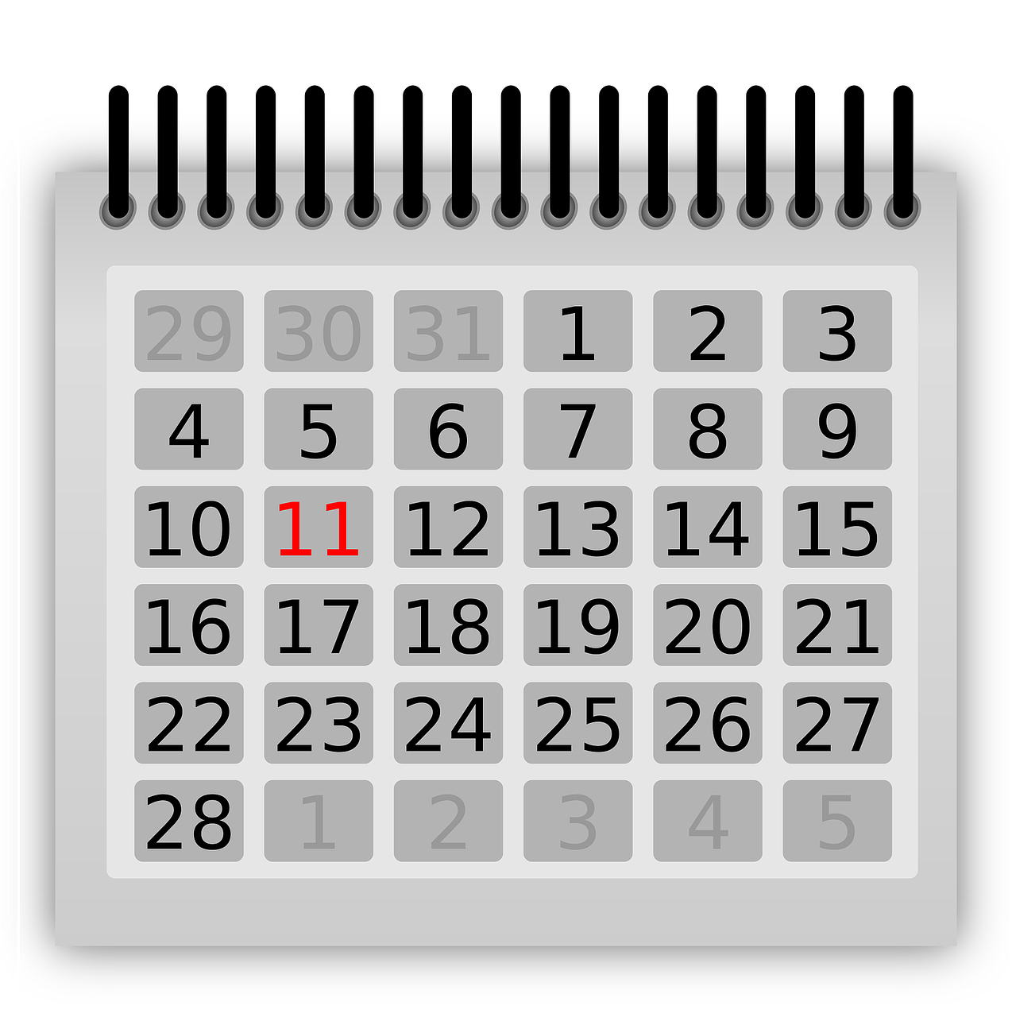
External Aids: Calendars
Transfer appointments
Designate a day
Consolidate calendars
Consult morning and evening
Cross it off!
Transfer incomplete tasks
Notes:
A fitting question is, “What good is knowing when your appointment is if you do not know what the day is today?” It sounds silly, but we all know how easy it is to get distracted and lose track of the days of the week.
QUESTION: How do you use a calendar to organize daily activities?
Here are some helpful tips:
Ensure that your appointment book and calendar are in sync.
Make updating your calendar an appointment! Designate a day and time to update your calendar.
Consolidate your personal and community calendar so that all of your events and appointments are in one place.
Check your calendar frequently throughout the day. It doesn’t do any good if you don’t look at it!
Once a task or appointment is completed, don’t forget to cross it off. Doing so should feel good.
Carry unfinished items over to the next day. You can circle, underline or use a different color to draw attention to these tasks.
--------------
(Mayo Clinic Staff, 2011)

Slide 16
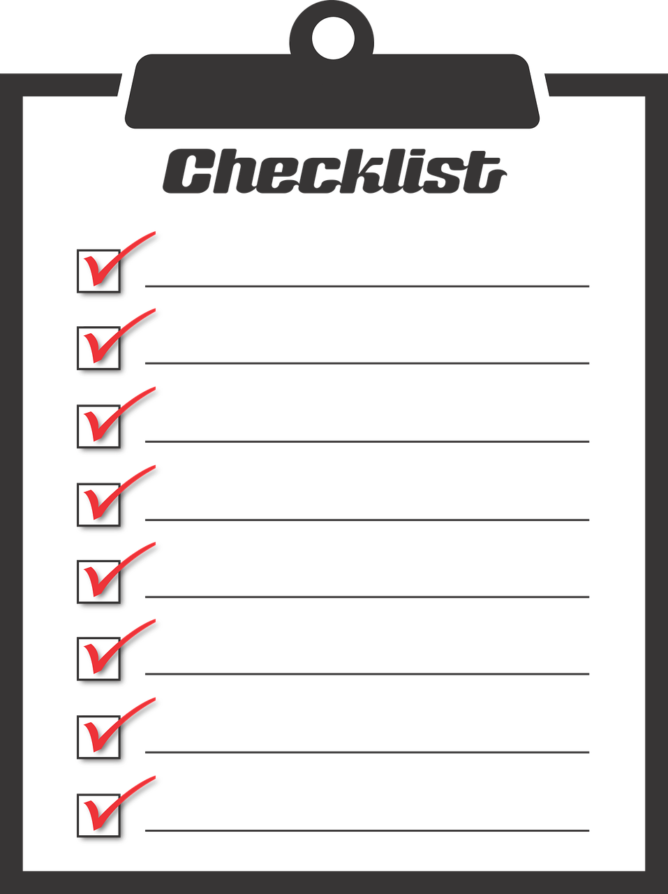
External Aids: Lists, Routines & Drills
Lists
To-do lists and shopping lists
Categorizing minimizes things that need to be remembered
Routines
Automatically assist memory functioning
Notes:
Many people use lists. Some lists may be longer than others, depending on their purpose.
Lists are proven to be very useful in decreasing forgetfulness. Who can think of some other examples of how lists are useful?

Slide 17
Brain Boosters!
Making a List, Checking it Twice
Notes:
We are going to perform a list exercise. The objective is to practice categorizing items on a list.
[Facilitator: disperse “Making a List, Checking It Twice” activity sheet.
Read directions to class. Facilitator should emphasize the strategy of categorizing items, not just remembering items individually.
While classmates are studying the list of items, facilitator should write the categories on the board.
Suggested categories: spiritual activities, intellectual activities, physical activities
Once one minute has expired, classmates should turn over their papers.
As a class, recall items from the list of programs, based on the provided categories.
Group discussion on list activity:
What items were easily forgotten and easily remembered?
Any thoughts on what hinders you from remembering these items?]

Slide 18
External Aids: Lists, Routines & Drills
Lists
To-do lists and shopping lists
Categorizing minimizes things that need to be remembered
Routines
Automatically assist memory functioning
Notes:
For most of us, every day is a process of routines. Sure, every so often we get out of our normal routine.
Take a moment to think of a time when you felt “out of routine,” whether it was this morning, yesterday, last week, etc. Try and bring yourself back to those feelings and thoughts.
Now, during that time did you feel more confident with your memory abilities, or did you feel flustered and disorganized?
[Facilitator, please encourage open discussion.]
Among our group here, let’s try to figure out some similarities and differences surrounding our individual routines.
It’s important for us to realize the differences in personalities and habits; therefore, routines are highly personal. While some may do the dishes immediately after dinner, others may relax and do the dishes a few hours later.
Routines must be established for your belongings. Designate a specific place for your keys, glasses, wallet and other items.
Regardless of how someone has a way of doing something, the point is that it helps our memory when we remain consistent, such as putting your keys in the same place every day or taking your pills at the same time.

Slide 19
External Aids: Lists, Routines & Drills
Drills:
Practice using as many of the five senses as possible
(Speaking aloud is very important)
Helps us in registering, retaining and retrieving
Notes:
Although some tasks seem automatic like turning off the stove or locking the door, our minds can get overloaded and these regular tasks can get forgotten or missed. We need to make sure we do not criticize ourselves for these mistakes. Instead, we need to focus our energy on practicing ways to enhance our ability to remember the all-too-common things.
Checklists can be helpful with procedures that are new to us or that we have trouble remembering. Write the steps down and place the instructions with the device. For example, if you get a new sewing machine, write down the steps for operating it and store it with the sewing machine.
One way to perform these drills is by using our five senses. We’re used to mostly relying on seeing and hearing, but all can be helpful.

Slide 20
Brain Boosters!
Drill, Drill, Drill
Check the car before locking it.
Check the contents of your wallet/purse before leaving home)
Notes:
[Activity: “Drill, Drill, Drill”
The objective of this drill exercise is to increase the use of our senses in a disciplined way.
Facilitator: read instructions
Have class divide into groups of 2, 3 or 4, depending on class size.
Explain that the goal is to incorporate as many of the following into each drill: hearing, seeing and touching.
Before groups begin, read the example:
While locking your door, you could say out loud, “The stove is off, I have my wallet and the door is locked!”
The incentive comes when you are away from home and wondering, “Did I turn off the stove?” You can say “Yes” with confidence because you used your sense of touch, sight and hearing.
Developing a routine may take at least 100 practices before it becomes automatic, so it’s important to stick with it!
Remember, the more senses we use, the better chance we have of registering information.
Now, in small groups, instruct participants to discuss how they would develop drills to:
Check the car before locking it.
Check the contents of their purse/wallet before leaving home.
Once sufficient time is provided and small groups seem ready, class should return to the large group and share their scenarios.]
Let’s talk about what we have learned. [Facilitator, encourage group discussion.]
How can both seeing and hearing a routine help you?
What other kinds of drills might be useful?
Does anyone have any personal examples of drills they use?
---------------
(Mayo Clinic Staff, 2011)

Slide 21
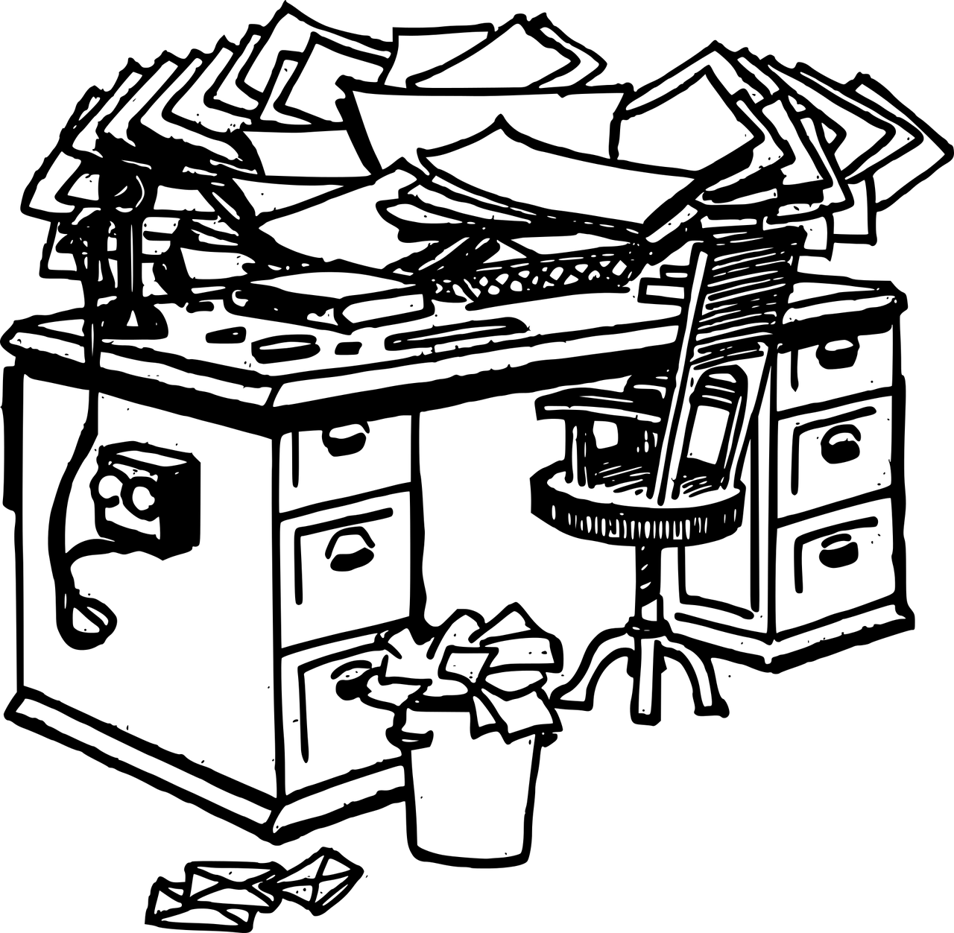
External Aids: Organization
& De-cluttering
Helps you remember where you put things
Minimizes distraction
What is one thing you can do
today to reduce clutter in your life?
Notes:
Organization and de-cluttering is a way to set up your environment for memory success. Having “memory places” for important items will help you become more efficient. Having less clutter encourages you to have systems for storage and in turn helps you remember where you put things. If there is less clutter around you, you’re more likely to retain information because you are less distracted and will be able to focus on what’s in front of you.
QUESTION: What is one thing you can do today to reduce clutter in your life?
----------------
(Mayo Clinic Staff, 2011)
(Nelson, 2005)
(Small, 2002)

Slide 22
Using your whole mind to remember!
Transfer language/numbers into distinctive images
Positive images are more easily remembered compared to negative
Give images color, dimension, movement and senses
Exaggerate the details
Use humor!
Notes:
We have just discussed many internal and external memory aids. Here are some more tips for maximizing your memory potential.
A web article suggests, “Using your whole mind to remember!” Let’s take a look at some of these helpful tips…
Sometimes transferring language and numbers into images can help the recall process. Remember, try to think outside the box! Our minds get bogged down with numbers, letters and words, so try associating them with a striking image.
It is better to use positive, happy images when trying to remember things, especially people and names. Physiological studies suggest that the brain tends to block out unpleasant images.
Give your images color, dimension and movement. Adding animation to inanimate items can allow those images to stick out in your memory.
It’s okay to slightly exaggerate details in order to register and retain them. Of course, while we use the strategy of exaggeration to register information, we want to make sure when we retrieve it, it is remembered accurately.
Humor works! Adding pleasant emotion to something you’re trying to remember increases your chances of actually remembering it. Unusual and silly things have a more lasting impression on our brain than normal things.
---------------
(The Brain Train, 2007)

Slide 23
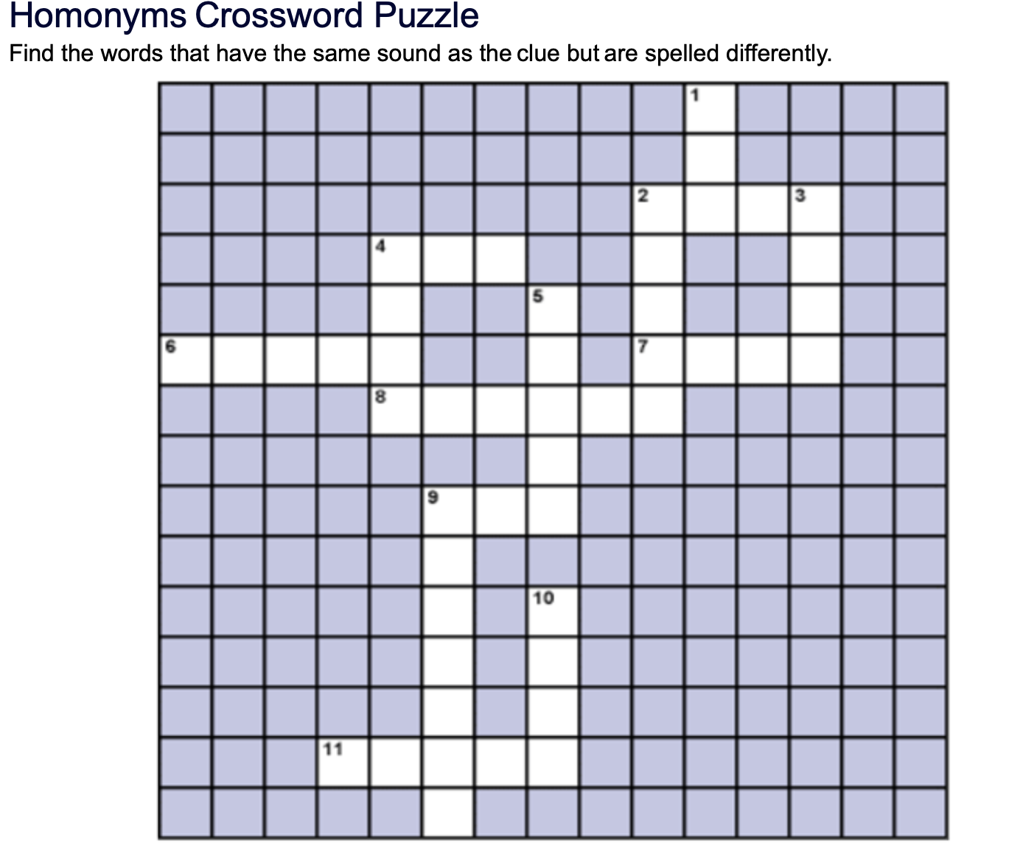
Brain Work
Continue new challenge
Same or different challenge
Try one thing to increase organization or de-clutter your environment
Brainwork
Homonym Crossword Puzzle
Notes:
For our next session, we’re going to add onto our existing brainwork. It’s time to put into practice the organization strategies we learned during today’s session. Try doing one thing to de-clutter your life and make your environment less distracting. Notice what kind of changes you feel in your memory and overall well-being and be ready to talk about these changes at our next session!
For homework, use your homonym skills to complete this crossword.
[Facilitator: hand out Brain work: Homonym Crossword]
Thanks for being here today. I have enjoyed all of your contributions to our learning and discussions.
[Facilitator should pass out any related articles for class to read over the next session. Remind class of next meeting and to bring his/her Neurobics folders.]

Slide 24
Course 5 Preview
01
Name & Face Recall
Looking at techniques that can improve name recall
02
Reviewing research update on face recognition
03
Discussing the importance of memory intentions
Notes:
Now that we’ve discussed some external and internal strategies that might improve our registering, retaining or retrieving, we’re going to talk about something many of us struggle with: name recollection.

Slide 25
COMPANY NAME
YOUR INFO HERE
Logo Company
Notes:
(Facilitator: Use this slide to feature additional brain fitness programs/opportunities within your organization.)
Please see Dr. Rob’s Cognitive Connections for ready-to-use brain fitness exercises for individuals and groups.

