Slide 1
Nourish A Nutrition Experience by Masterpiece Living
1st Course
Copyright © 2011 by Masterpiece Living, LLC
All rights reserved. No part of this program may be reproduced or transmitted in any form or by any means, electronic or mechanical, including photocopying, recording or by any information storage and retrieval system, without the written permission of Masterpiece Living, LLC except where permitted by law. For information address: 11360 N Jog Road, Suite 102, Palm Beach Gardens, FL 33418.

Slide 2
A quick survey…
Notes:
Before we begin our discussion today, please fill out the pre-program survey. This information is helpful to us in guiding our conversations and future programming.

Slide 3
Today’s Agenda
On the menu:
Introduction
Why does nutrition matter?
Nutrition over time
Nutrition knowledge
MyPlate
Serving Sizes
Food Diaries

Slide 4
Introduction
Notes:
Nutrition is good for our body and our souls. Often, social gatherings with our loved ones are centered around a good meal.
To get to know each other better – let’s go around the circle and introduce ourselves with our name and our favorite dish to make, or eat!

Slide 5
Healthy Snacking
Notes:
(Facilitator – hand out healthy snack and Healthy Snack Handout)
While we enjoy our healthy snack, let’s talk a little about our snacking habits. Are you surprised to hear that the United States has been referred to as “a snacking nation”? One study found that 98% of Americans snack at least once a day and 50% of adults snack two to three times per day. Snacking can be a good source of energy between meals if the snack is healthy and provides nourishment.
Let’s brainstorm – what are some healthy snacks that you like to eat?
(Facilitator – write these down on a white board or flip chart while participants are saying them)
Thank you, these are all great choices for healthy snacks.
(Mintel, 2015)

Slide 6
Why does nutrition matter?
Notes:
Why does nutrition matter?
Let’s start with the question – why does nutrition matter to you?
Nutrition matters to all of us because it is a key supporter of a successful aging lifestyle and maintaining, or obtaining, a healthy weight.
What we eat impacts how we feel today, tomorrow and in the future. When we eat good foods, we feel good afterward and eating healthy is important at every age – for different reasons.
There is value to eating healthy specifically for older adults. For instance, as a person ages, their muscle mass decreases with time. This means the body requires less calories from food to function. Research also tells us that that the metabolism of an older adult slows down as much as 30%. The actual percentage of metabolic slowing a person experiences varies depending upon several factors. Some of these factors include gender, weight, muscle mass and daily activity levels. It is from these changes that older adults are recommended to eat nutrient-dense foods to maximize the health benefits of the calories consumed. We will spend more time discussing specific food recommendations in the coming slides.
(Rowe & Kahn, 1999)
(International Council of Nurses, 2005)
(Tufts University, 2015)
(Mayo Clinic Staff, 2009)

Slide 7
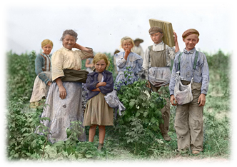
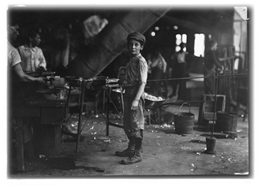
Nutrition over time
The Hunter-Gatherer Age
The Post-Industrial Age
The Agrarian Age
Today
Notes:
Let’s take a brief look at how our lifestyle and food choices have changed over time, starting at the hunter-gatherer age.
Here is an excerpt from Dr. Roger Landry’s book, Live Long, Die Short, about what life was life in the hunter-gatherer age:
"Because food could not be preserved, there was a tendency to eat heavily when it was available. Even though it was very rare, our ancestors preferred high-fat food, because it was calorie rich and able to sustain them for when food was not available -- a trait that causes difficulty today. Their diets consisted of mainly fruits, wild vegetables, nuts, fish, and the occasional meat from a small animal or the leftovers from a predator's kill. Remembering locations for food and water was a critical skill (which explains why our memory for images and locations is much better than for numbers and names). They ate often, foraging for whatever food was available. Sugar, other than that found naturally in foods was foreign to their physiology.“
Because of the scarcity of food, individuals in the hunter-gatherer age often ate small meals frequently as food became available to them. As we discussed earlier, we enjoy eating small meals, or snacks as we often call them. Maybe we aren’t so different from our ancestors, after all…
Now, let’s travel to the agrarian age, where individuals exchanged the nomadic lifestyle for more permanent shelter and food sources. Farming emerged during this time period which resulted in eating more cultivated crops and meat. Society’s livelihood was based on the production and maintenance of farms and crops.
Following the agrarian age, the post-industrial life brought 16-hour work days, little time for recreation and increased competition for resources. The diet at the time consisted of things like oats, bacon, bread and porridge. The water was too polluted to drink and the milk and dairy were too expensive to buy. The shift from an agricultural lifestyle to factory work drastically changed what we ate, and how we ate.
http://www.mylearning.org/everyday-life-in-the-industrial-revolution/p-2355/
Today, we have fast food and slow cookers. We can eat when we want, what we want, and how much we want. We have come a long way as a society from the hunter-gatherer age, and even since the agrarian age. However, our bodies still feel a pull to be connected with our ancestors lifestyle of community, staying active, being connected with the earth, and having a diet that reflects that lifestyle.

Slide 8
Nutrition is NOT a One-Size-Fits All
Human-beings are all different, which means our approaches to nutrition may look different too!
Today we will explore MyPlate, but we recognize that there are other nutrition guidelines from food pyramids around the world.
Notes:
Photo source: http://ayannacastro.com/wp-content/uploads/2017/10/One-side-does-not-fit-all.jpg

Slide 9
Nutrition Knowledge
MyPlate
Notes:
Today’s “nutritional knowledge” will focus on MyPlate, specific for older adults.

Slide 10
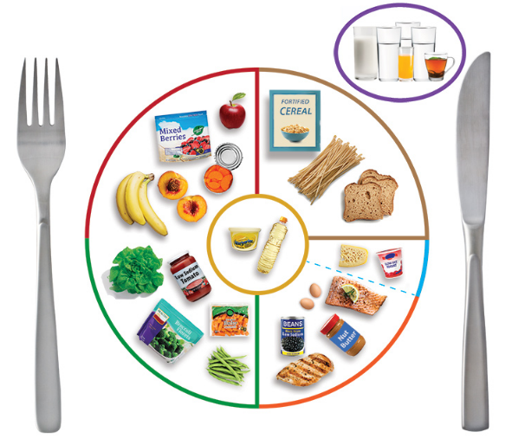
MyPlate for Older Adults
Notes:
(Facilitator: Please distribute the MyPlate handout to participants)
MyPlate was created to replace the traditional food pyramid. This shift in how we view are diet occurred because research tells us that we need to pay attention to portion sizes, aim to fill half our plates with fruit and vegetables and choose foods that are low in added fats and sodium.
As we look at MyPlate for Older Adults from Tufts University, there are many things that we want to highlight. In the next several slides, we will discuss each of the food groups identified in this guide. But before we discuss the specifics of the actual food group categories, MyPlate stresses the importance of the following recommendations for older adults:
1. Choose nutrient-dense foods and limit consumption of empty calories. Nutrient-dense food have a high nutrient to calorie ratio meaning they are rich in nutrients compared to their calorie content. Examples of nutrient-dense foods include spinach and blueberries. Empty calories are foods and beverages high in calories with little to no nutritional content. Examples of empty calorie foods and beverages include soda, alcoholic beverages and cookies.
2. Stay hydrated. The sections of liquids above the plate symbolize the importance of staying hydrated, regardless of feeling thirsty. It is recommended that older adults try to incorporate at least 8 glasses of water every day.
3. Stay (or become) active. It is recommended that older adults participate in moderate physical activity everyday. Moderate physical activity can mean long sessions of activities such as walking or riding the stationary bike, or shorter sessions of exercises like swimming, fast walking or walking stairs.
Again, these recommendations have been made specifically for older adults and are intended to promote a healthy diet. *The materials we discuss in this program are not directed for weight loss, although we have included many tips and nutrition basics that can support weight loss goals. If you are interested in learning more about healthy weight-loss strategies, please consult your physician or health care provider.
Now, let’s examine each section of the plate more closely.
(Tufts University, 2015)

Slide 11
Grains
Common whole grains:
Brown Rice
Buckwheat
Flaxseed
Oats, Rolled Oats, Oatmeal
Quinoa
Rye
Popcorn
Whole wheat bread
Whole grain tortilla chips
Notes:
Whole grains are a great source of fiber and B vitamins, and almost any grain based product now comes with the option for a whole grain version. Some common whole grains are flax seed, brown rice, oats and popcorn.
The fiber from whole grains helps improve blood cholesterol levels, and lowers our risk for heart disease, stroke, obesity and type 2 diabetes. Whole grains are also a great source of multiple other nutrients such as thiamin, folate and iron.
While whole grains contain the entire grain kernel – the bran, germ and endosperm – refined grains have been milled and lose the bran and germ in the process. This process improves the food’s shelf life and gives it a finer texture, but removes the dietary fiber, iron and many B vitamins that are so important in grains. To make up for this, they often enrich the grain afterward, adding iron and some B vitamins back. However, fiber is not added back.
Because of this, it is recommended that at least half of all grains eaten should be whole grains.
(Tufts University, 2015)
(The American Heart Association, 2016)

Slide 12
True or False:
Trivia
Multigrain and whole grain have the same health benefits.
Notes:
Trivia Question #1: True or false – Multigrain and whole grain have the same health benefits.

Slide 13
False!
Notes:
The answer is false. The multigrain and whole grain do not have the same benefits and there is a preferable choice in terms of the health benefits.
So, what is the difference between multigrain and whole grain? Sometimes, all the labels we see on food can be very confusing. Something may be labeled as multigrain, but is that better for us than whole grain? Does it matter? Whole grain means that the entire grain and all of its parts are included in the food. Multigrain, on the other hand, means that there are a variety of different grains included in the food. Multigrain does not mean that the whole grain is included. Whole grain is your healthiest choice because it has all the fiber and nutrients that a complete grain offers.
(Facilitator: Consider bringing in samples for participants to taste whole-grain foods. Also, bring in labels or different foods that are whole grain and multigrain to show participants what to look for.)
(Zeratsky, 2010)

Slide 14
Fruits
Examples of deeply colored fruits:
Blueberries
Blackberries
Cantaloupe
Cranberries
Mangoes
Nectarines
Peaches
Raspberries
Strawberries
Notes:
When selecting fruits, it is recommended that you “eat the rainbow” and choose ones that are deeply colored to maximize the intake of a variety of healthy nutrients. Fruit can come in many forms: fresh, frozen, canned and dried. Having all forms in your home increases your chances for being able to include in your favorite dishes.
(Facilitator: Ask - Can you think of some way you can incorporate fruit into your meals?)
Possible responses: sprinkle berries onto your yogurt or cereal in the morning, adding berries or other fruit to salads, using frozen fruit to blend in a smoothie or using dried fruit with nuts to make your own trail mix.
(Tufts University, 2015)

Slide 15
Vegetables
Examples of deeply colored vegetables:
Asparagus
Beets
Broccoli
Brussels Sprouts
Butternut Squash
Carrots
Collard Greens
Kale
Green, Red, Orange Bell Peppers
Romaine Lettuce
Notes:
As shown in the pictures, there are a variety of colors represented within the vegetable group. When selecting vegetables, it is recommended that we “eat the rainbow” and choose vegetables that are bright in color including dark greens, deep reds and vibrant yellows. This recommendation is made to ensure we not only get a variety of nutrients, but also maximize the nutrients we get from the vegetables we eat. For example, the dark green color of spinach is our indicator that it is a more nutritious choice than iceberg lettuce which is light green in color.
In addition to eating fresh vegetables, frozen vegetables found in the freezer section of the grocery store are also a good option for getting the recommended daily servings. Another tip to maximize nutrients in our vegetables is to avoid overcooking vegetables. Overcooked vegetables lose some nutrients during the cooking process. When cooking vegetables - rather than eating them in the raw state such as on a salad - a good rule of thumb is to keep them on the ‘al dente’ side. Al dente is an Italian expression meaning ‘to the tooth’. This expression commonly refers to the cooking of pasta but applies to vegetables as well. The expression refers to cooking something, such as Brussel sprouts or green beans, to the point that they have a tender bite. To have a tender bite, the vegetables are neither undercooked and raw nor are they overcooked and mushy.
Ultimately, whether eating them cooked or raw, vegetables pack in a lot of nutrients to support a healthy diet.
(Tufts University, 2015)

Slide 16
What vegetable made Popeye strong?
Broccoli
Carrots
Spinach
Tomatoes
Trivia
Notes:
Trivia Question #2: What vegetable made popeye strong?
Broccoli
Carrots
Spinach
Tomatoes

Slide 17
c. Spinach!
Notes:
Popeye attributed his superhuman strength to eating spinach. Because of this, Popeye actually boosted the sales of spinach and increased children’s vegetable consumption after watching Popeye cartoons.
Although spinach does not give us superhuman strength, it does provide us with many important nutrients. Specifically, Vitamin C and Vitamin K. Vitamin C is essential for repairing injured bone tissue. Vitamin K helps the body produce osteocalcin, which is what attracts the calcium to the bone tissue. Without it Vitamin K, our bones would be as soft as chalk!
In fact, a recent study from Tufts University found that people with low Vitamin K intakes have a significantly higher than average risk for hip fractures.
(Wikipedia, 2016)
(Tufts Journal, 2008)

Slide 18
Oils and Fats
Common liquid oils:
Canola
Corn
Olive
Peanut
Sesame
Soybean
Sunflower
Walnut
Fish
Avocado
Coconut
Notes:
Liquid oils provide us with important fatty acids and fat-soluble vitamins that serve as substitutes for solid fats.
As we can see, oils are a recognized food group in MyPlate. This means that they are an important part of the diet and nourishment of the body. Because of this, it is not healthy to cut fat entirely from the diet. Our bodies need fat to function properly. According to the Mayo Clinic, the body uses fat - along with protein and carbohydrates - to create energy. Fat is also used to support other bodily functions such as managing insulin levels and maintaining healthy blood sugar levels. Likewise, having a healthy amount of fat in the diet, improves the body’s ability to absorb vitamins properly.
When cooking with or consuming oils and fats, it is best to choose ‘good fats’ which can be found in vegetable oil such as canola, corn and olive oils. Beware of saturated fats which are considered ‘bad fats’ because they are bad for the heart.
Trans fat is another form of fat that is harmful to our health. Trans fat, for the most part, are generated during the processing of foods. Trans fats are often used as a preservative to extend the shelf life of packaged foods. While some fats are good for your heart, trans fats are considered ‘bad fat’ because they are bad because it is “human-engineered/fake” and is bad for the heart. It is recommended that you avoid foods containing trans fat. Trans fats can be found in stick margarine, shortenings and hydrogenated vegetable oils in processed foods and packaged cakes, crackers and cookies.
A good rule of thumb when determining if a fat source is a ‘good fat’ versus a ‘bad fat’ is the form it takes when at room temperature. For the most part, ‘bad fats’ - such as saturated and trans fats - become solids at room temperature. For example, lard and shortening are solid when at room temperature and need heat to turn into their liquid form. On the other hand, ‘good fats’ - such olive oil and corn oil - are liquid at room temperature. However, some plant-based oils, such as coconut oil, palm oil, and palm kernel oil are high in saturated fats and should be considered under the ‘solid fats’ category for nutritional purposes.
There can also be ‘bad fats’ and high fat contents in fattier cuts of meat and full-fat dairy products. We will discuss these in the next few slides.
(Mayo Clinic Staff, 2011)
(Tufts University, 2015)
(Tilden, n.d.)

Slide 19
Dairy
Healthy ways to include recommended amounts of dairy into your diet:
Make smoothies with unsweetened yogurt and fresh fruit
Use Greek yogurt instead of sour cream or cream cheese on foods for a healthier alternative.
Sweeten low-fat yogurt with berries and other fruits, or make it savory with chives
Notes:
Dairy products are a great source of protein, calcium and other important nutrients to our diet.
It is recommended that when consuming dairy, it is either low-fat or non-fat. For example, some cheeses have naturally lower fat contents including mozzarella, string cheese and goat cheese. Today, reduced-fat and non-fat milks are mainstream offerings at grocery stores. Likewise, the selection of reduced fat cheese are becoming increasingly common to find such as reduced-fat cream cheese or 2%-fat cheddar cheese. We will learn more about nutrition labels in the next course, but keep in mind that fat-free and low-fat dairy products can sometimes replace the “fat” with other fillers like sugar.
Some suggestions for incorporating low-fat and fat-free dairy into your diet are making smoothies with unsweetened yogurt and fresh fruit, using Greek yogurt instead of sour cream or cream cheese on foods, or sweetening low-fat yogurt with berries and other fruits, or making it savory with chives.​
(Tufts University, 2015)
(Haynes, n.d.)

Slide 20
Protein
Good sources of lean protein:
Fish and Shellfish
Beans
Eggs
Nut Butters
Lean meat and poultry
dairy products (in moderation)
Poultry without skin
Quinoa (also a grain)
Notes:
The Protein group of MyPlate includes a variety of protein sources such as beans, nuts, fish, poultry, meat and eggs.
As we spoke about “bad fats” in the previous slides, some sources of protein can be high in saturated fats. Again, saturated fats are bad for the heart. Lean options of poultry include skinless and white meat chicken or turkey. Also, when eating meat, choose leaner cuts of meat, such as the tenderloin or lean ground meat. The butcher in the meat section of the grocery store can help direct us toward the leaner cuts of meat. When picking out meat, a general rule of thumb is to look for cuts of meat with little fat marbling visible in them.
Beans, nuts and eggs are also good sources of protein. Beans, in particular, are a good source of protein because they are low in fat and cholesterol and have a high fiber content. Likewise, nuts - such as almonds and walnuts - are also a good source of protein and contain nutrients that support a healthy heart. Consider mixing beans or nuts into your next salad or side dish to get one of the recommend daily servings of protein.
(Facilitator: Take a moment to ask the group the question below. This could be a good time to highlight both the animal-based and non-animal sources of protein offered at your community.)
Now that we’ve spent some time talking about different sources of protein, how can we get the number of servings recommended on a daily basis?
(Mayo Clinic Staff, 2011)
(Castle, 2010)
(Tufts University, 2015)

Slide 21
You may shoo spiders and flies away but they’re actually great sources of protein… One ton of spiders has over 3 times as much protein than one ton of cooked beef!
Did you know?
There’s even accounts of eating bugs in the bible…
“John [the Baptist]’s clothes were made of camel’s hair… His food was locusts and wild honey.”
(Matthew 3: 4)
What’s the most exotic thing you’ve ever eaten?
Notes:
(Facilitator: Read facts on slide.)
Ask: What’s the most exotic thing you’ve ever eaten?

Slide 22
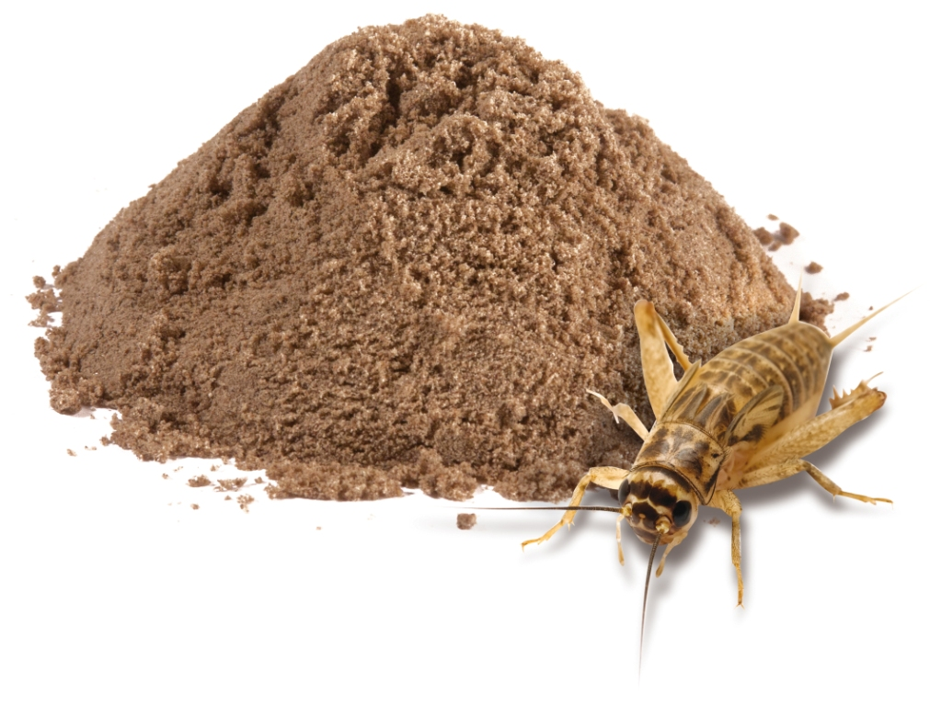
Did you know?
Cricket flour is growing in popularity because of its high protein content and sustainable production.
Cricket Flour Fun Facts
Cricket Flour has 3X more protein than steak
Contains Double the protein of chicken
It is estimated that crickets are 20 times more efficient as a source of protein than cattle.
What is Cricket Flour?
It is crickets dried and milled into a high protein powdered form.
Would you try or incorporate cricket-based foods into your diet?
Notes:
(Facilitator: Read facts on slide.)
Ask: Would you try or incorporate cricket-based foods into your diet?
https://draxe.com/cricket-flour/
Other Facts:
Crickets also require far less water than cattle; in fact, to get a pound of dry protein from a cow, between 1,700 and 2,500 gallons of water is required. To get the same amount of protein from a cricket, only one gallon of water is needed — that’s a tremendous difference.

Slide 23
Liquids
Tips for drinking more water:
Add fruit or veggies (orange wedges, lemon, cucumber) to your jug or glass of water to add flavor
Eat more fresh fruits and vegetables (melon is a great source of water from fruit)
Add a small bowl of soup to your meal
Drink unsweetened water-based beverages such as coffee or tea
Notes:
This section of the plate includes both water and other drinking liquids such as juice, tea and coffee. While drinking water is best, a morning cup of coffee or tea can also count toward the recommended daily servings.
Because our bodies are, after all, made up of 60% water, we need it to keep our bodies well hydrated. This is especially true for older adults who can experience a reduction in their sense of thirst as they age.
Like each of the food groups we’ve discussed, there are health benefits to each section of the plate. Specifically, water works to rid the body of toxins and helps to deliver food nutrients to where they are absorbed in the body’s cells. Proper hydration also supports good ear, nose and throat health and works along with fiber to aid digestion.
In addition to drinking water, there are other sources of liquid that can help to maintain proper hydration. For example, eating reduced-sodium soups or fruits with high water contents such as watermelon can also provide a serving of liquid. Please note that alcoholic beverages do not count towards a person’s daily water and liquid intake. In fact, alcohol actually dehydrates the body.
*As a friendly reminder, please note that these recommendations have been made for the general population of older adults. Please consult with your physician or health care provider for more information on hydration that is specific to your needs.
(Tufts University, 2015)
(Mayo Clinic Staff, 2010)
(Mayo Clinic Staff, 2009)
(International Council of Nurses, 2005)
(Mayo Clinic Staff, 2011)

Slide 24
Nutrition Knowledge
A ‘handy guide’ to serving sizes

Slide 25
Handy Guide
Finger Tip = 1 teaspoon
Serving: Butter, oil
Finger = 1 ounce
Serving: Cheese
Thumb = 1 tablespoon
Serving: Peanut butter, salad dressing
Palm = 3-5 ounces
Serving: Meat, poultry, fish
Notes:
Our hand can be used as a general guide to serving sizes for a variety of foods. Of course, measuring utensils and a kitchen scale are the most accurate way to measure a serving of food, but using the hand as a guide can be especially helpful when dining out at a restaurant or in the homes of friends and family.
Let’s look at the different parts of the hand that can guide our serving sizes. Please keep in mind that this is a general guide and is based upon an average-sized hand. The palm, for example, can be used as a general guide for a serving of meat, poultry or fish. The thumb is approximately the size of a tablespoon and can guide the portioning of foods such as peanut butter and salad dressing. Next, is the index finger which represents approximately 1 ounce and can be a guide for a serving of cheese. Then, we have the tip of the middle finger. This can be used as a guide for portioning foods like butter and oils.
(Gadia, 2009)
(Giancoli, 2010)
(Health, 2008)

Slide 26
Handy Guide
Fist = 1 cup
Serving: Cereal, fruit
Cupped Hand = 1/2 cup
Serving: Pasta, rice, beans, vegetables, ice cream
Notes:
Next, a hand - in the position of a fist - can serve as a guide for a 1 cup serving. The fist is a good visual image for measuring a serving of cereal or fruit. Lastly, one cupped hand is approximately the size of a half cup. The cupped hand is a guide for a serving of pasta, rice, beans, vegetables or ice cream.
Now that we’ve learned about this tool, we can let our hand be our guide the next time we go out for a meal.
(Gadia, 2009)
(Giancoli, 2010)
(Health, 2008)

Slide 27
Food Diaries
Notes:
The final piece of information I will leave you with today is the significance of Food Diaries, or recording your food consumption. This, along with exercise diaries are found to be to be significantly associated with weight loss.
I will be handing out a Food Diary today that you can utilize throughout this course and into the future.
(Burke, Wang & Sevick, 2011)

Slide 28
Course 1 Review
Why does nutrition matter?
Nutrition over time
Nutrition knowledge
MyPlate
A Handy Guide
Food Diaries
Notes:
As we know, we’ve covered a lot of information today. Here is a list of the topics we discussed.
(Facilitator: Please read contents of slide and distribute handouts to the group.)
Also, we’ve printed several handouts from today’s materials for us to take home and refer to in the future. The handouts we all have for our reference include the MyPlate for Older Adults, a Healthy Snacks Guide , the Food Diary handout and the 1st Course Nutrition Knowledge handout.

Slide 29
For the 2nd Course..
Homework for Next Time:
Bring Your favorite snack or packaged food products for a fun, interactive activity.
Notes:
(Facilitator: discuss with the group about bringing a favorite snack or packaged food products they eat on a regular basis at home. Also let participants know that you will also have packaged food products provided by the community available to use for the purposes of the activity.)

Slide 30
Coming up next…
Nutrition Labels
The future of nutrition labels
Food Labels
Calories
Tips for “Eating Intelligently”
Notes:
(Facilitator: Please read information on slide)
Thank you for joining us for the 1st Course of Nourish, we look forward to seeing you for the 2nd Course.

Slide 31
Customizable slide for organization
Organization Logo Here
Notes:
(Facilitator: Use this slide to feature additional nutrition programs/opportunities within your organization.)

