Slide 1
Add your company image or logo here.

Slide 2




Nourish
A Nutritional Experience By Masterpiece
4th Course
Notes:
Welcome to the fourth course of Nourish.

Slide 3

3rd Course Recap
Intuitive Eating
Connection with Food
Journaling and Food Diaries
Kaizen step
Notes:
In the third course, we discussed intuitive eating, being connected with food and journaling. Would anyone like to share what they did differently, since the last time we met, that made your eating experience more enjoyable? Does anyone want to share any “a-ha” moments with journaling or their food diary?

Slide 4
Nutrient-Rich Foods
Nourish 4th Course
Notes:
Building on to the previous courses, in the 4th course, we will focus on nutrient-rich foods, which are the foods dense in vitamins and minerals that are vital to your health.

Slide 5
Objectives
1
2
3
Identify top nutrients to support your wellbeing
Discover nutrient-rich foods
Determine how to add these foods to your nutrition
Notes:
The learning objectives for the fourth course are:
Identifying top nutrients to support your wellbeing
Discovering nutrient-rich foods and
Determining how to add these foods to your nutrition
Before we dive into the nutrient-rich foods or the foods some people call superfoods, let’s break down the importance of nutrients in them.

Slide 6

Vitamins
Essential organic compounds
Found naturally in food and not produced in the body (except Vitamin D)
Boost the immune system
Supports cells and organs to function properly
Water and fat-soluble vitamins
Notes:
We’ll start with vitamins. Vitamins are organic compounds that are essential for our vitality. All vitamins are found naturally in food and not produced in the body. However, Vitamin D, besides being found in some foods, is produced by our body when exposed to UVB rays from the sun. All 13 vitamins boost our immune system and supports our cells and organs to function properly.
The water-soluble vitamins are C & B. They are not stored in the body, so we need to replenish them often.
Fat-soluble Vitamins, A, D, E & K are stored in the body (specifically in the liver and fat tissue) for days or even months. You don’t have to eat these as often.
Next, we will review three of the top vitamins for older adults and why they’re important. Any guesses on what some of the top vitamins are?
Reference:
Brazier, Yvette (2020) What are vitamins, and how do they work? Medical News Today
https://www.medicalnewstoday.com/articles/195878#_noHeaderPrefixedContent

Slide 7
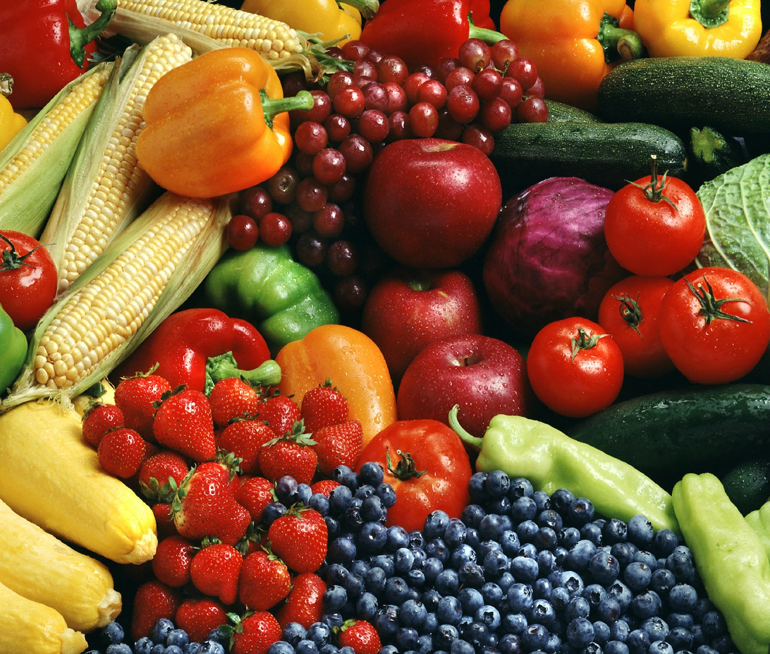
Vitamins
01
Vitamin B12
02
Vitamin D
03
Vitamin A
This Photo by Unknown Author is licensed under CC BY-NC-ND
Notes:
Vitamin B12 is a water-soluble vitamin. Your body doesn’t make it, so it is critical to ingest it from the foods you eat. Vitamin B12 is important for nerve and red blood cell health.
Deficiencies in Vitamin B12 can lead to weakness, bruising easily, and digestive problems. Many older adults are unable to absorb and use Vitamin B12 found in animal foods. Because of this, getting B12 from fortified breakfast cereals and supplements may be more effective. Your doctor can tell you what is best for your needs.
Vitamin D (fat-soluble) is the only nutrient your body produces when exposed to sunlight. Vitamin D is needed for the body in order to absorb calcium for the support and maintenance of strong bones. Older adults have thinner skin, and the body can’t produce as much Vitamin D through sunlight exposure, so it is important to eat food that contains it.
Vitamin A (fat-soluble) is important for vision, cell growth and reproduction. Vitamin A is also an antioxidant, which we will discuss later. Research has shown that Vitamin A can reduce your risk for macular degeneration.
Later in the presentation, we will highlight the foods that are rich in these vital nutrients. Vitamins don’t stand alone; they work together with minerals.
References:
https://www.mayoclinic.org/drugs-supplements-vitamin-a/art-20365945
https://www.healthline.com/nutrition/nutritional-needs-and-aging#You-Need-More-Calcium-and-Vitamin-D

Slide 8

Minerals
Inorganic elements from water, rocks, and soil
Turn the food we eat into energy
Build healthy bones and teeth
Boosting immune system
Supports nerves, muscles, heart and neuron function
.
Notes:
Every function in our body relies on minerals! Minerals are inorganic elements from water, rocks and soil. They work to turn the food we eat into the energy we need. Minerals are essential in building healthy, strong bones and teeth, boosting your immune system and supporting nerves, muscles, heart and brain (neuron) function.
Deficiencies in minerals increase risk for chronic diseases including heart disease, diabetes, cancer and osteoporosis. There are a total of 17 minerals and 1 out of 3 adults are deficient in 10! The best way to increase your mineral intake is to have them in healthy foods. We are going review 3 of the top minerals that are commonly low in older adults.
References:
Elderly Nutrition 101: Ten Foods to Keep You Healthy aging.com
https://aging.com/elderly-nutrition-101-10-foods-to-keep-you-healthy/
Dreier, Soren (2021) Why Most People Are Deficient in Minerals
https://sorendreier.com/why-most-people-are-deficient-in-minerals/

Slide 9

Minerals
01
Calcium
02
Potassium
03
Magnesium
Notes:
Calcium is a mineral that is important for strong bones and teeth, as well as muscle movement. Also, calcium helps to maintain a healthy blood pressure.
Vitamins and minerals work together. For example, the body needs calcium and Vitamin D to keep bones strong. Did you know that over 40 million adults in the U.S. are at risk for osteoporosis? This is due to insufficient calcium and Vitamin D intake. Calcium is also needed for muscle movements.
The hunter–gatherer diet was high in potassium and low in sodium. Now, the American diet is disproportionately higher in sodium than potassium due to hidden salts in processed food. This imbalance is a contributor to high blood pressure, which in turn is the leading risk factor in strokes.
80% of people in the U.S. are deficient in magnesium. In addition, magnesium helps to regulate blood sugar, so when you are craving sugar, it may be because you have low levels of magnesium. Eating magnesium rich foods equals lower risk for Type 2 diabetes and high blood pressure. Getting enough magnesium supports better sleep, digestion, heart function, mood and energy level.
Calcium, potassium, and magnesium are electrolyte minerals needed for every cell. If you have muscle cramps it may be due to low levels of these 3 minerals.
Minerals were the first antioxidants in living organisms producing oxygen and keeping our immunity strong, but now, let’s take a look at the more common antioxidants that keep us healthy.
References:
https://www.health.harvard.edu/staying-healthy/the-importance-of-potassium/
Danahy, Anne MS RDN (2019) List of Foods That Are Rich in Magnesium, Potassium and Calcium
https://www.livestrong.com/article/70088-list-foods-rich-magnesium-potassium/
Millard, Elizabeth (2021) 80% of Americans Are Deficient in This Mineral That Controls Sugar Cravings Eat This, Not That!
https://www.eatthis.com/news-americans-deficient-this-mineral/

Slide 10
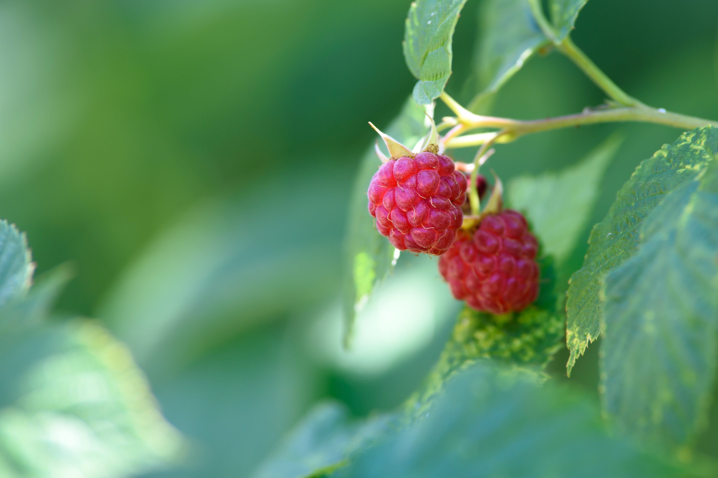
Antioxidants
Molecules that fight free radicals
Prevent or delay cell damage
Helpful in preventing disease
Vitamin C and E
Notes:
Antioxidants protect from excessive free radicals which are defined as unstable molecules that damage DNA and cells, they are linked to diabetes, heart disease and cancer. Can anyone share some examples of free radicals?
[Facilitator note: if no one knows- examples of excessive free radicals are air pollution, cigarette smoke, alcohol, high blood sugar levels, infections, toxins.]
Your body has its own antioxidants to fight free radicals and additional antioxidants in foods are needed to balance the level of free radicals: Vitamins C and E are effective antioxidants.
Vitamin C is the water-soluble antioxidant that plays a vital role in healing wounds. Vitamin C regenerates other antioxidants within the body and might help prevent or delay the development of certain cancers, cardiovascular disease, and other diseases. As you probably already know, Vitamin C plays an important role in immune function.
Vitamin E, fat-soluble is important to vision, reproduction, and the health of your blood, brain and skin. Most people can get enough Vitamin E from the foods they eat. If you do take supplements, they may not give you the same antioxidant properties, so it is still a good idea to focus on eating food rich with antioxidants.
Vitamins, minerals and antioxidants are vital for all functions of our body and the best place to start is by eating nutrient-rich foods.
References:
Mayo Clinic Staff (2020) Vitamin E
https://www.mayoclinic.org/drugs-supplements-vitamin-e/art-20364144
Vitamin C Fact Sheet for Health Professionals (2021)
https://ods.od.nih.gov/factsheets/VitaminC-HealthProfessional/
Arnarson, Atli BSc, PhD (2019) Antioxidants in Foods
https://www.healthline.com/nutrition/antioxidants-explained#food-sources

Slide 11

Nutrient-rich Foods
High in vitamins, minerals, antioxidants and healthy fats
Notes:
These foods have a combination of important vitamins, minerals, antioxidants and healthy fats.
As we go through these foods, use the worksheet, to take notes and add ways to include them in your nutrition plan.

Slide 12
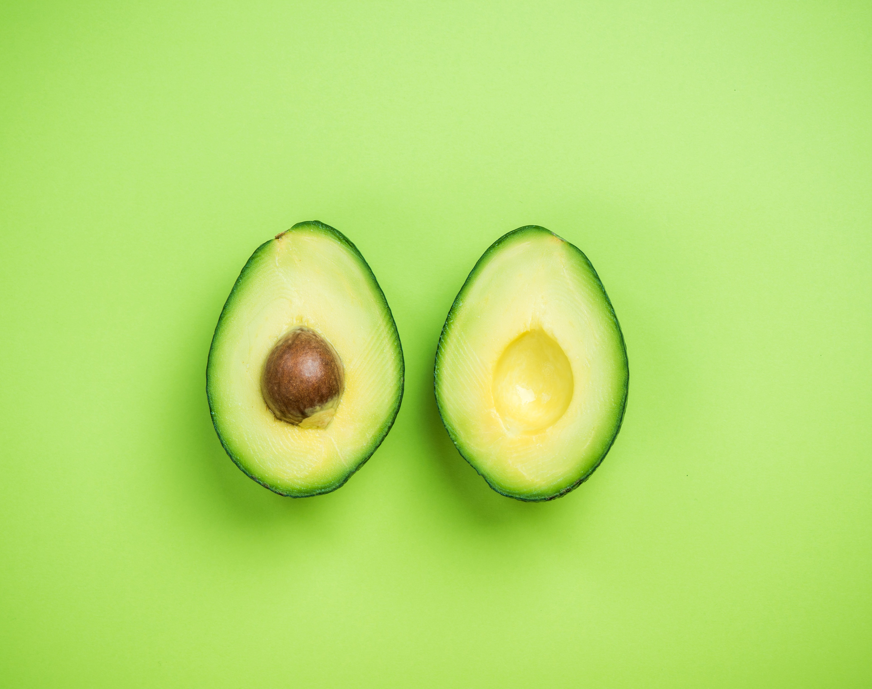
Avocados
Vitamin C, E and K
Potassium and magnesium
Omega-3 fatty acids
Notes:
Avocados contain Vitamins E, C, K, and potassium and magnesium. Most people think bananas are the best food for potassium, but avocados have more potassium than a banana.
Avocados provide Omega-3 fatty acids, which are the “healthy fats” and can help reduce inflammation in the body, decrease joint pain and lower heart disease risk factors, such as high cholesterol and high blood pressure. Omega-3’s also have a positive impact on sleep, mental health and cognitive function including lowering the risk of depression and dementia.
Who likes avocado? Anyone want to share their favorite way to eat it or a recipe?
If you don’t like avocado, olive oil is another great source of omega-3 fatty acids and vitamin E. It is commonly used in salad dressings; another simple way is to drizzle it on toast and add some tomatoes. As you can see there are several reasons to include these healthy fats in your nutrition plan. Let’s discuss one more.
Reference:
Marchione, Victor MD (2015) Top 10 Superfoods for People Over 50 Doctors Health Press
https://www.doctorshealthpress.com/food-and-nutrition-articles/superfoods-for-seniors/

Slide 13
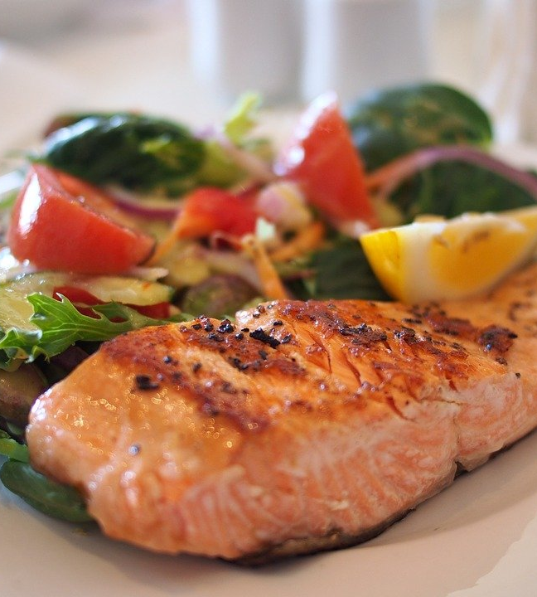
Fatty Fish
Salmon, cod, tuna and sardines
Vitamin B12 and D
Calcium, magnesium and potassium
Omega-3 Fatty Acids
Notes:
Fatty fish! Salmon, cod, tuna and sardines are great sources of vitamins B12 and D and also include calcium, magnesium and potassium, which are the 3 minerals we discussed. These fatty fishes are also full of protein and omega 3s. The American Heart Association recommends 2 servings of 3½ ounces of fatty fish per week which is about the size of a deck of cards.
A healthy side with your fish is greens, lets review the ones with the most nutrients.
References:
Marchione, Victor MD (2015) Top 10 Superfoods for People Over 50 Doctors Health Press
https://www.doctorshealthpress.com/food-and-nutrition-articles/superfoods-for-seniors/
Leech, Joe MS (2019) 11 Evidence-Based Health Benefits of Eating Fish Healthline
https://www.healthline.com/nutrition/11-health-benefits-of-fish#TOC_TITLE_HDR_2

Slide 14
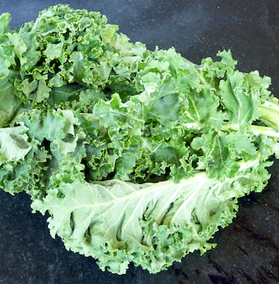
Dark Leafy Greens
Spinach, swiss chard, arugula and collard greens
Vitamins A, B, C, E, and K
Calcium, magnesium and potassium
Fiber
This Photo by Unknown Author is licensed under CC BY
Notes:
Another nutrient-dense food is dark, leafy greens. Dark green, leafy lettuces are always a better alternative to their lighter-colored greens such as iceberg lettuce. The most popular varieties of dark, leafy greens include spinach, Swiss chard, arugula and collard greens.
Dark greens are full of nutrients, vitamins A, B, C, E and K along with calcium, magnesium and potassium. Magnesium and calcium promote many functions to support our health. To review again, they work in the body to help maintain normal muscle and nerve function, keep heart rhythm steady, support a healthy immune system, regulate blood sugar and keep bones strong.
The researchers found that people who ate one serving, which is one cup raw or a ½ cup cooked, of leafy greens per day appeared 11 years younger in terms of their cognitive health when compared with those who rarely or never consumed green leafy vegetables. Results showed that those who ate greens could think more clearly, remember details and names better, had less brain fog, and were more productive every day.
Leafy greens also add fiber into the diet. They relieve constipation and may prevent diverticular disease, a condition where small pouches in the colon wall are inflamed and infected, which affects 50% of Americans over 50.
What is your daily go-to way of including dark leafy greens in your diet? Next, we’ll talk about a simple go-to.
References:
Human Longevity Project <watch@humanlongevityfilm.com>
Yan, Lin (2013) Dark Green Leafy Vegetables
https://www.ars.usda.gov/plains-area/gfnd/gfhnrc/docs/news-2013/dark-green-leafy-vegetables/
Raman, Ryan, MD RD (2017) How Your Nutritional Needs Change as You Age Healthline
https://www.healthline.com/nutrition/nutritional-needs-and-aging#You-May-Benefit-From-More-Fiber

Slide 15
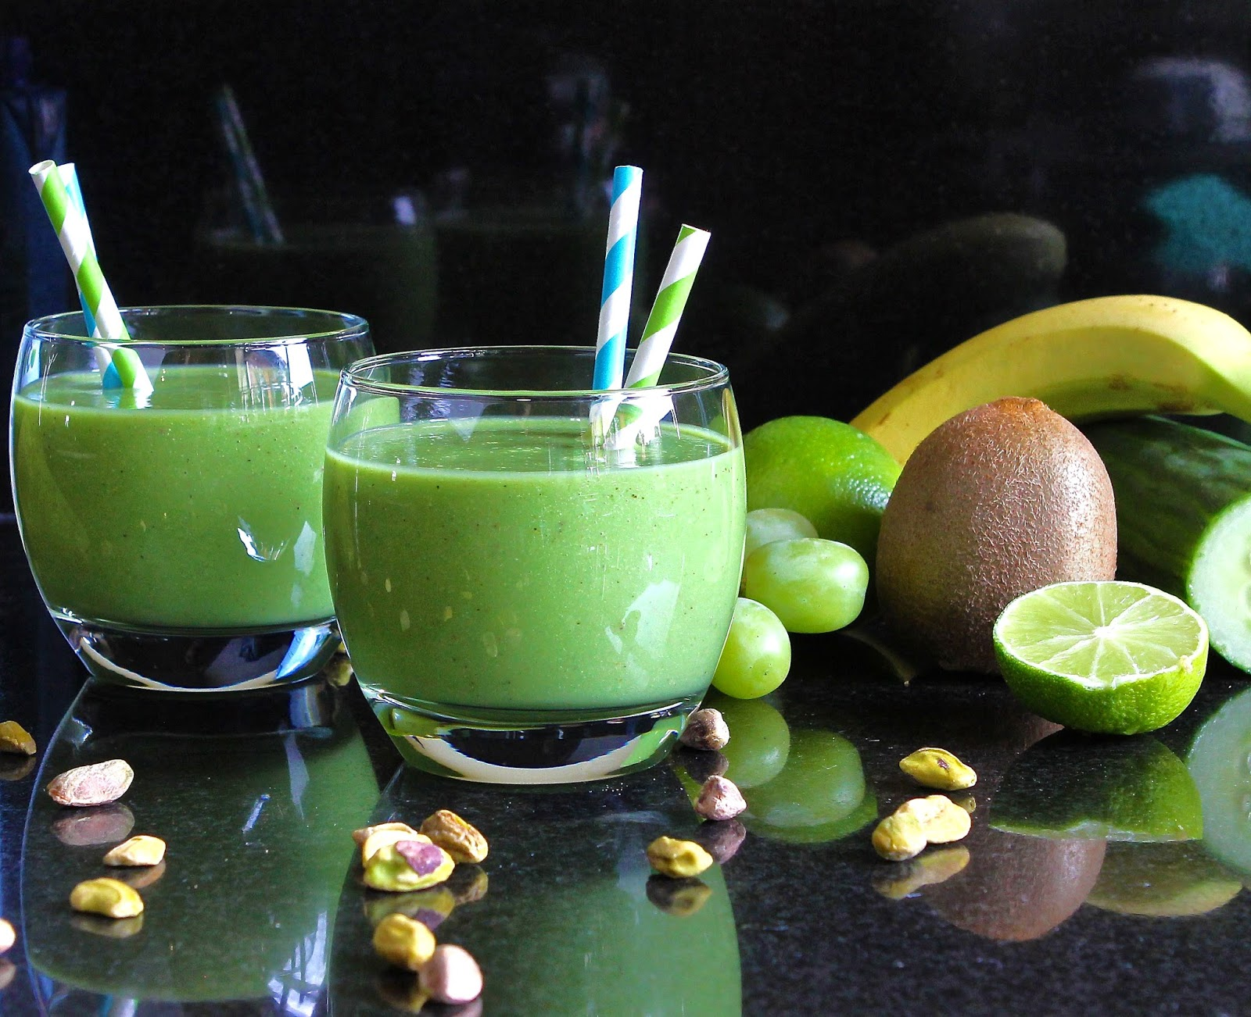
Smoothie Break
This Photo by Unknown Author is licensed under CC BY-NC-ND
Notes:
Smoothie break!
[Facilitator note: Prepare ahead of time with the dining team or make it together with a demonstration.]
Serves: 2
Ingredients
1/2 cup unsweetened almond milk, or water1/4 cup raw oats, (choose certified gluten free oats if you need to) 2 cups baby spinach 1/2 ripe, Fresh California Avocado, seeded, peeled, and cut into quarters 1 kiwi, ripe, peeled 1 cup green grapes 4 ice cubes agave syrup, or honey, optional, to taste
Instructions
In the order listed, add all ingredients, except the sweetener, into a high-speed blender and blend until smooth and creamy. Taste and then blend in a little agave syrup or honey if you prefer a sweeter smoothie.
Serving Suggestion: Top with slices of avocado, kiwi, a drizzle of honey, and fresh mint leaves.
Reference:
https://californiaavocado.com/recipe/greens-and-grains-superfood-smoothie/

Slide 16
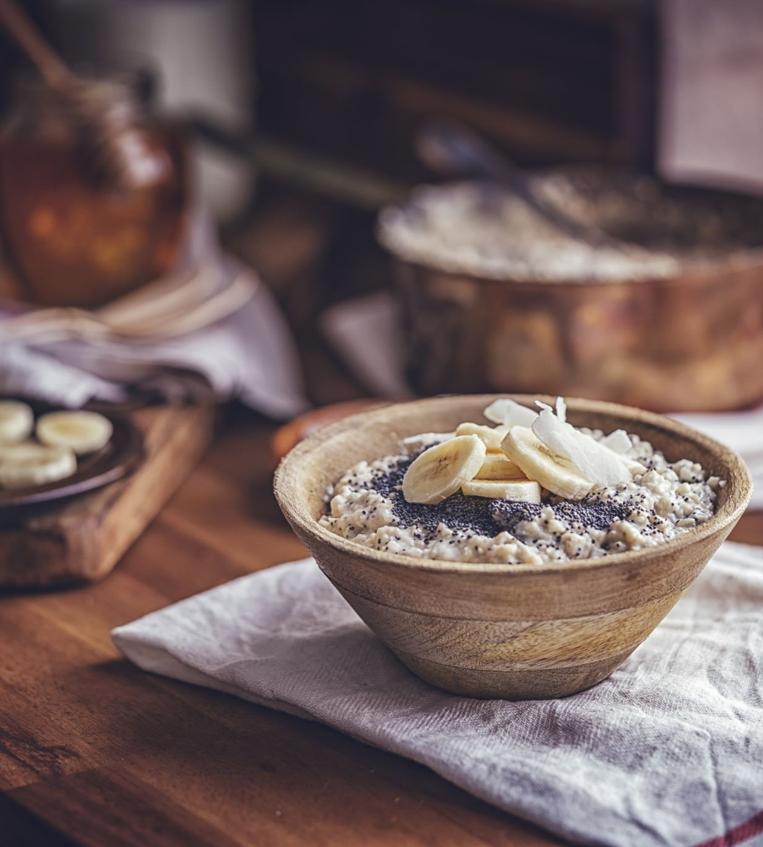
Seeds
Flax, chia, sesame, sunflower and pumpkin seeds
Antioxidants
Magnesium
Omega-3 fatty acids
Fiber and Protein
Notes:
Another great nutrient to put in smoothies is seeds. Seeds contain antioxidants and high levels of magnesium. Remember that magnesium plays a crucial role in 300 functions in our bodies. It keeps the heart healthy and the immune system and bones strong. Seeds also include omega 3’s, fiber and protein.
Flaxseeds have been considered the best plant-based source of Omega-3 fatty acids. It’s always best to grind flaxseeds with a coffee grinder before consumption or to purchase pre-grounded flaxseed to get the most heath benefit.
Other seeds can also provide a valuable source of nutrients too including sesame seeds, pumpkin seeds, and sunflower seeds. Sunflower seeds are good for mental function. Pumpkin seeds (also called pepitas) and sesame seeds can help complement healthy bones and joints. You can consume pumpkin seeds with or with out the shell.
What is a new way you want to add seeds to your day?
Adding seeds to oatmeal is another way to eat seeds. Oats and other grains are also on this nutrient-rich food list.
References:
https://aging.com/elderly-nutrition-101-10-foods-to-keep-you-healthy/
Marchione, Victor MD (2015) Top 10 Superfoods for People Over 50 Doctors Health Press
https://www.doctorshealthpress.com/food-and-nutrition-articles/superfoods-for-seniors/
https://www.heart.org/en/news/2018/10/25/pumpkin-seeds-pack-a-healthy-punch

Slide 17
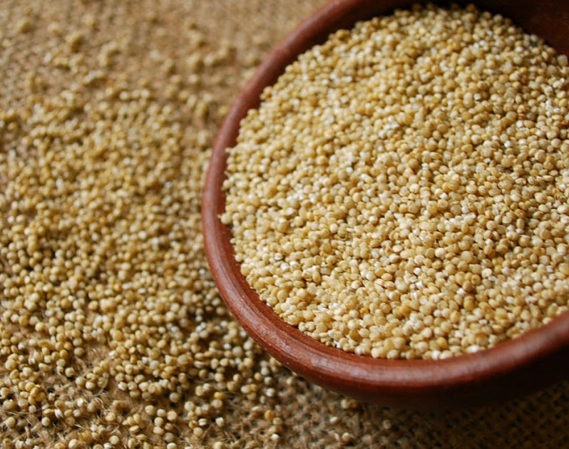
Ancient Grains
Quinoa, buckwheat, millet, farro and whole grain oats.
Protein
B Vitamins
Calcium, magnesium and potassium
Antioxidants
Fiber
This Photo by Unknown Author is licensed under CC BY-SA
Notes:
Keeping in line with “eating like our ancestors” another food that contributes healthy nutrition is ancient grains, such as quinoa, buckwheat, millet, farro and whole grain oats. Ancient grains haven’t been modified or changed for several hundred years and are more nutritious than modern grains.
They are high in plant-based protein, and most are gluten-free. In addition to protein, they contain significant levels of B vitamins, calcium, magnesium, potassium, antioxidants and fiber!
A fun fact about quinoa (pronounced Keen-Wa) and buckwheat is that even though they look and are eaten like a grain, they are actually seeds.
Quinoa is a food that is somewhat new to the North American diet. It originated with the Incas over 5,000 years ago.
The great news, is that these ancient grains come in different forms from pancake mix to pasta. What have you tried? What is your favorite way to eat them?
References:
Marchione, Victor MD (2015) Top 10 Superfoods for People Over 50 Doctors Health Press
https://www.doctorshealthpress.com/food-and-nutrition-articles/superfoods-for-seniors/
Palsdottir, Hrefna MS (2016) 9 Health Benefits of Eating Oats and Oatmeal Healthline
https://www.healthline.com/nutrition/9-benefits-oats-oatmeal#:~:text=Oats%20are%20a%20whole-grain%20food%2C%20known%20scientifically%20as,time%20to%20cook%2C%20the%20texture%20may%20be%20mushy.
Largeman-Roth, Frances, RDN (2015) Why Are We Obsessed With Ancient Grains?
https://health.usnews.com/health-news/blogs/eat-run/2015/01/20/why-are-we-obsessed-with-ancient-grains

Slide 18
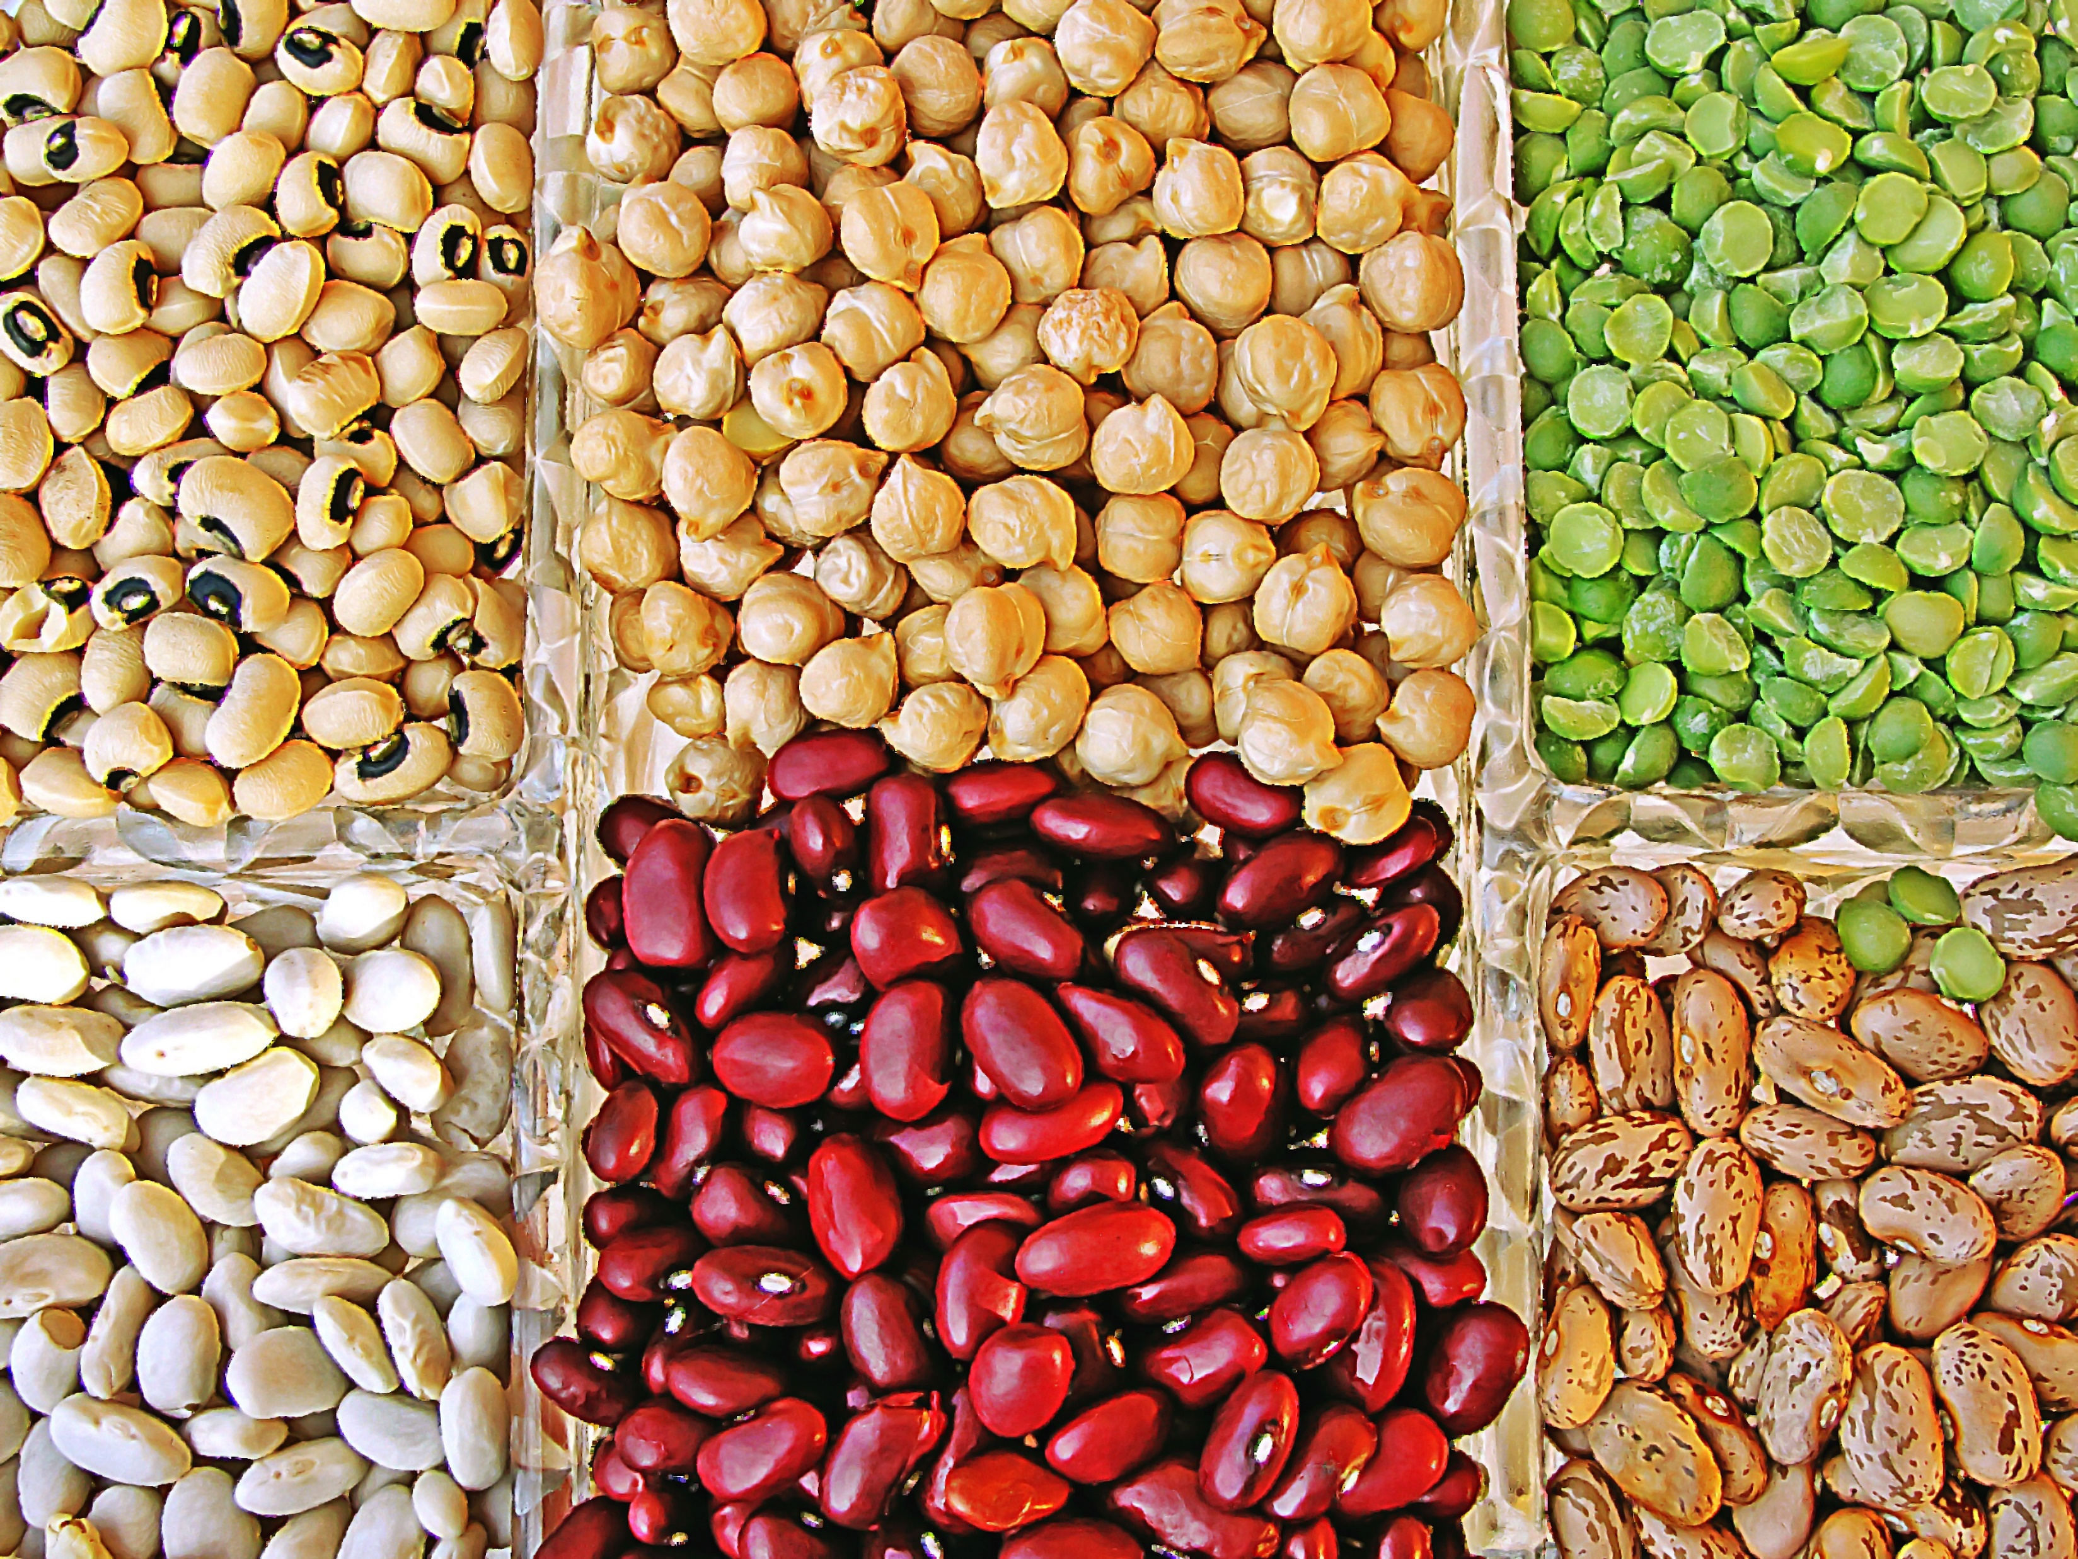
Legumes
Lentils, beans, chickpeas, and peas
Vitamin B12 and other Bs
Calcium, magnesium and potassium
Protein
Fiber
Notes:
Large studies have shown the importance of legumes to wellbeing, showing strong evidence for longevity with regular intake of legumes. A study of the oldest people in several developed countries, including Japan, Sweden, Australia and Greece found that eating legumes was the single strongest predictor of survival. Research shows that people consuming one serving of beans per day were associated with a 38% reduced risk of heart attack, compared to those eating beans less than once per month.
Lentils, beans, chickpeas, and peas are considered legumes and contain Vitamin B, important minerals, protein and fiber.
Legumes are anti-inflammatory. Chronic inflammation to has been linked to the onset and progression of many types of disease, including diabetes, cancer, cardiovascular diseases, arthritis, inflammatory bowel disease and obesity.
Here is a short video on one of Blue Zones, Costa Rica where beans are a staple.
References:
Gellman, Abbie MS, RDN, CDN (2019) An Anti-Inflammatory Diet: What To Eat and Why it Matters American Fitness Magazine
https://blog.nasm.org/an-anti-inflammatory-diet-what-to-eat-why-it-matters
Diler Freuman, Tamara (2019) Why You Should Love Legumes
https://health.usnews.com/health-news/blogs/eat-run/articles/why-you-should-love-legumes

Slide 19

Notes:
[Facilitator note: After showing the video, ask a few discussion questions.]
What was your takeaway from the video? What surprised you?
References:
https://www.youtube.com/watch?v=V8Opil6j-ac

Slide 20
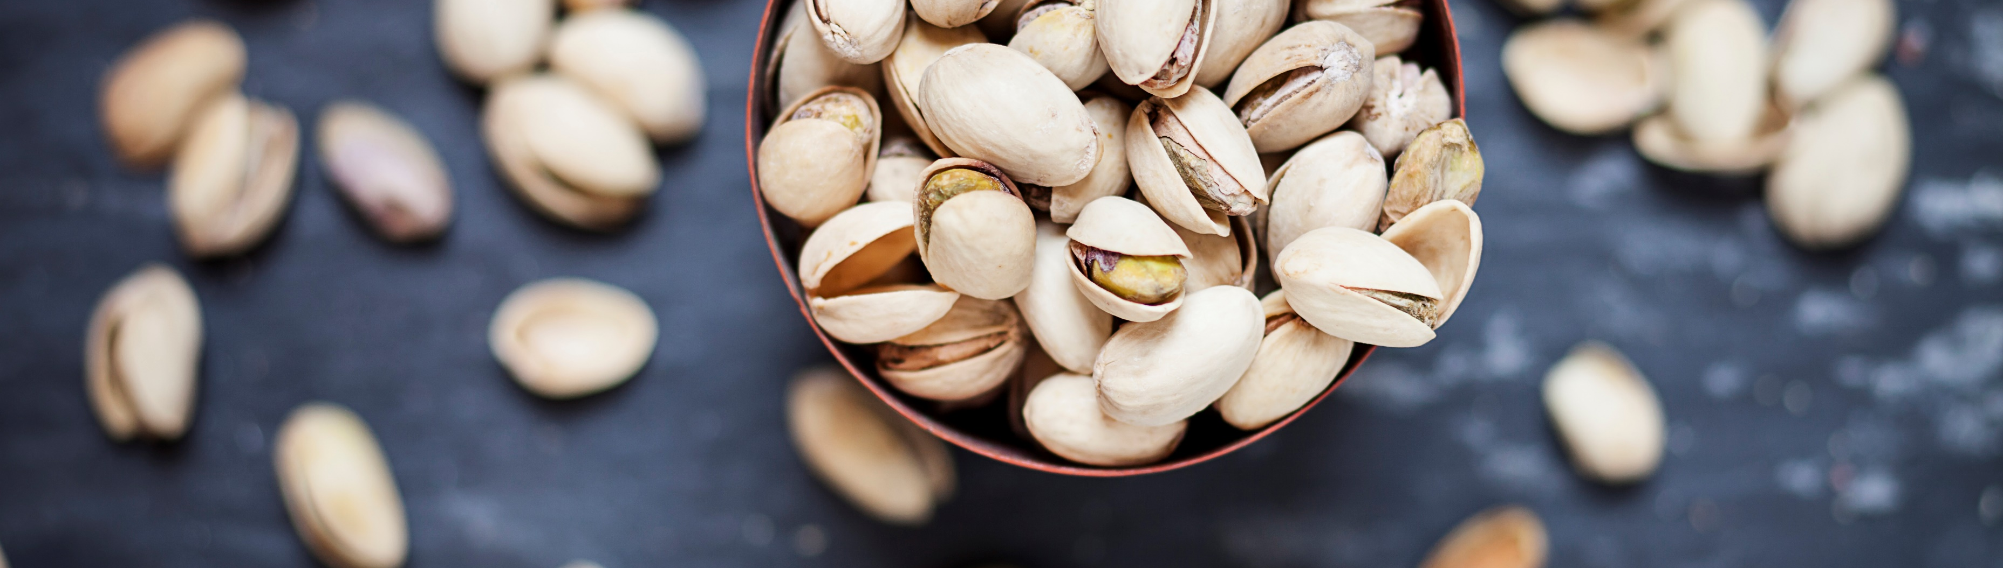
Nuts
Omega-3 fatty acids
Vitamin E
Magnesium
Protein
Fiber
Almonds, walnuts, pistachios and cashews
Notes:
Almonds, walnuts, and cashews are great choices as nutrient-rich foods for older adults. They are excellent sources of the omega-3 fatty acids, vitamin E and magnesium that promote heart and bone health. They also contain protein and fiber. In a study of Japanese men and women, eating ¼ cup to ⅓ cup of walnuts per day lowered “bad” cholesterol by as much as 10%.
Another study found that eating similarly to a Mediterranean diet, plus 30 grams of nuts per day, decreased the prevalence of metabolic syndrome, which is a clustering of at least three of the following five medical conditions: abdominal obesity, high blood pressure, high blood sugar, high serum triglycerides, and low serum high-density lipoprotein (HDL). Metabolic syndrome is associated with the risk of developing cardiovascular disease and type 2 diabetes.
So, what is 30 grams? 20 almonds, 10 walnuts, 15 cashews and 30 pistachios
Fun fact: almonds are a seed from the almond fruit. Similar to almonds, walnuts and pistachios are not considered nuts either because they grow fleshy, leathery exteriors instead of hard shells. However, because we already know them as a nut, we will keep them in this category.
References:
Strutner, Suzy (2016) FYI, Almonds Are Not Nuts. And Neither Are A Lot of Other ‘Nuts’. Huffpost
https://www.huffpost.com/entry/almonds-are-not-nuts_n_582b536be4b0aa8910bd21be
Robertson, Ruairi PhD (2018) The Top 9 Nuts to Eat for Better Health Healthline
https://www.healthline.com/nutrition/9-healthy-nuts#TOC_TITLE_HDR_3

Slide 21
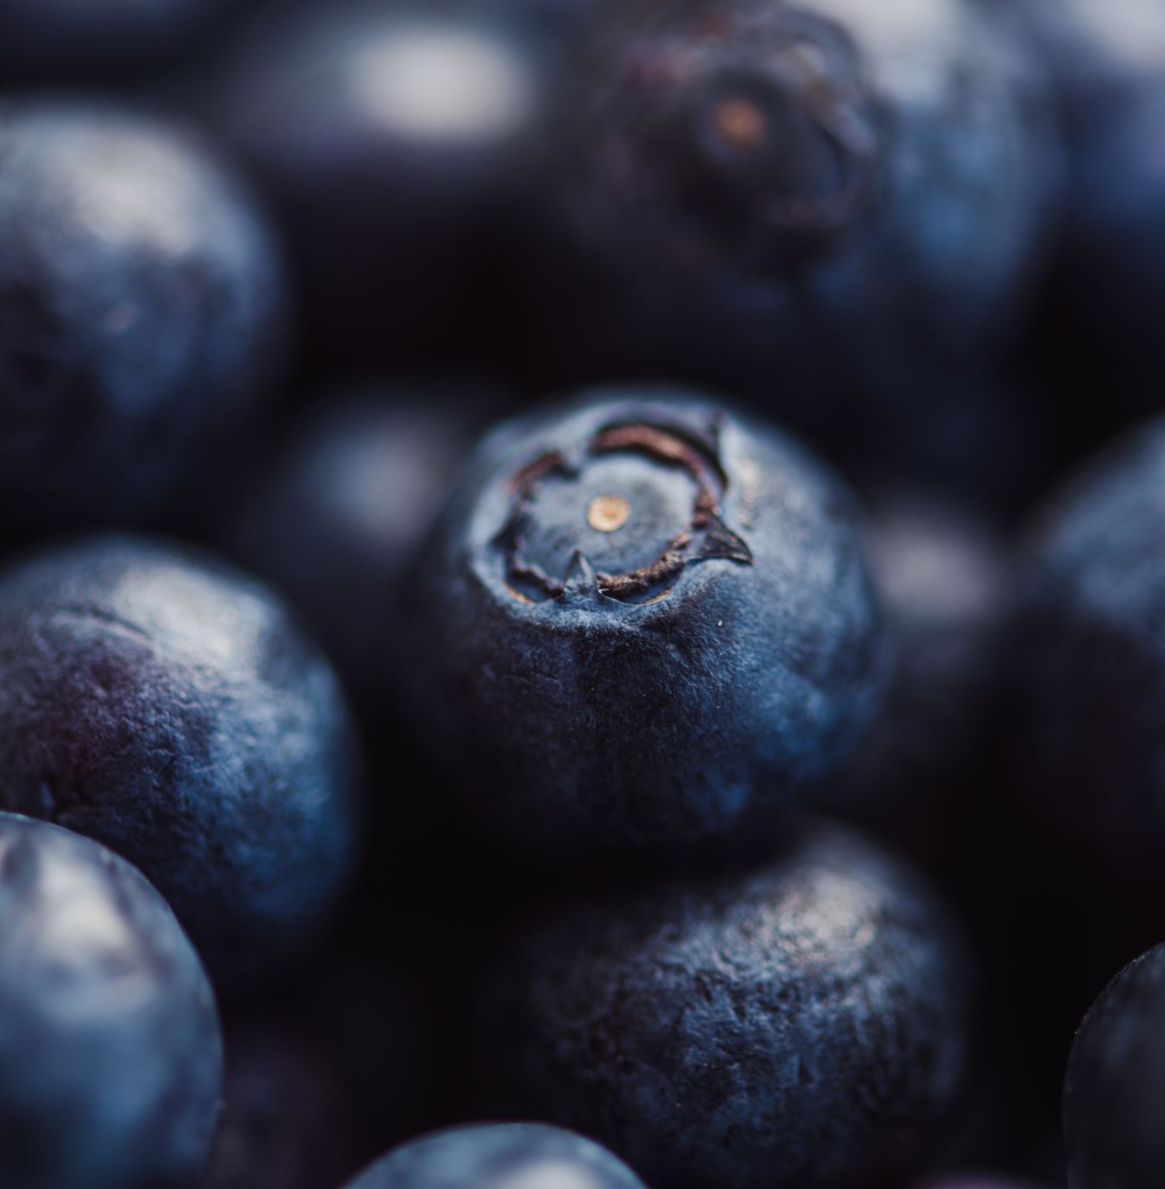
Fruit
01
High in antioxidants
Blueberries
02
Apples
03
Mangos
Notes:
Does anyone know what Native Americans call blueberries? The answer is “star berries” because the blossom at the end of the berries looks like a five-pointed star. Blueberries are the most antioxidant-rich of 40 fruits and vegetables studied. Blueberries effectively fight disease and help maintain heart health. But if you don’t like blueberries, don’t worry, other berries and grapes are also high in antioxidants and fiber.
Apples have many health benefits. They contain potassium and several antioxidants including one that supports neuron health. Another health benefit of apples is that they contain fiber which helps lower cholesterol and blood sugar levels. ​
​
Mangos have been named the most widely consumed fruit in the world. One cup has 100% of your daily requirement of Vitamin C, and 35% of the required Vitamin A. Those vitamins alone help improve immunity as well as vision. ​A specific antioxidant found in mangos, filters out harmful blue light rays and is thought to play a protective role in eye health and possibly decrease the risk of and progression of age-related macular degeneration. ​
​
References:​
Robertson, Ruairi PhD (2020) The 8 Healthiest Berries You Can Eat Healthline
https://www.healthline.com/nutrition/8-healthy-berries
Ware, M., RD, LD. (2017, August 22). Everything you need to know about mangoes. Medical News Today. Retrieved from https://www.medicalnewstoday.com/articles/275921.php ​

Slide 22
“
The cool thing about superfoods is that they’re basically pre-made combinations of synergistic nutrients – Liz Wolfe
“
Notes:
This quote sums up what we’ve learned in this course on nutrient-rich foods which some people call “superfoods”. “The cool thing about superfoods is that they’re basically pre-made combinations of synergistic nutrients.” Liz Wolfe. Liz is a nutritional Therapy Practitioner and best-selling author.

Slide 23

Kaizen
Step
Notes:
In you packet are a few questions to think about how you want to incorporate some of these powerful foods. Variety is key! Remember, next steps are most successful when they are small and simple. I will give you a few minutes to discuss or self-reflect about one small step you can take to positively add to your nutrition.

Slide 24
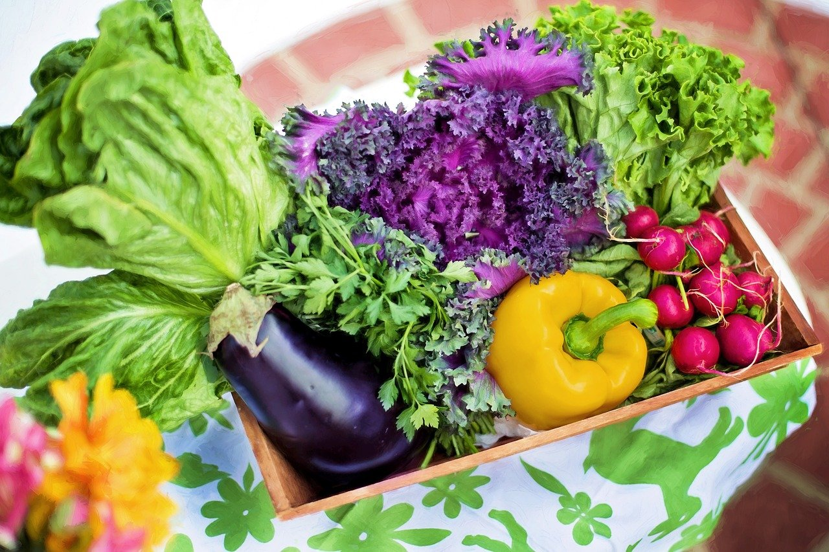
Coming Up Next
1
2
3
Discover the Importance of Water
Identify the Challenges of Staying Hydrated With Aging
Determine the Foods with the Highest Water Content
Notes:
Please join us for the 5th course, where will discuss the benefits and importance of water, hydration changing with age, and more nutrient-rich foods that are high in water content.

Slide 25
Upcoming Event
Logo Company

