Slide 1
Session 2
Copyright © 2018 by Masterpiece Living, LLC
All rights reserved. No part of this program may be reproduced or transmitted in any form or by any means, electronic or mechanical, including photocopying, recording or by any information storage and retrieval system, without the written permission of Masterpiece Living, LLC except where permitted by law. For information address: 11360 N Jog Road, Suite 102, Palm Beach Gardens, FL 33418.
Notes:
Welcome to the second session of Inspire, a spirituality exploration program by Masterpiece Living.

Slide 2
Last session...
Spirituality Overview:
Definition
Spirituality and health
Spiritual practice
Spirituality Theme:
Mindfulness
Notes:
Last session, we explored the topic of spirituality and defined what it means to be spiritual. We discussed that Masterpiece Living broadly defines spiritual fulfillment as our search for purpose and meaning. More specifically, it includes having a meaningful role and being engaged in productive pursuits. Spirituality also helps us to cope with worries, concerns and grief. Spiritual activities include, but are not limited to, religious and faith-based involvement, volunteerism or service, hobbies and appreciation of nature or surroundings.
We then discussed the magnificent benefits of spirituality on health. Some of these benefits include better overall health; a greater sense of happiness; better relationships; less stress/more peace; a greater sense of purpose, optimism and hope; a longer lifespan; compassion and kindness to others; connectedness to a higher power and a greater acceptance of life changes. We also discussed the endless ways in which a person or group of people can practice spirituality.
Along with the discussion of spirituality, we explored the theme of mindfulness. As a quick reminder, mindfulness is about being present in the moment – being keenly aware and without judgment. Then, we experienced a few mindfulness exercises to practice this theme of spirituality.
Discussion: What did you notice as you practiced mindfulness during the time since we last met? Was being mindful easier or more challenging than you expected? In what ways do you think mindfulness practices help us to better appreciate our surroundings? How does mindfulness relate to spirituality for you?
(Gall, Charbonneau, Clarke, & Karen Grant, 2005)
(Levin, 2001)
(Mayo Clinic Staff, 2009)
(Mayo Clinic Staff, 2010)
(Mayo Clinic Staff, 2011)
(Pace, et al., 2009)
(Seeman, Dubin, & Seeman, 2003)

Slide 3
Today…
Spirituality Themes:
Mindfulness
Peacefulness
Compassion
Acceptance
Purpose
Notes:
Today, we are going to explore the theme of peacefulness. We will also experience peacefulness through a few guided exercises. Before we do this, let’s take a quick moment to review our program guidelines.

Slide 4
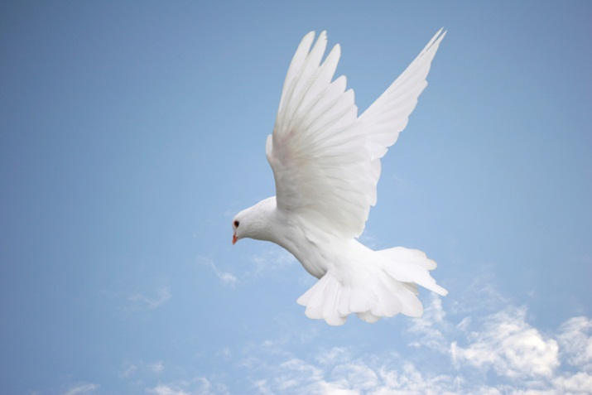
A Friendly Reminder…
Be respectful of other people’s opinions.
Share without imposing your beliefs onto others.
Keep an open mind and open heart.
Notes:
As we discussed last session, our group has agreed to adopt the following guidelines throughout our spiritual exploration. These guidelines include:
Be Respectful: Each person in this room comes from a different background which has formulated who they are as a person and contributed to their unique opinions. As a group, we will observe respect as a guiding principle as we interact, dialogue, experience and discuss. It is our goal that all participants feel equally valued, respected and heard.
Share without imposing your beliefs on others: As we’ve mentioned, spirituality is unique to each individual. We invite all participants to share their beliefs as they feel comfortable. We also ask that each person take responsibility for their own opinions and agree to refrain from convincing others to adopt their personal opinion.
Keep an open mind and open heart: The purpose of this program is to explore spirituality in a supportive, enriched, and experiential setting. We kindly ask that all participants adopt an open mind and heart as we discuss spirituality and spiritual practices. It is possible that you may not connect to every exercise we experience together. However, because spirituality is a broad topic, we’ve purposely compiled a diverse grouping of exercises and activities to give us all the opportunity to enjoy this process together. By doing so, we hope to have a lot of fun along the way!
It is also important that this is a ‘safe space’ in which all participants feel comfortable to share and express themselves. We hope to have rich discussions and value participation from each member of the group. Likewise, if something is said that you find offensive, we hope to have created an environment in which people feel comfortable expressing so. While we hope this does not occur, we’d prefer to respectfully discuss it as a group rather than leave a person feeling uncomfortable or upset. The nature of this program is for us to grow and experience various expressions of spirituality together.
Now, that we’ve reviewed our guidelines, let’s move to the spiritual theme of peacefulness.

Slide 5
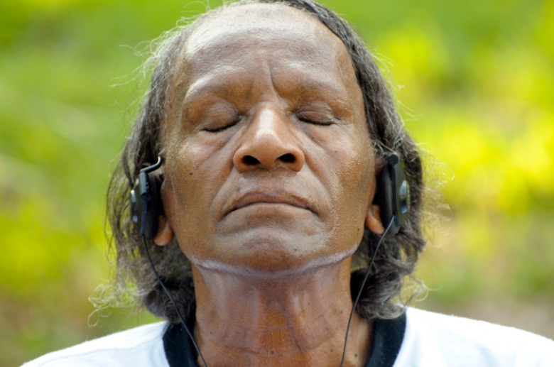
Spirituality Exploration: Peacefulness
Peace·ful: untroubled by conflict, agitation, or commotion; quiet, tranquil
Notes:
Peacefulness is a main theme of spirituality.
So, what does it mean to be peaceful?
Peacefulness can be defined as a state of being that is untroubled by conflict, agitation or commotion and the experiencing of quietness and tranquility. Others may attribute the experience of peacefulness to their religious belief in a higher power. Whether or not this is the case for you, the general concept of peacefulness certainly sounds appealing, doesn’t it?!
(Merriam-Webster, 2012)

Slide 6
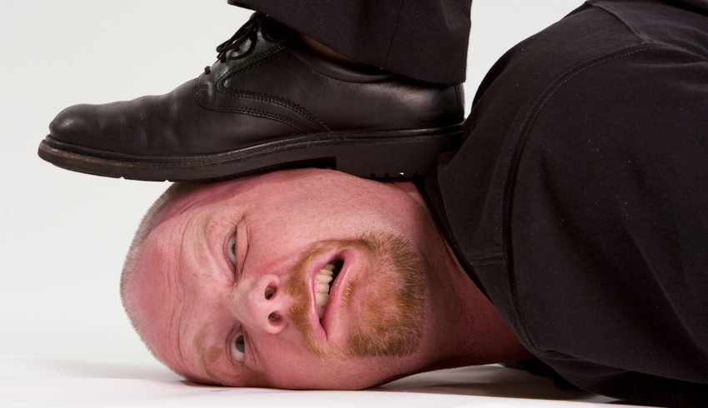
Peacefulness Blockers
Being unable to change a situation or event
Poor health
Conflict with another person
Being “stressed out” by too many responsibilities
Worry
???
Notes:
While there is a certain appeal to being at peace, there are numerous things than can get in the way of feeling an inner sense of peace. Some of those things may include …
[Facilitator: Please read bullet points on slide.]
Discussion: What things have you noticed interrupt or inhibit your experience of peacefulness?

Slide 7
Peacefulness Boosters
Expressing gratitude
Being positive
Finding joy in simple things
Exercising
Being kind to others
Accepting life’s circumstances
???
Notes:
The good news is, despite those real obstacles, there are also many ways we can pursue peacefulness and increase the experience of peace in our everyday lives. What are some ways we can feel happier and more at peace? Some ways we can boost our experience of peacefulness are by…
[Facilitator: Please read bullet points on slide.]
On the topic of gratitude, the research demonstrating the health benefits of gratitude is noteworthy. Specifically, research tells us that a one’s ability to appreciate the positive aspects in life is related to a generally higher level of mental well-being. Additionally, gratitude also plays a big role in a person’s sense of happiness. Those who participate in gratitude exercise/activities report higher levels of alertness, enthusiasm, determination, positivity, energy, and less depression and stress.
Discussion: What things or experiences do you find help to boost your sense of peacefulness? Given the positive impacts on health, how can we increase our sense of gratitude even further?
(Emmons & McCullough, 2003)
(Linehan, 1993)
(Mayo Clinic Staff, 2010)
(Mayo Clinic Staff, 2011)
(Mayo Clinic Staff, 2012)
(McCollough, 2003)
(Monroe, 2012)
(Whitbourne, 2010)

Slide 8
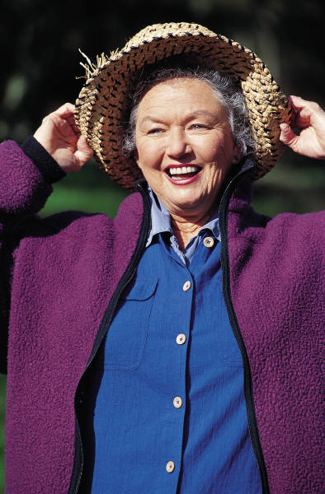
Experiencing Gratitude
“Let us rise up and be thankful, for if we didn't learn a lot today, at least we learned a little, and if we didn't learn a little, at least we didn't get sick, and if we got sick, at least we didn't die; so, let us all be thankful.” ~ Gautama Buddha
Notes:
As we discussed last session, throughout the program we will turn to the thoughts of spiritual leaders from around the world. In thinking about gratitude, we turn for a moment to sentiments from Buddha.
[Facilitator: Please read quote on slide.]

Slide 9
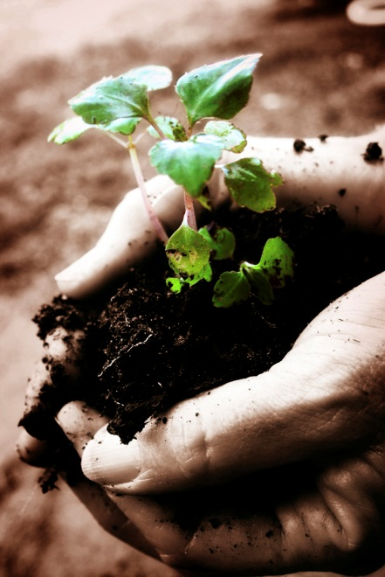
Peacefulness Activities
Stretch, breathe and meditate
Take an aromatherapy bath or get a massage
“Get lost in” an activity: gardening, cooking, an art project, listening to music
Dance, exercise or get active
Connect with nature
Keep a journal
Volunteer
Laugh
Notes:
Stress can also dramatically impact our ability to experience peace. In fact, stress can negatively impact our health. Constant stress in our lives kills brain cells, limits the growth of new brain cells and makes our immune systems weak. Because of this, it is important to find ways to de-stress and therefore create room for a more peaceful mind. Here are just a few ways to unwind:
[Facilitator: Please read bullet points on slide.]
Discussion: In what ways to you manage stress? What do you notice about your ability to experience peace when you are stressed? What other ideas can you share on ways to bring peacefulness into our everyday lives?
(Cearlock & Laude-Flaws, 1997)
(Gandee, Knierim, & McLittle-Marino, 1998)
(Kim & Georgia)
(Mayo Clinic Staff, 2010)

Slide 10
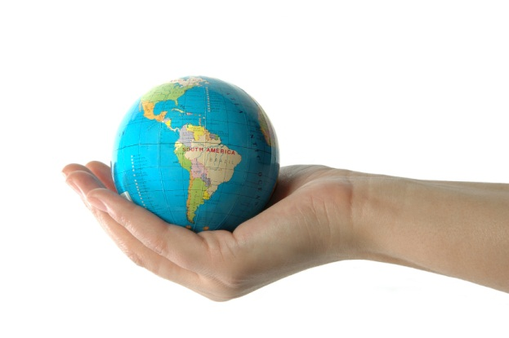
Experiencing Peace
“If you wish to experience peace, provide peace for another.” ~ Dalai Lama
Notes:
In thinking about peace, we turn for a moment to sentiments from the Dalai Lama.
[Facilitator: Please read quote on slide.]

Slide 11
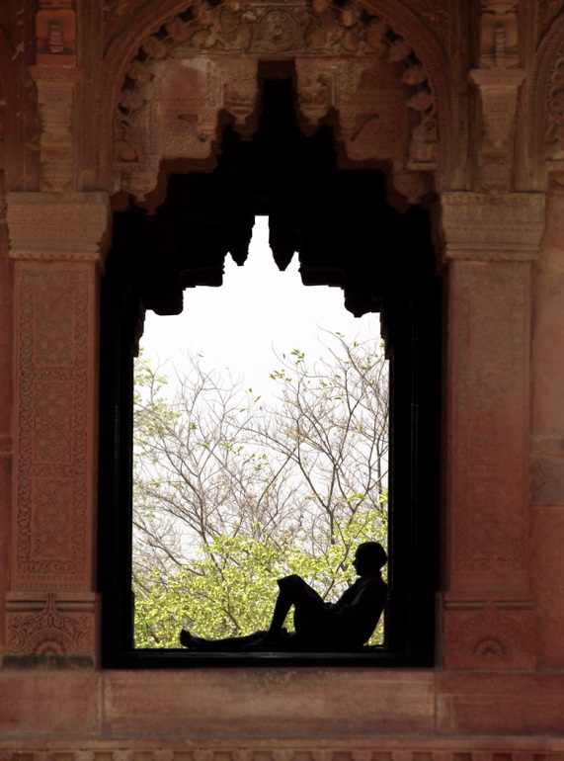
Love and Goodwill
Affirm divine calmness and peace, and send out only thoughts of love and goodwill if you want to live in peace and harmony. ~ Paramahansa Yogananda
Notes:
Another sentiment on peace comes from Paramahansa Yogananda, an Indian yogi, who was a pioneer for yoga and meditation teachings in the western world.
[Facilitator: Please read quote on slide.]
(Paramahansa Yogananda’s Biography , 2012)

Slide 12
Let’s give it a try…
What are you grateful for?
Notes:
With these sentiments in mind, we will now shift our efforts to experience several exercises on this spiritualty theme of peacefulness. Let’s start out by trying one from your Expressions of Spirituality Guidebook.
[Facilitator: Please refer participants to find the “Gratitude List?” page in the Session 2 section on Peacefulness. For the next 5 minutes, ask participants to write down everything in which they are grateful – no matter how small or how silly the item may seem. It can be anything from “a beautiful sunset” to “my friends” or even “herbal tea”. Nothing is too insignificant!]
Discussion: For those who are comfortable with sharing, please list one thing you are grateful for. What is your reaction or feeling after making such a list? Appreciation? Gratitude? Peacefulness? Overwhelming sense of blessing? A feeling of centeredness? How can we incorporate an exercise like this into our everyday lives?

Slide 13
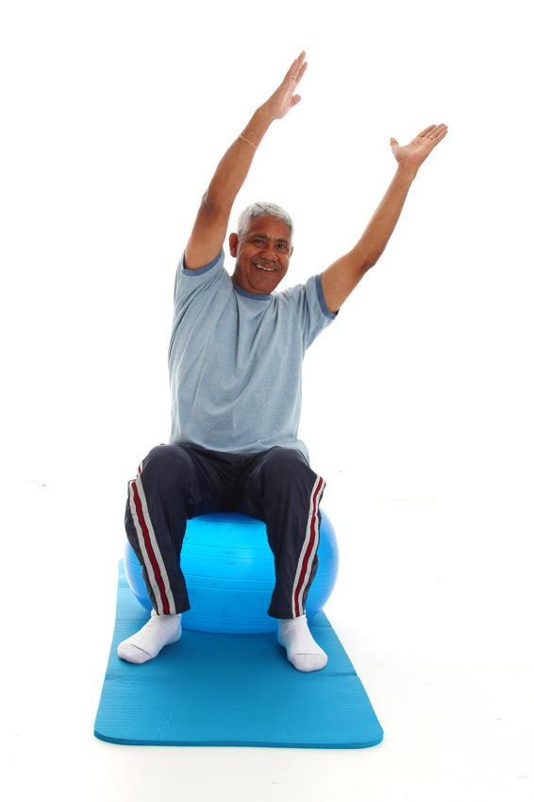
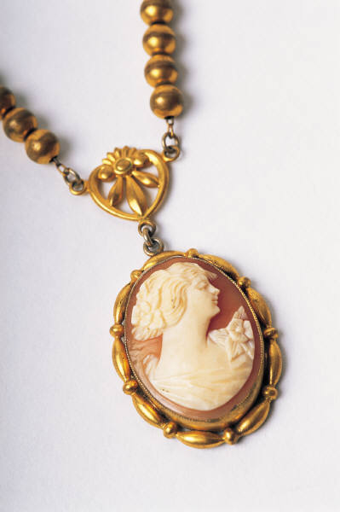
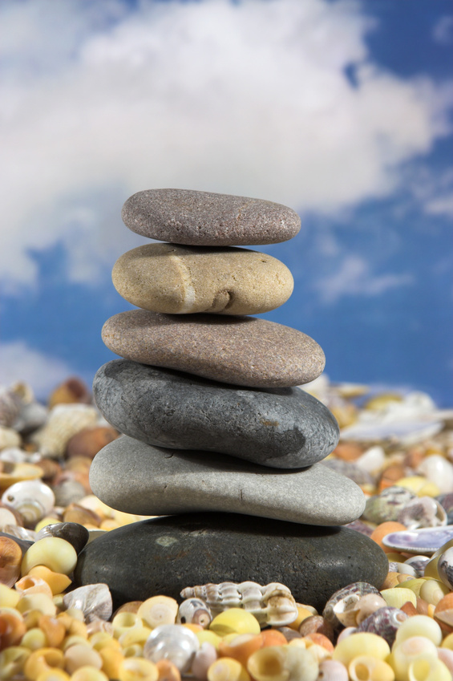
Peacefulness Expressions
Notes:
Continuing with our experience of peacefulness, we have a few more exercises to experience.
[Facilitator: Please use the Peacefulness Prayer and Devotional, Kindness Meditation, Calming Stretch, Family Heirloom and Gratitude Stone exercises to facilitate the peacefulness expressions. Please keep in mind that you can customize the exercises used to meet your scheduling and group desires. Please also refer participants to their Expressions of Spirituality Guidebook to reflect on these spiritual practices until the next session.]
Discussion: [Use the follow-up questions on the Kindness Mediation to facilitate discussion.] Ask participants about their experience of each of the peacefulness exercises. What are they taking away with them? What would they like to remember from today’s discussion and experiences?

Slide 14
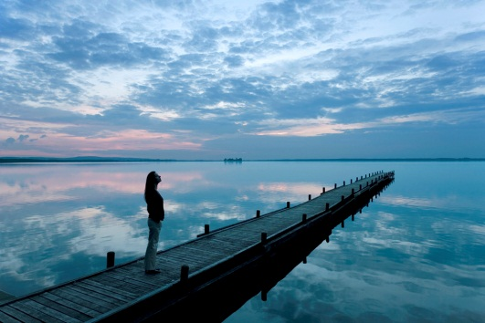
Expressions of Spirituality Guidebook & Next Session
Continue to ponder peacefulness.
Practice, practice, practice.
Notes:
Please remember to refer back to your Expressions of Spirituality Guidebook throughout the week to continue practicing these spiritual expressions. In our next session, we will explore the theme of compassion.
Thank you for your thoughtful participation and discussion as we explored peacefulness today.
Facilitator: Please remind participants to bring their Expressions of Spirituality Guidebook with them to each session. Also, if participants are being encouraged to practice or work on any of the exercises from this session on their own, please be sure to provide any needed directions or information for them to do so (please refer to the Facilitator’s Guidebook for the directions/information specific to each exercise).

