Slide 1


Session 4
Copyright © 2018 by Masterpiece Living, LLC
All rights reserved. No part of this program may be reproduced or transmitted in any form or by any means, electronic or mechanical, including photocopying, recording or by any information storage and retrieval system, without the written permission of Masterpiece Living, LLC except where permitted by law. For information address: 11360 N Jog Road, Suite 102, Palm Beach Gardens, FL 33418.
Notes:
Welcome to the fourth session of Inspire, a spirituality exploration program by Masterpiece Living.

Slide 2

Last session …
Spirituality Theme:
  Compassion
Notes:
Last session, we explored the spiritual theme of compassion.
We defined compassion as having a sympathetic consciousness of distress combined with a desire to help alleviate this distress in some way. In essence, compassion requires us to be able to put ourselves in another person’s shoes, so to speak. Then, we experienced several expressions of compassion to practice that theme of spirituality.
Discussion: What thoughts have you had on the topic of compassion since we last met? What did you notice as you practiced expressions of compassion? How does compassion relate to spirituality for you?
(Merriam-Webster, 2012)

Slide 3
Today …
Spirituality Themes:
  Mindfulness
  Peacefulness
  Compassion
  Acceptance
  Purpose
Notes:
Today, we will explore the theme of acceptance. We will also express acceptance through a few guided exercises. But before we do this, let’s take a quick moment to review our program guidelines.

Slide 4
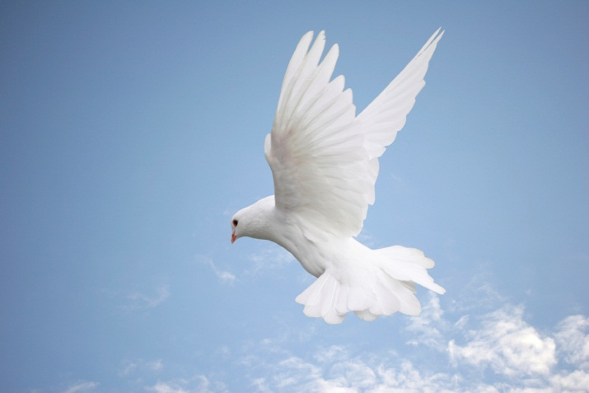
A Friendly Reminder
Be respectful of other people’s opinions.
Share without projecting your beliefs onto others.
Keep an open mind and open heart.
Notes:
While we have reviewed these guidelines each session, today’s topic of acceptance emphasizes the group guidelines we’ve adopted throughout the program. These guidelines include:
Be Respectful: Each person in this room comes from a different background which has formulated who they are as a person and contributed to their unique opinions. As a group, we will observe respect as a guiding principle as we interact, dialogue, experience and discuss. It is our goal that all participants feel equally valued, respected and heard.
Share without imposing your beliefs on others: As we’ve mentioned, spirituality is unique to each individual. We invite all participants to share their beliefs as they feel comfortable. We also ask that each person take responsibility for their own opinions and agree to refrain from convincing others to adopt their personal opinion.
Keep an open mind and open heart: The purpose of this program is to explore spirituality in a supportive, enriched, and experiential setting. We kindly ask that all participants adopt an open mind and heart as we discuss spirituality and spiritual practices. It is possible that you may not connect to every exercise we experience together. However, because spirituality is a broad topic, we’ve purposely compiled a diverse grouping of exercises and activities to give us all the opportunity to enjoy this process together. By doing so, we hope to have a lot of fun along the way!
It is also important that this is a ‘safe space’ in which all participants feel comfortable to share and express themselves. We hope to have rich discussions and value participation from each member of the group. Likewise, if something is said that you find offensive, we hope to have created an environment in which people feel comfortable expressing so. While we hope this does not occur, we’d prefer to respectfully discuss it as a group rather than leave a person feeling uncomfortable or upset. The nature of this program is for us to grow and experience various expressions of spirituality together.
Now, that we’ve reviewed our guidelines, let’s move to the spiritual theme of acceptance.

Slide 5

Spirituality Exploration: Acceptance
ac·cept·ance: the act of taking or receiving something offered; favorable reception; approval; favor
tol·er·ance: a fair, objective, and permissive attitude toward opinions and practices that differ from one's own
Notes:
In our exploration of compassion, we talked about putting ourselves in another person’s shoes. This notion transitions nicely into our next theme of spirituality. Acceptance is one of the main themes of spirituality. Let’s begin by first discussing a few words and definitions that relate to the topic.
Acceptance can be defined as the act of taking or receiving something offered. Acceptance also involves offering favorable reception, approval or granting favor. Another way some may view acceptance is by considering tolerance. Tolerance is defined as having a fair, objective and permissive attitude. The application of a tolerant attitude is expressed toward other people, opinions, and lifestyles especially in cases in which differ from our own.
(Collins English Dictionary - Complete & Unabridged 10th Edition)
(Merriam-Webster, 2012)

Slide 6

Related Terms
u·nique: being the only one; being without like or equal
di·ver·si·ty: the condition of having or being composed of differing elements; variety
Notes:
Here are a few additional terms related to the topic of acceptance.
[Facilitator: Please read terms and definitions on slide.]
Discussion: What images come to mind when you think of acceptance? What do you believe encourages people to adopt acceptance? In what circumstances do you feel people most easily express/adopt acceptance? Conversely, what circumstances are the most challenging in expressing acceptance? In what ways have you been on the receiving end of acceptance?
(Merriam-Webster, 2012)

Slide 7
What makes us unique and diverse?
Personality
Beliefs
Hobbies and interests
Physical features
Gender
Ethnicity
Childhood and upbringing
Life experiences
Personal goals
Personal journey
???
Notes:
In thinking of tolerance, images of controversial topics may come to mind. But for the purposes of today, we really are talking about acceptance. And acceptance can come in all forms – both big and small. As we explore this further, let’s talk about what makes each and every one of us unique. These are the things that contribute to our diversity and uniqueness (and, therefore, specialness) includes many things. Some of these things include …
[Facilitator: Please read bullet points on slide.]
Discussion: What else contributes to making people unique and diverse?

Slide 8

What makes YOU unique?
Notes:
Discussion: What is unique about you?
[Facilitators: Ask participants to share one or two things making them unique.]
Our responses demonstrate that there is great diversity even amongst a group who lives in the same geographical area. Our responses also highlight the many ways our uniqueness makes us special.

Slide 9
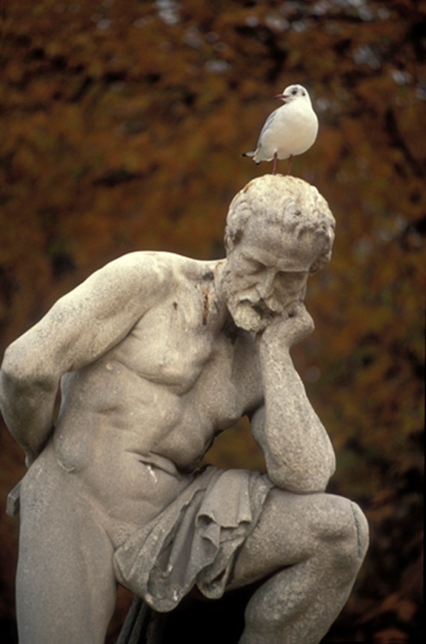
Thoughts on Acceptance
Being “tolerant” and “accepting” does not require agreement
It does require respect
Notes:
Thinking again to this topic of acceptance, we want to remember that being “tolerant” and “accepting” of a person or idea does not necessarily mean we agree with them. We can still be respectful toward another person’s opinion or lifestyle while maintaining our own.

Slide 10
Identifying Acceptance Opportunities
Consider…
Republican, Democrat, Libertarian, Green Party, Independent
Male, Female
Young, Old, Middle-aged
Heterosexual, Gay, Transgendered, Bi-sexual
Muslim, Judaism, Catholicism, Islamic, Wiccan, Buddhist, etc.
Asian, Black, African-American, White (Caucasian), Latino (Hispanic), Native American, Indian, etc.
Overweight, Underweight, Healthy Weight
Employed, Unemployed, Retired
???
Notes:
It’s probable that a person is able to be accepting of other people and opinions in regards to certain topics while other topics are more challenging to accept. Just as we are all unique individuals, the topics which we find easily acceptable versus more challenging are also unique from person-to-person.
Take a moment and test your own tolerance by privately noticing your emotional reaction to the following words in these examples …
[Facilitator: Please read bullet points on slide.]
To benefit from these considerations, we don’t need to verbally share our reactions to these words. But, we can take personal note of the areas in which we may be able to grow in terms of acceptance on an individual basis. It’s also important to take note of the areas in which we feel we’re strong in exhibiting acceptance. Take another moment to consider the circumstances in which allow you to be accepting of these topics. Consider how that knowledge and attitude can be translated to the areas in which you’ve identified as being more difficult for you?

Slide 11

Acceptance Opportunities
Just like me …
… this person has made mistakes
… this person has regrets
… this person has felt pain
… this person has felt sadness
… this person seeks happiness
… this person seeks love
… this person wants to be healthy
… this person wants to feel safe and supported
… this person wants to feel peaceful
… this person is also on a spiritual path
Notes:
Another way we can increase our ability to accept differences is to consider similarities. Remember the “Just Like Me” affirmation from the session on compassion? This affirmation fosters acceptance because it helps us to consider the ways in which we are similar to another person – especially a person with an opposing beliefs, opinions, or lifestyle than our own.
Consider trying this affirmation the next time you are faced with an opportunity to practice acceptance. The affirmation encourages us to repeat some or all of these phrases to ourselves …
[Facilitator: Please read bullet points on slide.]
(Baubata, 2007)
(Glaser, 2007)
(Weigel, 2012)

Slide 12
Acceptance Blockers
prej·u·dice: preconceived judgment or opinion
ster·e·o·type: a set form; convention; a simplified and standardized conception or image invested with special meaning and held in common by members of a group
Notes:
Another way we can boost our acceptance is by identifying the ways that acceptance is hindered. For instance, prejudice is defined as a preconceived judgment. The presence of prejudice can fuel whether we are tolerant or intolerant toward another person or group of people. But where do those preconceived notions come from? Prejudice often stems from stereotypes. A stereotype is defined as an overly simplified image applied to a group of people.
Unfortunately, stereotypes are all around us … in everyday conversation, print materials and media images. For the purposes of a quick example, let’s consider a few gender stereotypes …
Women are too sensitive.
Men are the “breadwinners.”
Girls are better at English and Social Studies.
Boys are better at Math and Science.
Women are bad at sports.
Men can’t cook.
Women love to shop.
Men like to fix cars.
Again, these are examples of stereotypes. Why? Because they are a simplified classification of the roles and talents of men and women. These stereotypes presume many things. Of particular note, these stereotypes presume that ALL women fit into the same category – sensitive and loving to shop. Certainly, we can think of examples to the contrary. Likewise, the stereotypes group men in a way that says ALL men like working on cars and can’t cook. A quick look at the restaurant industry would present many male chefs who can indeed cook. Again, the generalizations are not accurate for ALL people. These examples illustrate the potential dangers and inaccuracies of stereotypes.
Discussion: Can you think of a time it was assumed you couldn’t (or shouldn’t) do something because of your gender? In what other ways do stereotypes exist in our culture? [Facilitator: Potential responses may include: religious, political, sexual orientation, racial, ethnic, career, age, body size.] In what ways can you see stereotypes being dangerous? What are the risks of perpetuating stereotypes?
(Merriam-Webster, 2012)

Slide 13

Acceptance Booster
ac•cept•ance: the act of taking or receiving something offered; favorable reception; approval; favor
I have decided to stick with love. Hate is too great a burden to bear. ~Dr. Martin Luther King Jr.
Notes:
Another important aspect of acceptance relates to accepting things as they are. This notion especially applies in situations or circumstances in which we are not in control. Spiritual leader, Eckart Tolle, tells us that if things are not as we desire, we have essentially three choices. We can work to 1) make changes - either to the situation or in our thinking 2) walk away or 3) come to a place of acceptance.
Being aware of these choices as well as the blockers of acceptance can help us to take our own acceptance to new levels - in which we build even greater acceptance. As we more toward greater acceptance, let’s look again at the definition of acceptance.
Acceptance can be defined as the act of taking or receiving something offered. Acceptance involves offering favorable reception, approval or granting favor.
In thinking about building greater acceptance, we turn to sentiments from Dr. Martin Luther King Jr.
[Facilitator: Please read quote on slide.]
(Merriam-Webster, 2012)
(Tolle, 2009)

Slide 14

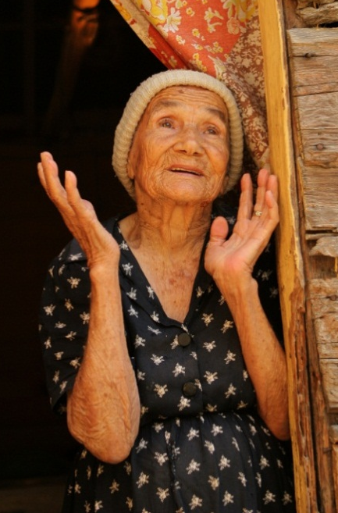


Acceptance Expressions
Notes:
With this in mind, we turn now to our exercises on acceptance. We invite you to keep an open heart and an open mind as we use our Expressions of Spirituality Guidebooks for meditations, prayers and exercises in acceptance.
[Facilitator: Please refer to the Prayers of Acceptance, Drop in the Bucket, Hot Topic, Sharing Traditions and Morning Affirmation exercises to facilitate the acceptance expressions. Please keep in mind that you can customize the exercises used to meet your scheduling and group desires. Please also refer participants to their Expressions of Spirituality Guidebook to reflect on and practice these spiritual expressions until the next session.]
Discussion: Ask participants about their experience of each of the acceptance exercises. What are they taking away with them? How can we increase our own experience and expression of acceptance? How can we support others in doing so as well?

Slide 15
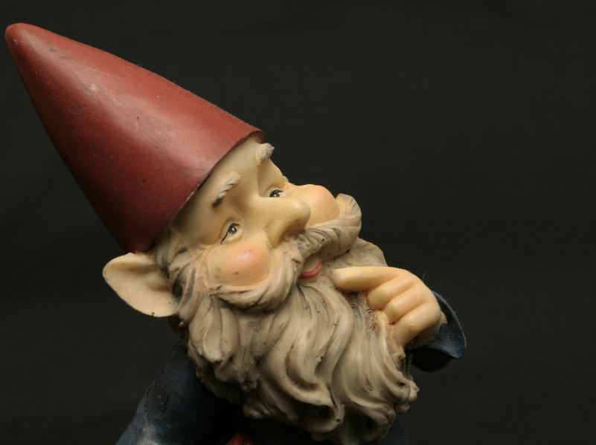
Expressions of Spirituality Guidebook &
Next Session
Continue to ponder acceptance
Practice, practice, practice
Notes:
Please remember to refer back to your Expressions of Spirituality Guidebook throughout the week to continue practicing these spiritual expressions.
Thank you for your thoughtful participation and discussion as we explored acceptance today.
Facilitator: Please remind participants to bring their Expressions of Spirituality Guidebook with them to each session. Also, if participants are being encouraged to practice or work on any of the exercises from this session on their own, please be sure to provide any needed directions or information for them to do so (please refer to the Facilitator’s Guidebook for the directions/information specific to each exercise).

