Slide 1
Vertical 360
A Fall Prevention Program
by Masterpiece Living
Notes:
Welcome to Vertical 360, a fall Prevention Program by Masterpiece Living. Vertical 360 is an interactive, six session program that we will experience over the course of the next few [months, weeks, etc.]I am so happy you are here!

Slide 2
A Quick Survey
Notes:
Before we begin our discussion today, please fill out the pre-program survey. This information is helpful to us in guiding our conversations and future programming.

Slide 3
True or False?
Maintaining mobility and preventing falls can only be addressed by the physical component of my lifestyle choices.
Notes:
Before we jump into “What is Vertical 360?”, I have a question for you.
(facilitator: read information on slide)

Slide 4
FALSE!
Notes:
False!

Slide 5
The 360 in Vertical 360
In order to address fall prevention effectively, we need to address our lifestyles holistically, from a 360-degree point of view.
Notes:
In fact, we can maintain our mobility and prevent falls most effectively by addressing our lifestyles holistically, from a 360 degree point of view.

Slide 6
Vertical 360 shows us how four key components of our lifestyle can positively impact our mobility and fall risk.
Notes:
(facilitator: read information on slide)
These four components are known as Masterpiece Living’s SIPS of successful aging. SIPS stands for social, intellectual, physical and spiritual. Now let’s look at how they are each defined.

Slide 7
Social and Intellectual Defined
Notes:
Social Engagement means fostering a wide range of meaningful relationships with family, friends and others. Being socially connected includes giving and receiving social support, as well as contributing one’s skills and talents for the benefit of others. Social connections improve immune function and lower the risks of many chronic conditions.
Intellectual Challenge is comprised of activities that are complex, new and continually challenging in an individual or group setting. Research shows that challenging the brain in new ways and on an ongoing basis can retain and even enhance most mental abilities. Activities such as puzzles, games, computer brain training, learning new languages, dancing and other structured learning activities can help challenge and improve brain function.

Slide 8
Physical and Spiritual Defined
Notes:
Physical Health is the continual growth of physical function. It also includes actions that limit or prevent disease and disability. Aerobic activity, strength, balance, flexibility, nutrition, sleep and taking part in preventive screenings are all keys to physical health. Being active in these areas may help lower risk for heart disease, stroke, diabetes, cancer, osteoporosis, depression, falls and Alzheimer's disease.
Spiritual Fulfillment can be broadly defined as our search for purpose and meaning. More specifically, it includes having a meaningful role and being engaged in productive pursuits. Spirituality also helps to cope with worries, concerns and grief. Spiritual activities include, but are not limited to, religious and faith-based involvement, volunteerism or service, appreciation of nature or surroundings and meaningful pastimes.

Slide 9
Tying it all together.
Notes:
You may be asking yourself the question, “How do all of the SIPS tie into fall prevention”? Not surprisingly, some SIPS are easier to relate to fall prevention than others, but they all matter!
Let’s focus on the social component first. Having social support reduces your risk of falling. Research shows that telling someone about your goals makes you more likely to achieve them! Social support can also help mitigate other risks that lead to falls, such as cognitive decline.
As for Intellectual, maintaining cognitive health is key to fall prevention! Those experiencing dementia are more likely to experience falls. Therefore, constantly challenging your mind is so important!
The physical component has the most obvious benefit to fall prevention. Staying physically active and working to maintain good balance, flexibility, strength, and power greatly reduces fall risk.
The spiritual component of fall prevention may seem the most out of place. Keep in mind, the spiritual component can be different things to different people. For some, physical tasks that prevent falls, like Tai chi and Yoga, may also be spiritually fulfilling. Whereas practicing mindfulness and volunteerism are also ways to reduce falls. Whatever your preferences– you will likely reap many rewards.
We will look more closely at each of the SIPS and their relevance to fall prevention in future Vertical 360 sessions, but what we just covered is a good foundation to understanding the relevance of each of the SIPS in your fall prevention journey.

Slide 10
What do you hope to gain from this program?
Notes:
(facilitator: read question on slide)
Each of you is here today for different reasons. While we will all be learning the same content, what you hope to gain from Vertical 360 might be different. Would anyone like to share what you hope to take away from Vertical 360, by the time we get to session six?
Speakers Note: If no one would like to share, consider giving a few examples below.
Possible Answers:
Better Balance
Tools to improve my mobility
More confidence
New friends
Strategies for goal-setting

Slide 11
What is your motivation for maintaining or improving your mobility?
Notes:
We will begin each module with a question that I simply want you to keep in the back of your mind as we go through each session’s content. Don’t answer now - we will revisit this question at the end of today.
(facilitator: read question on slide)
I will let you ponder that question. In the meantime, let’s dive in to today’s agenda.

Slide 12
Session 1 Agenda
Fall Statistics
Successful Aging & Resilience
Mobility Review
Accountability Partner Brainstorm
Fall Risks
The 4 Lifestyle Components
Notes:
(facilitator: read the agenda)

Slide 13
Fall Facts
Session 1
Notes:
Today we will be covering fall facts, from covering fall statistics to reviewing potential fall risks. Let’s get started!

Slide 14
Fall Statistics
1 in 2
5X more
11 Seconds
Notes:
Each year 1 out of 2 older adults 80 and older experiences a fall
Older adults are hospitalized for fall related injuries 5X more than other causes
Every 11 seconds an older adult is treated in the emergency room for a fall
Speaker Notes: Invite participants to share their thoughts on these statistics.

Slide 15
Fall Statistics
Total cost of fall injuries in 2014 was $31 Billion, imagine what the costs are today!
1 out of 5 falls causes serious injury such as broken bones or a head injury
Notes:
(facilitator: read fall statistics on slide)
Speaker Notes:
In addition to the facts and statistics on the slide, feel free to choose 2-3 more statistics listed below:
According to the CDC (U.S. Centers for Disease Control and Prevention):
Each year, 3 million older people are treated in emergency departments for fall injuries.
Over 800,000 patients a year are hospitalized because of a fall injury, most often because of a head injury or hip fracture.
Each year at least 300,000 older people are hospitalized for hip fractures.
More than 95% of hip fractures are caused by falling,⁸usually by falling sideways.
Falls are the most common cause of traumatic brain injuries (TBI).¹
In 2015, the total medical costs for falls totaled more than $50 billion. Medicare and Medicaid shouldered 75% of these costs.
Falls can cause broken bones, like wrist, arm, ankle, and hip fractures.
Falls can cause head injuries. These can be very serious, especially if the person is taking certain medicines (like blood thinners). An older person who falls and hits their head should see their doctor right away to make sure they don’t have a brain injury.

Slide 16
Fall Statistics
Every year 2.8 million older people are treated in emergency departments for fall injuries
Death rates from unintentional falls among adults ages 65+ increased 110% from 1999 to 2016.
Notes:
(facilitator: read fall statistics on slide)
Speaker Notes: Invite participants to share any fall statistics they know. Additional statistics are also listed below to share at the discretion of the facilitator.
Statistics from the Center of Disease Control (Article from ICCA):
Stats: Fall death rates up by 110% for adults 65+
- Death rates from unintentional falls among adults ages 65 and older increased 110% from 1999 to 2016, from 29.4 to 61.6 per 100,000, according to the US Centers for Disease Control and Prevention (CDC). The increase represents an 89% increase among men and an increase of 122% among women, although unintentional falls were higher overall for men than for women throughout the entire period.
Source:
Bowers, L. A., & Lois. (2018, September 28). Fall-related death rate among older adults increases 110%. Retrieved December, 2018, from https://www.mcknightsseniorliving.com/home/news/fall-related-death-rate-among-older-adults-increases-110/

Slide 17
Notes:
We just learned a lot about fall statistics and the profound impact falls have on health and quality of life. One fall can be the beginning of a long slow decline, or it can simply be a bump in the road.
This successful aging curve shows us two distinct roads. With the solid line, we are born, we reach peak functioning, and then we spend as much as half of our life in a state of slow decline. In contrast, the “high road” or dotted line shows us that we can maintain high functioning until the end of our life, and then experience what’s called “compressed morbidity.” Essentially the dotted line shows us that it is possible to live well and die short.
The good news is that 70% of how we age physically is determined by our lifestyle choices, not genes, not luck. The question is, what choices matter most?

Slide 18
Successful Aging
Notes:
The landmark, ten-year study by the MacArthur Foundation changed what researchers knew about aging. The study found that people who lived well and died short (as we saw in the previous slide) had three key characteristics in common. They:
Minimize risk of disease and disability
Continue engagement with life
Maintain physical and cognitive function
The content that we cover throughout Vertical 360 will reiterate these characteristics as not only key to successful aging, but also to prevent falls and continue mobility.

Slide 19
Notes:
Did you notice the bump in the road in the successful aging curve? This represents when life throws an inevitable curveball. It could be fall, a loss, illness or an assortment of other challenges. The degree to which we are making the lifestyle choices we just discussed, the better we will weather the storm and return to high functioning – remaining on that high road to aging. This is resilience.

Slide 20
Notes:
Resilience is defined as the human ability to adapt in the face of tragedy, trauma, adversity, hardship and ongoing significant life stressors.
It is a dynamic process that influences the ability to deal with, survive, overcome, learn from and/or recover from inevitable adverse experiences of life.
The good news is that we can all become more resilient, and one way to do that is to know our risks.

Slide 21
Masterpiece Living’s Mobility Review
Notes:
Masterpiece Living provides two Reviews to help identify strengths and risks. The Lifestyle Review identifies lifestyle strengths and risks, while the Mobility Review is extremely useful in identifying fall risk.
(facilitator: Ask participants, “Who here has participated in the Lifestyle Review? Mobility Review?”)
The Mobility Review is a tool designed to measure upper and lower body strength, flexibility, gait, agility, fall risk and general mobility.
These confidential Reviews are offered to everyone in our community and are intended as a resource for you to evaluate your strengths and areas for growth as it relates to your mobility and lifestyle choices. Deidentified, aggregate data helps [our community] make decisions to serve you better.
Speakers Notes:
Optional- Invite the Fitness Coordinator or other appropriate team member to join for this portion of the class to provide assistance if necessary and to demonstrate an exercise of choice. This can be an opportunity for Vertical 360 participants to practice exercises in the Mobility Review as a group.
Some Examples:
30-second chair stand (Guided exercise is provided on next slide)
Single-leg balance
Chair sit and reach
See Masterpiece Living’s Mobility Review for other examples

Slide 22
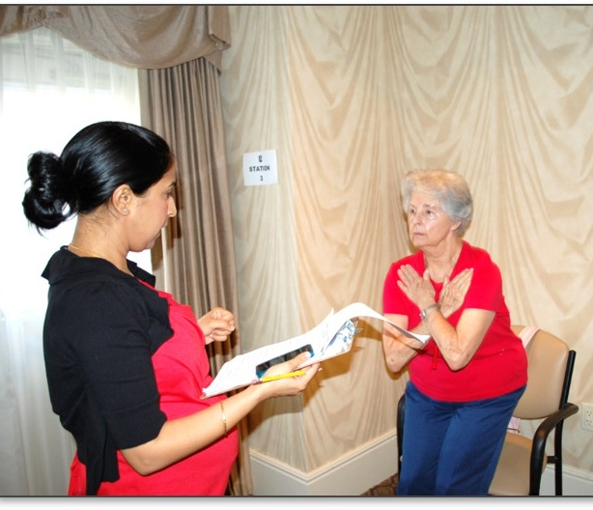
Practice! Sit to Stand
→ Sit towards the front edge of the chair with back straight
→ Place feet flat on the floor with arms crossed over chest.
→ Rise to full stand then return to fully seated position
→ Repeat exercise 10 times
Notes:
Optional: Let’s practice this sit to stand exercise, which will prepare us for the 30-second chair stand.
(facilitator: Consider sharing community statistics on the 30-second chair stand, which can be found in the Portrait Data Report for the community).
Speaker’s Notes: This is recommended as a guided exercise with a Fitness Coordinator or other appropriate team member present to provide aid if necessary and to demonstrate the exercise.
Photo credit: http://www.spinpoi.com/health/#4

Slide 23
Masterpiece Living Network Fall Statistics
68% have low risk of falling
27% scored above average on the 30-Second Chair Stand
Notes:
Did you know that Masterpiece Living partnered communities like ours have lower risk of falling compared to national averages? The Mobility Review score is made up of the Tinetti Gait and Balance Assessment Tool and the Functional Reach Test. The Tinetti Assessment Tool measures an individual's ease of movement and balance for activities of daily living such as getting up from a chair to answer the phone or door, turning around or changing directions, and maintaining good balance while walking or standing. The national average for men and women over the age of 60 is a score between 24 and 27 out of a total of 30. In 2018, there were 3767 Independent Living residents who participated in the Mobility Review within the Masterpiece Living Network. 68% of the participants are considered at low risk for a fall.
The 30-second Chair Stand measures lower body strength needed to climb stairs, walk distances, dance, or any other activity that requires lower body movement. Lower-body strength also helps reduce the risk of balance issues and falls. In this exercise, the participant sits at the edge of a standard chair with his/her arms crossed over the chest and rises to a full stand and returns to a fully seated position as many times as he/she can in 30 seconds. The national average for women 60 and older is 8 to 17 and for men the range is 10 to 17. 27% of Masterpiece Living participants are considered above these ranges when compared to older adults living in their own homes.

Slide 24
Masterpiece Living Network Fall Statistics
70% of men & 76% of women score average or above average in lower body flexibility
41% are able to balance on one leg for more than 5 seconds
Notes:
The Chair Sit & Reach exercise measures flexibility in the lower body, which is important for posture and mobility tasks like walking and climbing stairs. In this exercise, the participant sits at the edge of a standard chair with one leg straight and his/her heel resting on the floor. He/she then places one hand over the other and reaches toward his/her toe. Touching the toe gives a score of zero, while not quite reaching the toe is a negative score and overreaching is a positive score. The score is measured in inches. 70% of men and 76% of women participants in the Masterpiece Living Network scored an average or above average score on lower body flexibility.
The Single Leg Balance exercise measures balance and is an indicator of how likely a person is to experience a fall. If the participant stands on one leg more than 5 seconds, his or her risk of having an injurious fall is lowered; if the participant stands on one leg more than 30 seconds, his or her risk of falling is very low.
In 2018, 41% of Independent Living MPL Network participants stood on their right leg for longer than 5 seconds.
What do these statistics tell us? Where you live matters!

Slide 25
Community Data
Here you can add community specific data on fall risk (MR), fear of falling (LR), fall incidence (LR), etc.
Check your matched data to compare year over year results of residents and team members.
Notes:
Speakers Notes: Here is an opportunity to share your community data on falls with participants and how your community stacks up to other Masterpiece Living communities, as well as national averages.
A few suggestions:
Pull from comparative or match Portraits
Fall risk can be identified through the Mobility Review (MR)
Fear of Falling can be identified through the Lifestyle Review (LR)
Fall Incidence can be identified through the Lifestyle Review (LR)

Slide 26
Fall Risks Worksheet
Notes:
(facilitator: pass out Fall Risk Worksheet to participants)

Slide 27
Fall Risks Worksheet
INSERT SCREENSHOT OF PHOTO HERE
Notes:
Over the course of Vertical 360 we will be utilizing this Fall Risks Worksheet. You are encouraged to complete a portion of the worksheet with each Vertical session, and by the end it will be complete. This can be used as a tool for you to monitor your progress and keep your goals and strategies top of mind. Today as we discuss fall risks, please keep this worksheet handy. If any of the potential fall risks stand out to you– write them down on your fall risk worksheet in the “my risks” column.
Now let’s dive into common fall risks.

Slide 28
FALL RISKS
Lack of Physical Activity
Medication Side Effects
Vision Impairments
Assistive Devices
Environmental
Hazards
Fear of Falling
Poor Sleeping Habits
Others!
Notes:
These are the primary risks associated with falls. The good news is that many of these risks can be reduced or prevented altogether.
(facilitator: read the information on the slide)

Slide 29
Fear of Falling
Notes:
Being fearful of falling can actually contribute to your fall risk.

Slide 30
Fear of Falling
Increases risk of falling
Leads to further physical decline due to limiting activities
Notes:
Not only does fear of falling increase your risk of falling, but unfortunately it often leads to further physical decline. This fear may cause a person to cut down on their everyday activities. When a person is less active, they become weaker and this increases their chances of falling.
Source: CDC- Important Facts about Falls
https://www.cdc.gov/homeandrecreationalsafety/falls/adultfalls.html

Slide 31
Fear of Falling
Decreased muscle strength and balance
Social Isolation due to limiting social engagements
Leads to feelings of hopelessness
Notes:
Fear of falling also can lead to a decrease in muscle strength and balance, along with feelings of hopelessness. This fear can also contribute to limiting social engagements, which can manifest into social isolation.

Slide 32
The Cycle: Fear of Falling
Fall
Fear of falling again
Less Activity
Decreased Muscle Strength & Balance
Increased Risk of Falling
Notes:
Unfortunately, if an individual has experienced a fall, this often leads to a cyclical process, where the fear of falling again increases the likelihood of another fall happening in the future.
The cycle begins with a fall, which leads the person to develop a fear of falling. This then manifests into less activity, which decreases the person’s muscle strength and balance, ultimately leading to an increased risk of falling and often results in another fall. The cycle will continue to repeat itself, until someone can break through that fear.

Slide 33
Lack of Physical Activity
Notes:
A struggle that many face is getting enough physical activity. A 2008 National Health Interview Study found that 59 percent of adults never participated in vigorous physical activity lasting more than ten minutes in a given week. Unlike our ancestors, we have virtually programmed physical movement out of our daily lives.
Source: Live Long, Die Short

Slide 34
Lack of Physical Activity
Increases risk of falling
Leads to:
Poor balance
Gait issues
Notes:
This lack of physical activity increases our risk of falling. Lack of physical activity leads to poor balance, gait issues, and a decline in muscle strength. Not being active also leads to a decline in the ability to perform activities of daily living.
Activities of daily living include things like eating, bathing, dressing, going to the bathroom, and more. For most of us, these are activities that allows us to maintain our independence. We will talk more about physical activity in session four of Vertical 360.

Slide 35
Medications
Notes:
Medications can also be a contributor to fall risk. Let’s look at a few ways your risk can be impacted by medications…

Slide 36
Medications
Side Effects
Polypharmacy
Notes:
Some medications may increase fall risk due to various side effects. Since everyone is unique, these side effects will vary from person to person. Be aware of these potential side effects so they don’t catch you by surprise. For example, some over-the-counter medicines can affect balance and how steady you are on your feet.
Polypharmacy is the use of four or more medications and has been associated with increased risk of falling and recurrent falls. For some, being on four or more medications is necessary, this also means that these individuals will need to be very proactive in understanding their risks. In session four we will discuss some ways to manage medications.

Slide 37
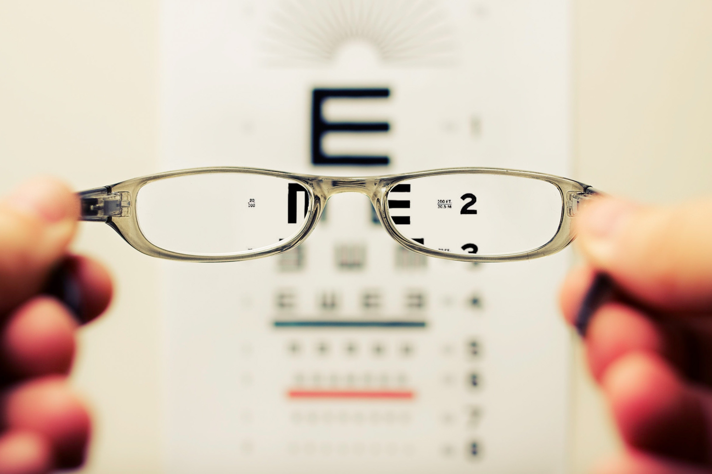
Vision Impairments
Notes:
Vision impairments, although common as we age, are also associated with higher fall risk, mobility problems, and poor balance.

Slide 38
Vision Impairments
Increased Fall Risk
Type of eyewear/lenses
Notes:
The type of eyewear and lens can also increase your fall risk. For example, bifocals or progressive lenses can make things seem closer or farther away than they actually are. This can lead to a fall. We will go more in depth on the risks associated with vision impairment and ways to address those risks in a future Vertical 360 session.

Slide 39
Assistive Devices
Notes:
Assistive devices are mobility aids such as wheelchairs, scooters, walkers, canes, crutches, prosthetic devices and other orthotic devices.
Source: https://www.nichd.nih.gov/health/topics/rehabtech/conditioninfo/device

Slide 40
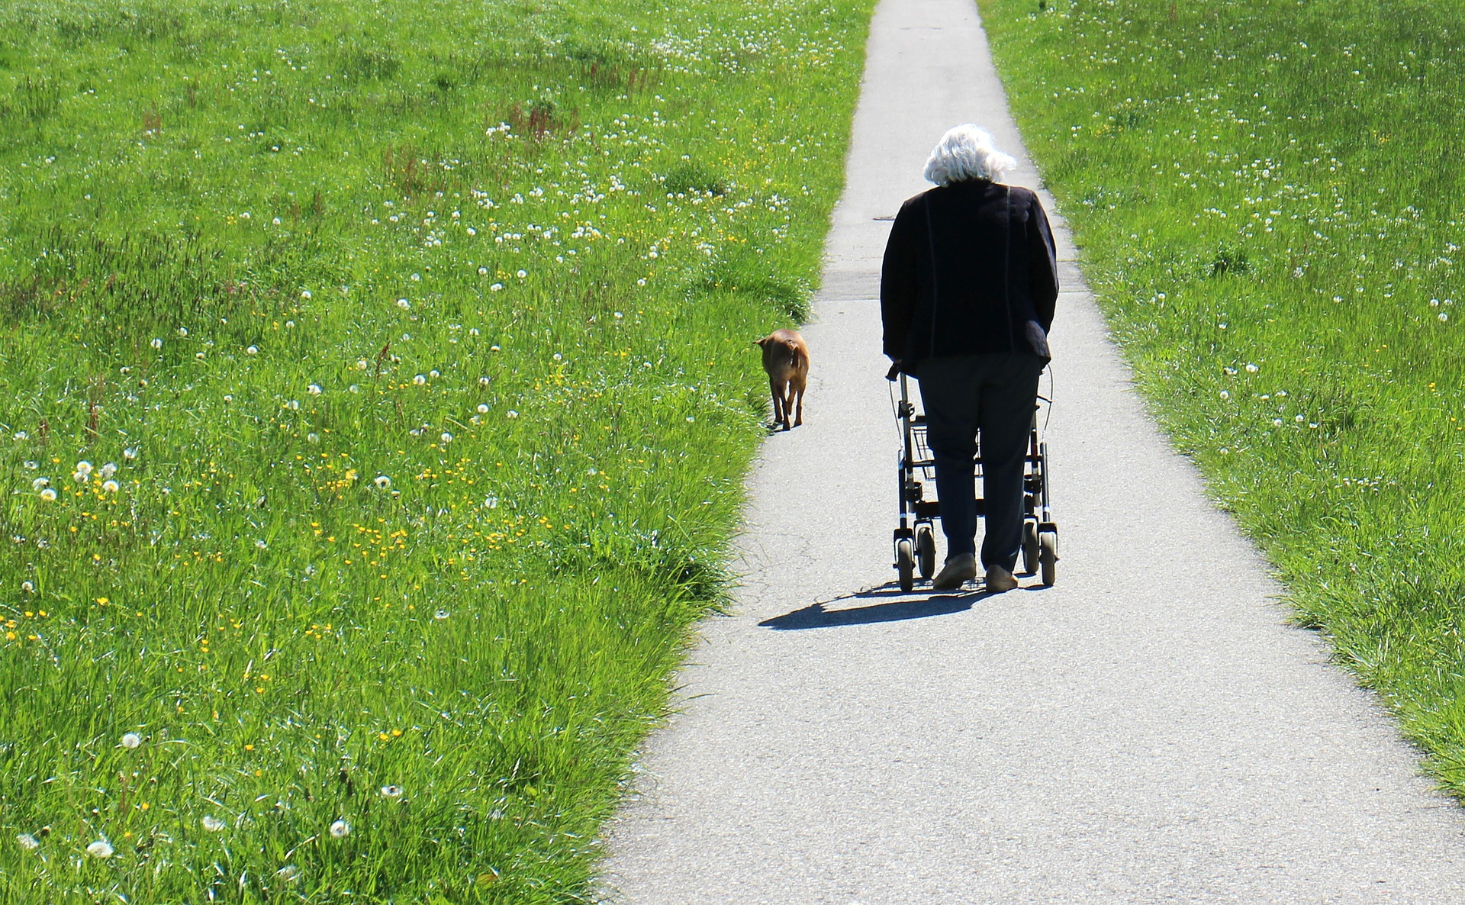
Assistive Devices
Can increase fall risk if…
Improper fit
Lack of Training
Notes:
Assistive devices can be very helpful in maintaining mobility and independence. However, there are some risks involved when using these devices. Your risk of falling can increase if you are unnecessarily using an assistive device. You also have an increased risk if using the wrong type of assistive device, there is an improper fit, you purchased or borrowed an assistive device without professional input or you started using an assistive device without proper training.

Slide 41
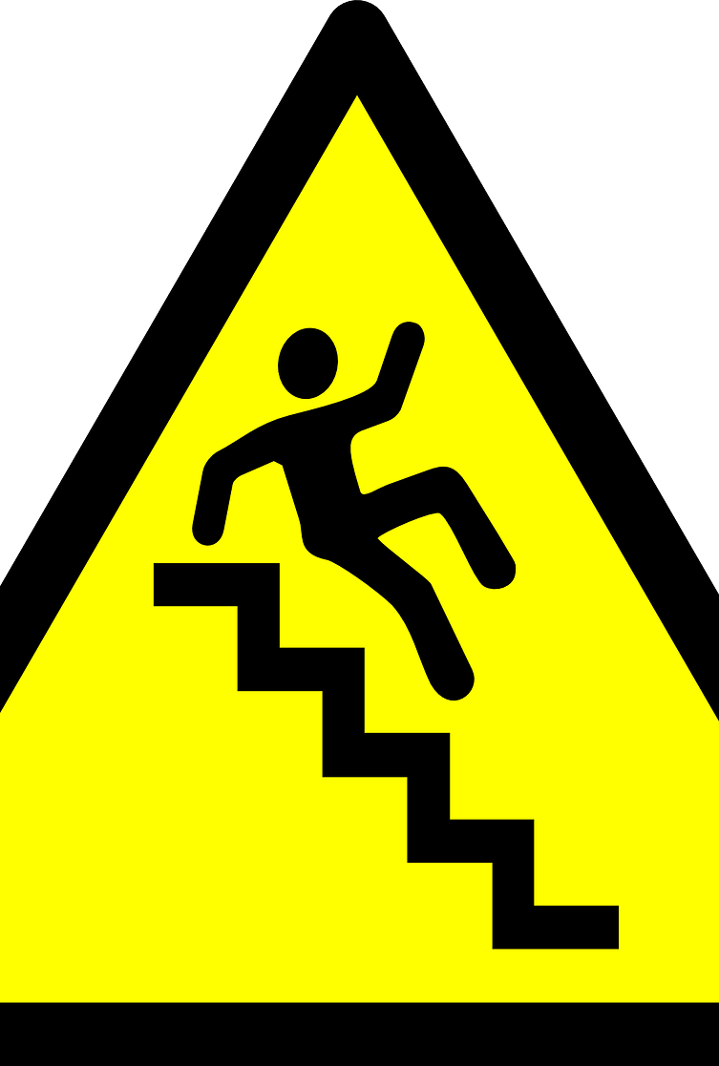
Environmental Hazards
Inside the Home
Outside the Home
Notes:
Environmental hazards include hazards inside and outside the home. Some examples of these hazards include broken or uneven steps, and throw rugs or clutter that can be tripped over. In session three we will cover more in-depth environmental hazards and experience as a group the Home Hazards checklist.

Slide 42
Sleep
Notes:
Believe it or not– sleep also has an impact on your fall risk.

Slide 43
Sleeping Habits
Studies show that poor sleeping patterns are associated with increased falls in older adults.
Insomnia symptoms
Snoring
Others
Notes:
Studies have shown that poor sleeping patterns are associated with increased falls in older adults. Snoring is the primary cause of sleep disruption. Insomnia, sleep apnea, restless leg syndrome and reflux can also contribute to fall risk.
Source: The National Sleep Foundation- Aging and Sleep https://www.sleepfoundation.org/sleep-topics/aging-and-sleep/page/0/3

Slide 44
Footwear
Notes:
Footwear may seem like a minor detail when it comes to fall prevention and continued mobility, but inappropriate footwear has been shown to increase fall risk. In a later module we will go into more detail about the types of footwear that can pose a risk and how to pick out the best footwear to prevent falls.

Slide 45
Low Blood Pressure
Notes:
Low blood pressure, also known as hypotension is a biometric factor that can influence your fall risk. There are a variety of conditions that can cause low blood pressure, such as heart problems, dehydration, or lack of nutrients in your diet. In addition, a side effect of some medications is low blood pressure. We will cover potential strategies to mitigate the risk of low blood pressure in a later session.
Source: https://www.mayoclinic.org/diseases-conditions/low-blood-pressure/symptoms-causes/syc-20355465

Slide 46
Poor Nutrition
Notes:
The last fall risk we will touch on is poor nutrition. Research has shown that poor nutrition or malnutrition has a profound impact on the aging population. Poor nutrition or malnutrition is defined as a deficiency, excess or imbalance in a person’s intake of energy and/or nutrients. Malnutrition can be caused by muscle loss, cognitive impairment, inadequate food intake, polypharmacy and more. As we make our way through the Vertical 360 program, we will discuss strategies to evaluate your nutritional status and decrease your fall risk through proper nutrition.

Slide 47
FALL RISKS
Lack of Physical Activity
Medication Side Effects
Vision Impairments
Assistive Devices
Environmental
Hazards
Fear of Falling
Poor Sleeping Habits
Others!
Notes:
Today we’ve learned that a number of factors influence fall risks. This is a summary of the risks that we’ve covered today. The other category includes footwear, low blood pressure and poor nutrition. The good news is that many of these risks can be prevented or reduced. A first step is identifying which risks impact you.

Slide 48
Fall Risks Worksheet & Group Discussion
Notes:
Hopefully you’ve been noting the fall risks that stood out to you in the “your risks” column on your worksheet.
I would like to offer the opportunity for those who feel comfortable to share what they identified as their fall risks and discuss any thoughts you have on today’s content. The goal is to generate a meaningful discussion. Before we begin, I would like to set the expectation that anything shared here in this space– stays here. We will always practice respectful communication and please only share what you feel comfortable sharing. Would anyone like to share?
Speakers Notes: If participants are hesitant to share, consider providing a few examples below.
Some examples include:
I had no idea that fear of falling could contribute to my fall risk
I am looking forward to learning more about how I can address my risks
My fall risk was…
I will be interested to find out more about how the spiritual component can mitigate my fall risk

Slide 49
Now that we know the risks…how do we manage them?
Notes:
(facilitator: read information on slide)

Slide 50
Managing Fall Risks through the 4 Components
The next modules will cover fall prevention strategies related to:
Social Component
Intellectual Component
Physical Component
Spiritual Component
Notes:
Luckily, there are many strategies we can cultivate to manage our fall risks. These strategies can be found through Masterpiece Living’s SIPS components, which we touched on at the beginning of today’s content. In the sessions to come we will cover continued mobility and fall prevention strategies related to the SIPS components: Social, Intellectual, Physical, Spiritual.

Slide 51
What is your motivation for maintaining or improving your mobility?
Notes:
Remember the question that I asked you to keep in the back of your mind at the beginning of the session? Well, we have made our way back to it! Hopefully, you have been thinking about this question and have identified what your motivation is for maintaining or improving your mobility. Would anyone like to share?
(facilitator: give participants the opportunity to share their motivation for maintaining or improving their mobility)
Speakers Notes:
If participants do not feel comfortable sharing, below are a few ideas to start conversation:
To be able to play with my great-grandkids.
I want to be able to walk a mile.
I hope to continue to garden- it is my favorite hobby.
To maintain my independence.

Slide 52
Key Takeaways
Fall Statistics
Fall Risks
Managing fall risks through the SIPS components
Motivation for Maintaining Mobility
Notes:
Today we covered a lot of content, and I hope between now and our next time together you’ll be able to reflect on the information you have learned. Some key takeaways from today’s session were fall statistics, fall risks, Masterpiece Living’s SIPS components and asking the question, “what is your motivation for maintaining or improving your mobility?”

Slide 53
NEXT TIME!
The Social Component of Fall Prevention
Session 2
Copyright © 2019 by Masterpiece Living, LLC
All rights reserved. No part of this program may be reproduced or transmitted in any form or by any means, electronic or mechanical, including photocopying, recording or by any information storage and retrieval system, without the written permission of Masterpiece Living, LLC except where permitted by law. For information address: 11360 N Jog Road, Suite 102, Palm Beach Gardens, FL 33418.
Notes:
Does anyone have questions?
(facilitator: give a couple minutes for participants to ask any questions they may have)
Next time we will cover the Social Component of Fall Prevention. Make sure to bring your Fall Risk Worksheet. See you then!

