Slide 1
Masterpiece Living Mobility Review
Instruction Guide
Notes:
Change order to instruction guide booklet

Slide 2
Purpose of the Mobility Review:
To measure upper and lower body strength, flexibility, gait, agility, fall risk and general mobility.
Obtain baseline measure and use as a goal-setting tool.

Slide 3
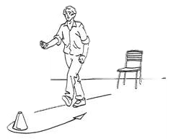
Eight-Foot-Up-and-Go: Dynamic Agility
Equipment:
Stopwatch
Cone or similar marker
measuring tape
Straight back or folding chair (17 inches set height (43cm)
Set-Up and Scoring:
Place chair against the wall and make sure it is stable.
Place a cone 8 feet away from the chair- measure from the front edge of chair and to the furthest edge of the cone.
The score is the number of seconds this exercise took to complete.
Notes:
Improvement over time would show a lower score or less time.

Slide 4
Eight-Foot-Up-and-Go
Tips for Success:
Tell participant they cannot run or touch the cone.
Tell participant you will start the timer on “GO” and stop it when participant sits down.
Administrator stands between cone and chair to assist if participant loses balance.
Give participant a practice test, then trial 1 and trial 2.
Take the best score.
Notes:
Improvement over time would show a lower score or less time.

Slide 5
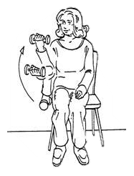
Arm Curl: Upper Body Strength
Equipment:
Stopwatch
Chair with no arms
5lb (women) and 8lb (men) dumbbell
Set-Up and Scoring:
Place chair against the wall and make sure it is stable.
Your score represents the number of repetitions fully completed in 30 seconds.
Notes:
necessary for numerous daily functions, such as lifting groceries, performing housework and general lifting.
Participant completes as many bicep curls as possible in 30 seconds, using full range of motion, holding a hand weight (5 lbs. for women, 8 lbs. for men). Participant sits on a chair with back straight, feet flat on the floor, close to the edge of the seat. The weight is held down at the side, in the dominant hand with a firm grip. From the down position, the weight is curled up with the palm gradually rotating to a facing-up position during flexion. The weight is then returned to the fully extended down position.

Slide 6
Arm Curl
Tips for Success:
Have participant sit on the side edge chair of dominant arm.
Participant practices 1-2 repetitions.
Start with holding weight down to the side with palm facing in and as participant curl, palm faces up.
Flexion and extension should only be at the elbow, not the wrist.
Notes:
necessary for numerous daily functions, such as lifting groceries, performing housework and general lifting.
Participant completes as many bicep curls as possible in 30 seconds, using full range of motion, holding a hand weight (5 lbs. for women, 8 lbs. for men). Participant sits on a chair with back straight, feet flat on the floor, close to the edge of the seat. The weight is held down at the side, in the dominant hand with a firm grip. From the down position, the weight is curled up with the palm gradually rotating to a facing-up position during flexion. The weight is then returned to the fully extended down position.

Slide 7
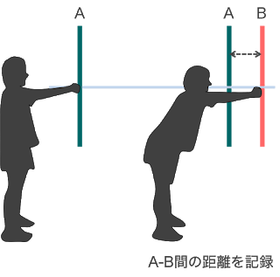
Functional Reach: Balance and Stability
Equipment:
Functional Reach Ruler (provided by MPL)
Masking tape
Set-Up and Scoring:
Have participant stand next to a wall and hold their arm straight out in front of them, mark that spot with tape.
The score (0-2) is based on how far the participant reaches.
Functional Reach

Slide 8
Functional Reach
Functional Reach
Tips for Success:
Have participant stand up tall and use dominant arm to reach.

Slide 9
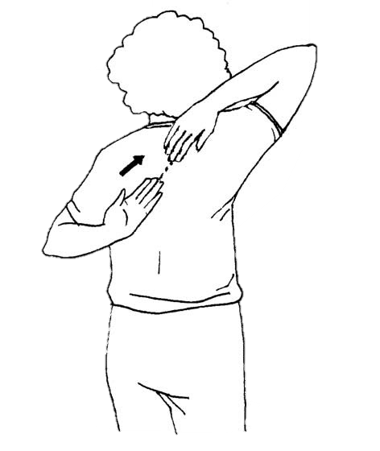
Back Scratch: Upper Body Flexibility
Equipment:
18-inch ruler
Scoring:
The score represents the number of inches between the middle fingers of your hands. Negative numbers indicate that your fingers did not touch and positive numbers indicate an overlap.

Slide 10
Back Scratch
Tips for Success:
Dominant arm will reach up.
Give participant 2 warm-up trials.
Remind participant to breath during movement and move slowly.
Stop test of participant experiences pain
Don’t perform test if participant had neck or shoulder injuries.

Slide 11
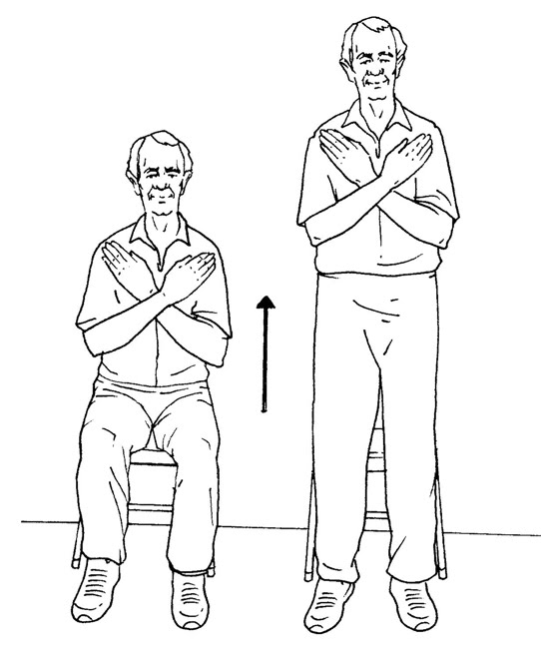
30-second Stand: Lower Body Strength
Equipment:
Stopwatch
Straight back or folding chair (17 inches set height (43cm)
Chair with arms available if needed
Set-Up and Scoring:
Place chair against the wall and make sure it is stable
The score represents the number of times the participant started at a fully seated position, stood to a full standing position and returned to a fully seated position.
Notes:
needed to climb stairs, walk distances, dance, or any other activity
that requires lower body movement. Lower-body strength also helps reduce the risk of balance issues and falls.

Slide 12
30-second Stand
Tips for Success:
Have participant practice fully standing up and sitting back down with arms crossed.
Have someone watch for balance concerns.
Adapt chair size if participant is in pain or cannot sit as low as the chair.
Test can stop sooner that 30 seconds if participant is no longer able to perform stands.
Notes:
needed to climb stairs, walk distances, dance, or any other activity
that requires lower body movement. Lower-body strength also helps reduce the risk of balance issues and falls.

Slide 13
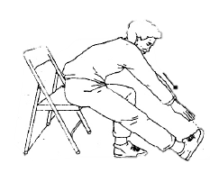
Chair Sit & Reach: Lower Body Flexibility
Equipment:
Folding chair (17 inches (43 cm) with legs that angle forward to prevent tipping.
18-inch ruler
Set-up and scoring:
Place chair against wall
The score represents the number of inches between the tips of your fingers and your toes. Negative numbers indicate that your fingers did not touch your toes and positive numbers indicate past your toes.
Notes:
which is important for posture and mobility tasks like walking and climbing stairs.

Slide 14
Chair Sit & Reach
Tips for Success:
Participant sits on edge of chair.
Remind participant to exhale as they slowly bend forward. Never hold their breath.
Only stretch to the point of discomfort, not pain.
Do not test people that have pain bending forward, severe osteoporosis or recent knee or hip replacements.
Notes:
which is important for posture and mobility tasks like walking and climbing stairs.

Slide 15
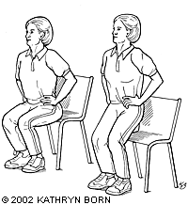
Balance: Tinetti Assessment Tool
Equipment:
Chair
Set-up:
Have participant start in the seated position and stand without arm rests.
If participant can’t stand without arms, use arm rests.

Slide 16
Balance
Tips for Success:
Nudged
Participant's feet should be as close to together as possible for the Nudged section.
Tell participant you are going to press or nudge them 3x on the top of their chest or sternum.
Place your other hand behind them to catch them if they lean back too far.
360-degree turn
Have participant widen their stance and step away from the chair before turning in a circle.
Either direction is acceptable.

Slide 17
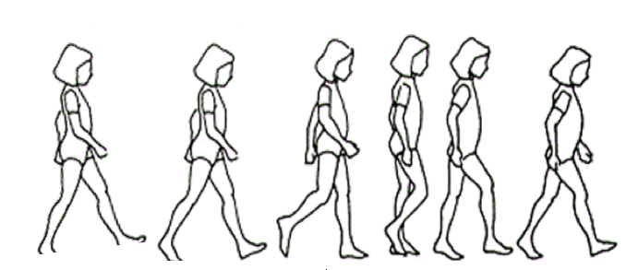
Gait: Tinetti Assessment Tool
Set-up
15 feet walkway
Tips for Success
Participant walks at “usual” pace down the hall and “rapid but safe” pace back.
If additional observation is needed, have the participant repeat assessment.
Gait

Slide 18
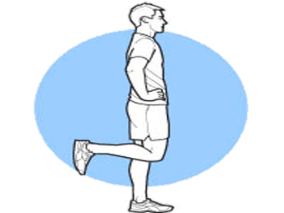
Single Leg Balance
Equipment:
Stopwatch
Set-Up and Scoring:
Set-up station in the corner of a room.
Your score represents the number of seconds you stood on each leg.
Assessment stops if participant starts hopping around (standing foot must stay on the ground).
Notes:
which helps to reduce the risk of or prevent falls.

Slide 19
Single Leg Balance
Tips for Success:
Allow participant to practice standing on each leg.
Have participant stand in the corner of the room so if he/she loses their balance they can use the walls for support.
Do not perform test if there is pain or high risk of falling.
Notes:
which helps to reduce the risk of or prevent falls.

Slide 20
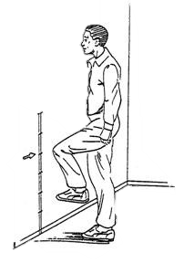
2-Minute March: Endurance
Equipment :
Stopwatch
Tape measure or piece of cord about 30 inches long
Masking tape
Tally counter to help count steps
Set-Up and Scoring:
1. Set up minimum knee-stepping height which is the level even with the midway between the kneecap and front hip bone. Use tape measure or cord to measure height.
2. Mark the height on the wall.
3. The score represents the number of times the right knee reached the marked height in two minutes.
Notes:
which can be helpful when walking any distance, running errands,
dancing, or participating in leisure activities.

Slide 21
2-Minute March
Tips for Success:
Running in place is not allowed.
Have participants stand in between to rails or chair for support in case of loss of balance or corner of room.
Have participant practice stepping to designated height.
Remind participants not to stomp their feet.
Monitor for overexertion.
Have participants cool down by walking slowly for a few minutes.
Notes:
which can be helpful when walking any distance, running errands,
dancing, or participating in leisure activities.

Slide 22
Best Practices
Demonstrate each exercise.
Encourage participants to:
Do their best but not to the point of overexertion.
Stay within thier own safety limits.
Communicate any pain or discomfort.

Slide 23
Best Practices
Lead a warm-up session before administering the exercises:
5-8 minutes
Warm-up movements should include all major muscle groups (walking, swinging arms, etc.).
Examples of stretches:
Head turns and half circles
Single-arm Cross Over
Chest Stretch
Calf Stretch
Hamstring Stretch
Hold each stretch for 5-10 seconds and repeat at least 2 times.

Slide 24
Best Practices
Optimal order of exercises for recovery time:
Balance and Gait
Functional Reach
Single leg Balance
30-second stand
Arm Curl
8 Foot Up-and-Go
Chair Sit and Reach
2-minute March
**A low score is better than using modifications.**

