Slide 1
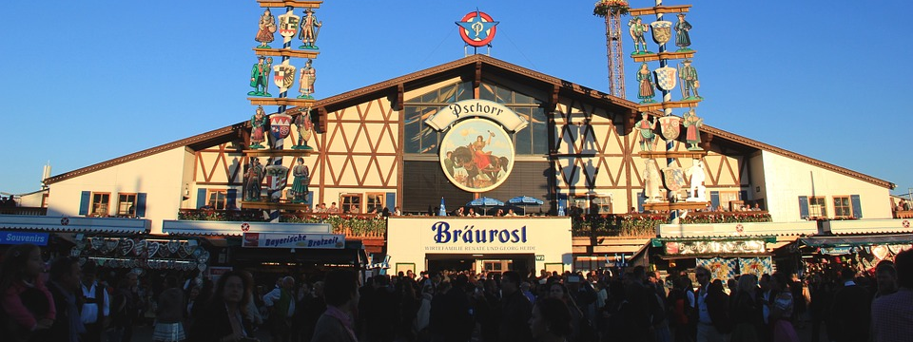
Oktoberfest Training
#takeamobilityreviewday

Slide 2
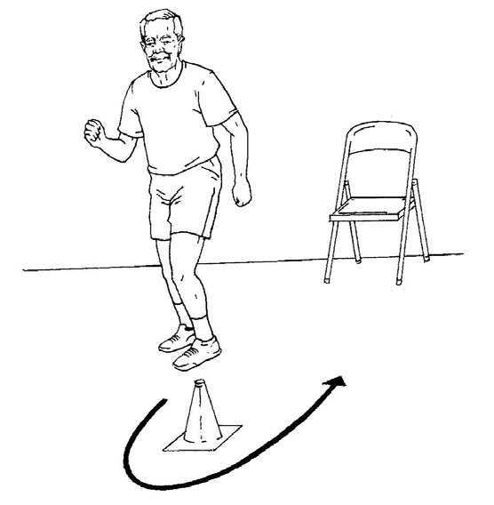
Oktoberfest Crowd Maneuver Eight Foot Up-and-Go

Slide 3
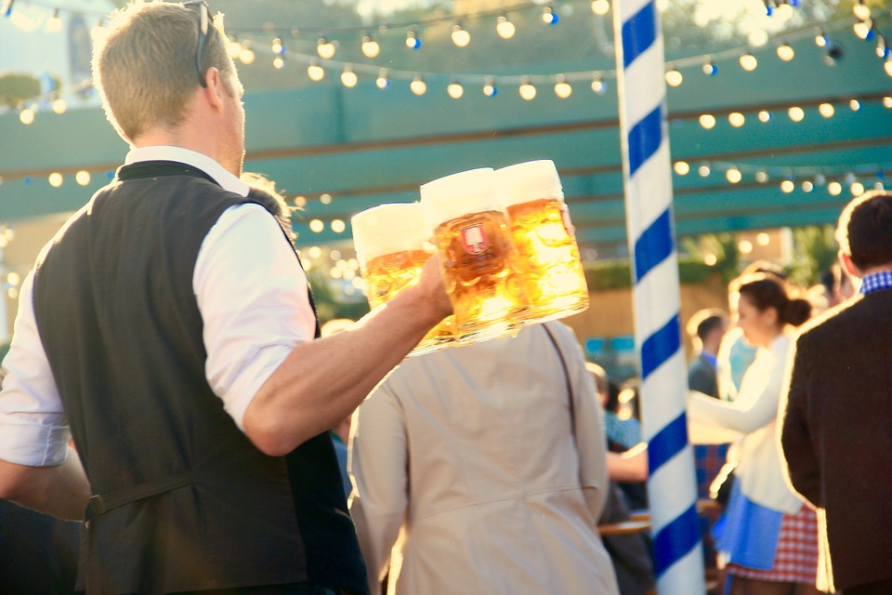
Holding Your Beer Stein Arm Curl Test

Slide 4
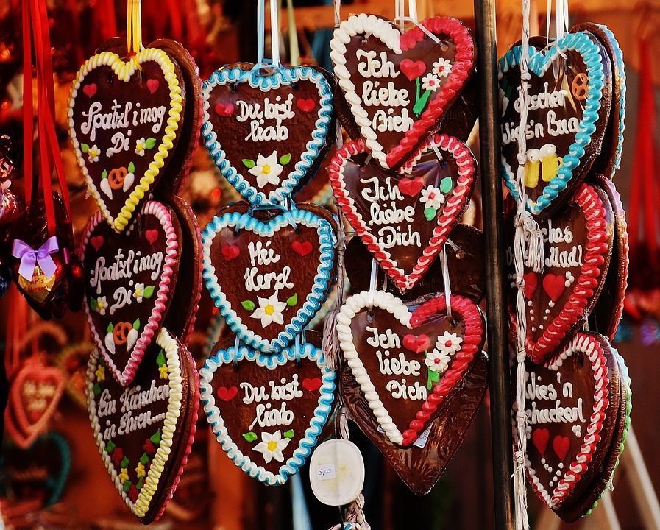
Reach for Your Gingerbread Heart Functional Reach Test

Slide 5
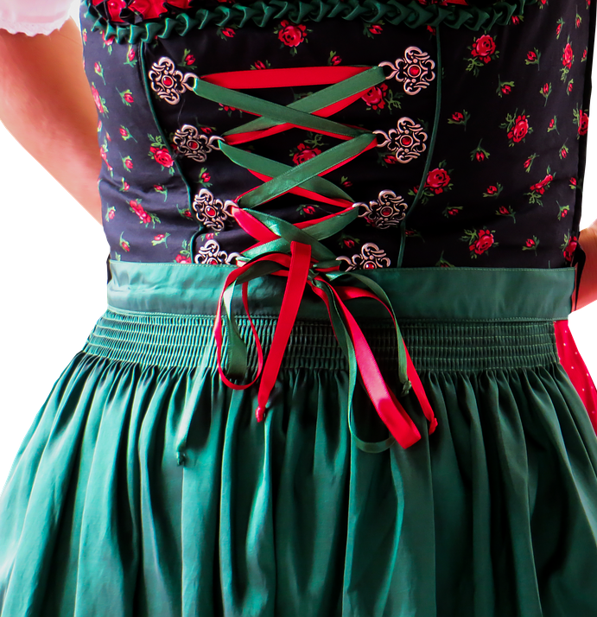
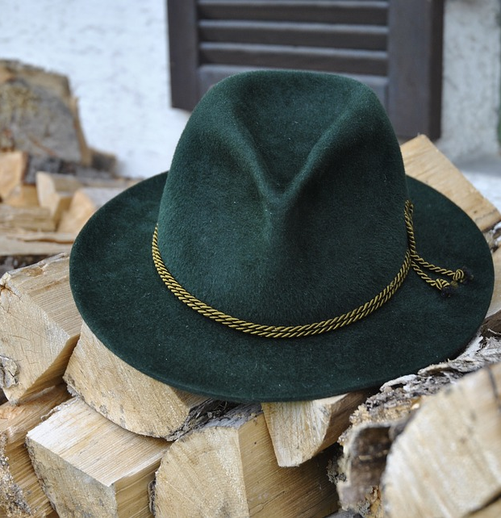
Putting on Your Felt Hat or Tying Your Dirndl Back Scratch

Slide 6
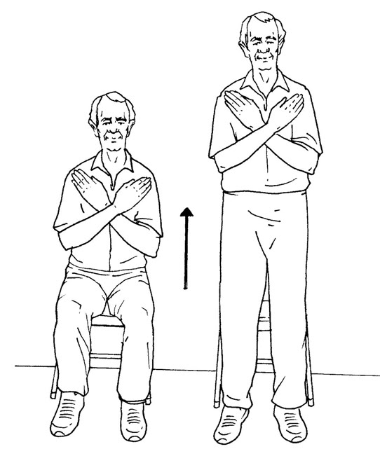
Get Up and Get More Wurstl (sausages) and Brezen (pretzels) 30 –Second Stand

Slide 7
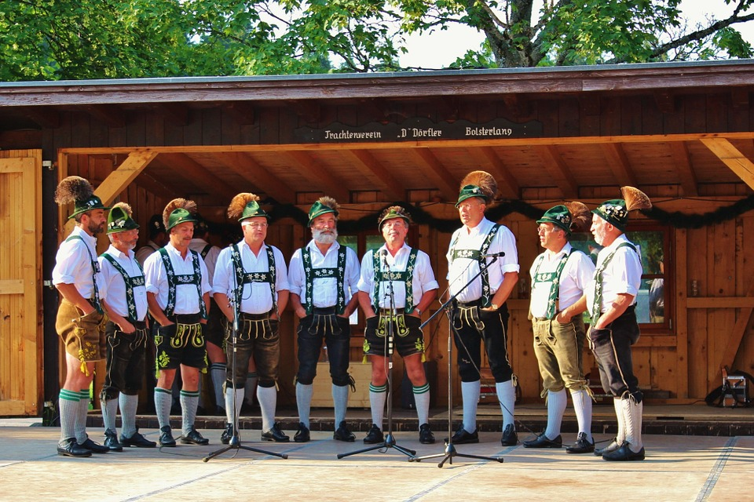
Put on Your Lederhosen and Bavarian Socks Chair Sit & Reach

Slide 8
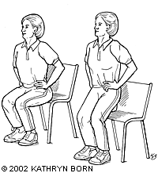
Preparing to Get on The Ferris Wheel Balance

Slide 9
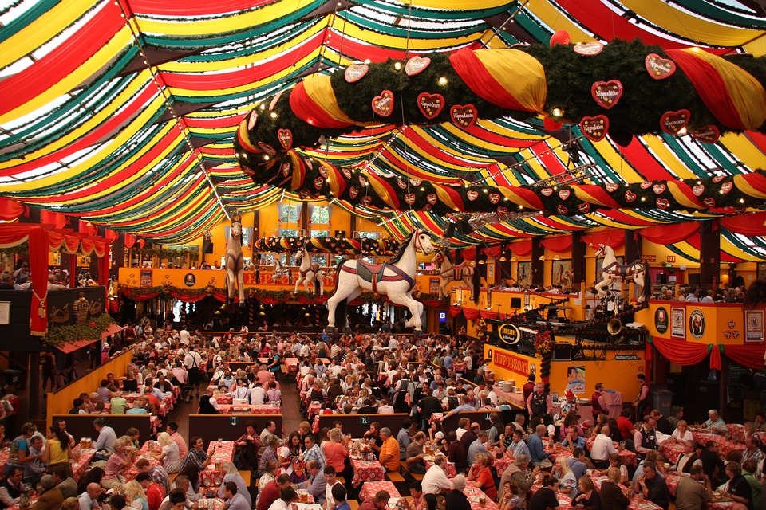
Walking From Tent to Tent Gait

Slide 10
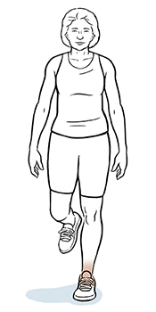
Warm up for the Schuhplatter (German Folk Dance) Single-Leg Balance

Slide 11
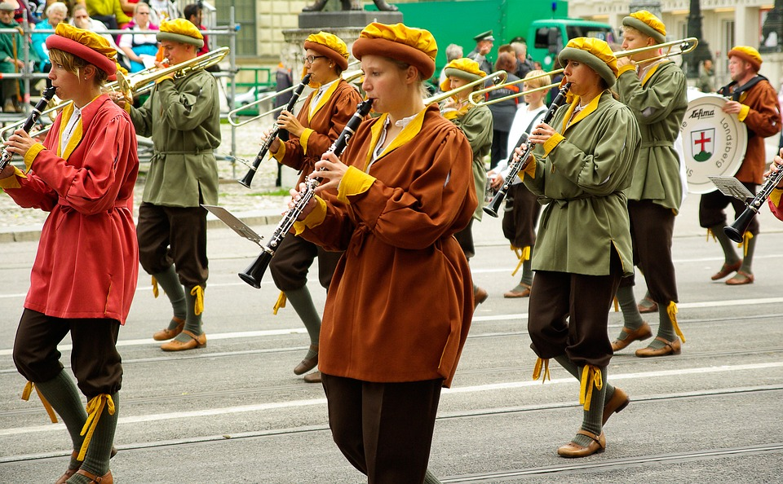
Preparation for the Opening Day Parade 2-Minute March

