Slide 1
Name here

Slide 2
A Generational Journey: Women
Women and the Media
Notes:
Welcome to the second session of A Generational Journey: Women. The title of this session is Women and the Media.

Slide 3
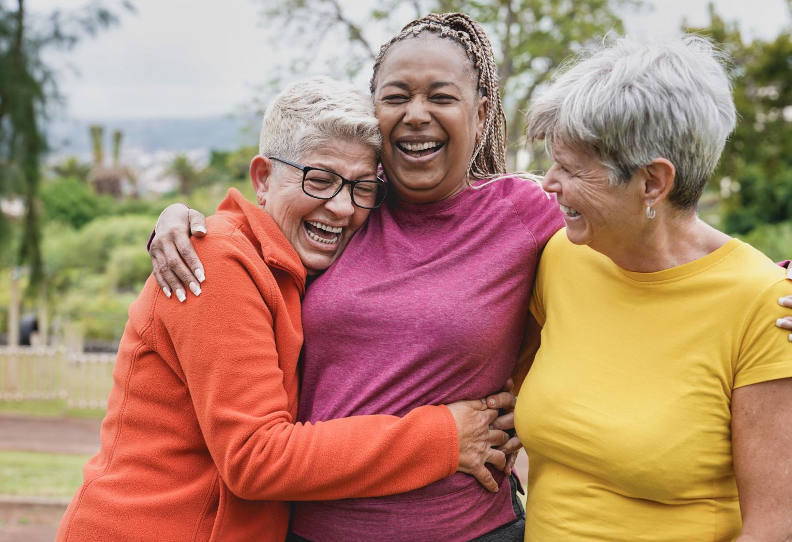
Session 1 Review
Notes:
In the last session we discussed the historical shift in education and cultural expectations for women. We explored changing views on careers and motherhood and wrapped up with work-life balance, including the impact it has on women in our society.
What was a “take away” from that session that was helpful to you, or even surprised you?
Making successful changes in lifestyle is about succeeding in small kaizen steps, one at a time.
Who is willing to share a bit about a kaizen step they took recently?

Slide 4
Today’s Agenda
1
2
3
Examine the changing perception of women’s choices as reflected in the media.
Discuss the media’s portrayal of women.
Explore ways to share experiences with women of younger generations.
Notes:
Today’s session is about the media’s depiction of the changing role of women.
We’ll examine the changing perceptions of women’s life choices and career options as reflected in the media over the past century.
We’ll also discuss the media’s portrayal of aging women in American culture.
Finally, we’ll take time to explore ways to share life experiences with younger generations, comparing similarities, challenges and desires.

Slide 5
Large Family
Notes:
In our early history, marriage and parenthood were highly valued standards. Large families could help support the family farm or business and protect against poverty, provide care to aging relatives, and contribute to the greater community. Social identity for women was largely built through families. So, imagine what it may have been like in those days if a woman did not marry, or could not give birth to children.

Slide 6
Notes:
Women who remained single, whether by choice or without a proposal, were often shunned or discriminated against. The term “spinster” was historically used to describe someone who spun thread for a living. Later this term described women who were of age to marry but were not yet married or were older and no longer likely to marry.
Identified by the label “old maid”, some believed these terms were not only attached to singleness but also to childlessness and bleak prospects for their future financial and social status. Caricatures of spinsters or old maids were drawn with unflattering themes, reflecting undesirable looks and living conditions.
Messaging through historical cartoon depictions, stories and even songs placed negative connotations on spinsters. One example can be heard in the song titled “The Old Maid in the Garret,” an old Irish song referring to a single woman living in the garret, a small room in the attic. The lyrics, sung by generations of children, likely discouraged girls from choosing to live independently when they grew up.
[Facilitator: Note the words to the song are in the participant packet if they wish to follow along].
__
References:
Schwartz & Wolf. (1976) Singlehood and the American Experience: Prospect for a Changing Status.
https://www.jstor.org/stable/44011693

Slide 7
Home Boys Home
Notes:
[Facilitator: Click on video to play. It may take about 10 seconds to open]
___
Reference:
The Clancy Brothers and Tommy Makem. Home Boys Home. Video url: https://youtu.be/0Z7_KHt94u8

Slide 8
Notes:
Another group that did not fit the social norms of the mid 1800s to early 1900s was the suffragettes. As these women pursued the right to vote, better access to education and profitable employment, the popular media jumped on the theme of role reversal. Drawings in newspapers and journals depicted exhausted husbands tending to home and children as wives and mothers marched off to promote the vote. Often depictions portrayed suffragettes as angry, bossy, and less than feminine.
__
References:
Edwards, Rebecca. (2019) Early Women’s Rights Activists Wanted Much More than Suffrage.
https://www.history.com/news/early-womens-rights-movement-beyond-suffrage
Gustin, E.W. Editorial Cartoon: “Election Day!” (January 21, 1909) Source of picture: Library of Congress. Call Number: LOT 4404

Slide 9
Notes:
We are aware of how powerful the media is in promoting the fashion industry today. This was also true in the 19th century. When bloomers were introduced to women as a form of less restrictive clothing, the media focused attention on how these were very much like men’s pantaloons. In this drawing the artist suggests dressing like men would make women act like men, including smoking cigarettes, wearing men’s ties and unfeminine hats and the public reaction would be gossip, anger and bullying.
How does the media portray or influence behaviors or dress choices for women? For women of different ages?
__
References:
Photographer Unknown. “Bloomerism – an American Custom.” (1851) Punch/Wikipedia Commons.
Taylor, Stephen.(Apr 9, 2015) “A Skirt Divided.” Hoosier State Chronicles.
https://blog.newspapers.library.in.gov/tag/cycling

Slide 10
Notes:
In April 1917, America joined WW l. As discussed in the last session, as millions of men were needed for service, women were called upon to fill their jobs. The public media was tasked with reframing the historic messaging of “A woman’s place is in the home” to a new message of patriotic service. To convince women who feared they would become too masculine doing men’s work, war posters focused on the feminine look of women as they drove trucks, used farm equipment and worked in munition factories.
__
References:
Christy, Howard Chandler. New Spring Horse Show – The Motor Corps of America. (1918) Library of Congress.
National Museum of American History. “A Vast Enterprise in Salesmanship”
https://americanhistory.si.edu/advertising-war/a-vast-enterprise-in-salesmanship

Slide 11
Notes:
During this war, women were also encouraged to grow liberty gardens, can and pickle the bounty to help stretch food resources, and maintain the positive morale of their families.
What do you think it was like to experience this dual role of work and family during the war?
What similarities might these expectations have to working women today?
Women were released from their war jobs when men returned from the war and returned to their role in the domestic sphere. Emboldened by this new work experience, women recognized that they could develop skills outside of the home and proved they could perform “a man’s job.”
__
References:
Flagg, James Montgomery. “Will you have a part in Victory?” (1918) Library of Congress.

Slide 12
Notes:
Following WW l and the 1918 flu pandemic, the “Roaring Twenties” began. America was feeling good, the economy was beginning to boom, and the 19th Amendment giving women a right to vote had passed. A generation of young women with new attitudes about gender roles and sexuality were eager to enjoy independence unlike any generation of women before them. They purchased products that represented freedom such as cars, makeup, lingerie, perfume and cigarettes. Many joined the workforce or pursued higher education while also enjoying drinking and dancing with men in speakeasies and dancehalls. These actions were new to the accepted norms for women's behavior in the past.
While some media touted flappers as overly sexual, they were generally portrayed as young women expressing their independence and having fun, even while pushing the boundaries of social and sexual freedoms.
The flapper generation, along with the Roaring Twenties, came to an end with the stock market crash of 1929, followed by the Great Depression. This experience, however, continued to define a new avenue of choice for women in the future.
Who might be able to share family stories about 1920s flappers?
__
References:
Holton, L.J. “Now Shall We Commence.” (June 2, 1927) Life Magazine. Women and the American Story, New York Historical Society Library. https://wams.nyhistory.org/confidence-and-crises/jazz-age/flappers-in-media#resource
Pruitt, Sarah. (Sep 17, 2018) “How Flappers of the Roaring Twenties Redefined Womanhood.” History Stories.
https://www.history.com/news/flappers-roaring-20s-women-empowerment

Slide 13
Notes:
Unemployment was at 25% during the Great Depression. Business and industry asked married working women to give up their jobs to men who needed to support a family, or single women who needed to support themselves.
With most women at home during the Great Depression, advertising companies designed their ads to promote this gender model. Ads and photos in the print media showed men working in offices, factories and on farms while women were most often placed in the home, cooking, cleaning and caring for families.
To better appeal to women who had previously worked in challenging roles outside the home, advertisements touted the rewards of mastering domestic chores and spun a message that excitement and learning, such as chemistry, could be found in cooking and cleaning.
__
References:
Blakemore, Erin. (Nov 8,2021) Why Married Women Were Banned From Working During the Great Depression.
https://www.history.com/news/great-depression-married-women-employment

Slide 14
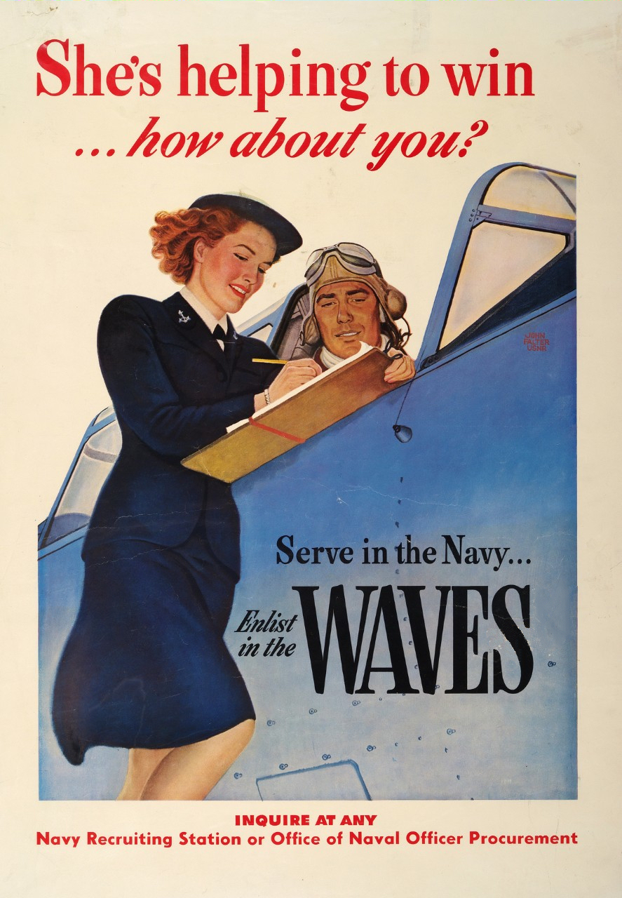
Notes:
In December 1941, the United States entered WW ll. Poster campaigns, again, used feminine images to encourage women to fill men’s jobs on the home front, and new to this war, an unprecedented array of positions in the armed forces.
The experience women had reshaping gender roles in the workplace during both world wars, along with freedoms experienced in the 1920s, would continue to set the stage for accepted changes of women’s roles in the future.
__
References:
Falter, John. S”he’s Helping to Win … how about you?” (1943) Naval History and Heritage Command. Women of World War ll.

Slide 15
Subtitle here
Notes:
Once again, the social norm of the woman’s role changed after WW ll. The post-war economy was healthy and marriage and family were centerstage. Many middle-class couples purchased homes in the suburbs that allowed for expanding families as women returned to domestic roles.
With more disposable income and credit than previous generations, companies were eager to promote their wares to the American public. Advertisements for merchandise pictured women smartly dressed, smiling as they used products that enhanced life in the private sphere, whether it be time saving appliances, cleaning products, food for the family dinner, or an afterwork cocktail or cigarette for the hard-working husband.

Slide 16
Women’s Roles in the 1950’s
Notes:
Let’s look at this brief clip of the expected role of women in the 1950s.
[Facilitator: Click on video to play. It will begin in about 10 seconds]
__
References:
“Cultural Shift: Women’s Roles in the 1950s” (Retrieved December 2021)
https://www.youtube.com/watch?v=zlnH6V83QRA

Slide 17
Notes:
The average age women married in the 1950s was 20 years old, compared to 27 years old today. Many young women postponed or opted out of higher education in order to marry and begin families. Movies reinforced these social norms through story lines.
Let’s look at messaging from the 1955 popular movie, The Tender Trap.
__
References:
Online article. PBS. American Experience. Women in American History. Mrs. America: Women’s Roles in the 1950s. https://www.pbs.org/wgbh/americanexperience/features/pill-mrs-america-womens-roles-1950s/

Slide 18
1955 Film: The Tender Trap
Reynolds: The theatre’s alright, but it’s only temporary.
Sinatra: Are you thinking of something else?
Reynolds: Marriage, I hope. A career is just fine, but it’s no substitute for marriage. Don’t you think a man is just the most important thing in the world? A woman isn’t a woman until she’s been married and had children.
Notes:
In a conversation between two leading characters, Debbie Reynolds and Frank Sinatra, Frank has just asked Reynolds if she is excited about being selected for a main role in her very first professional show.
Facilitator: [read script on slide or below]
Reynolds: The theatre is all right, but its only temporary.
Sinatra: Are you thinking of something else?
Reynolds: Marriage, I hope. A career is just fine, but it’s no substitute for marriage. Don’t you think a man is just the most important thing in the world? A woman isn’t a woman until she’s been married and had children.
__
References:
The Tender Trap. Warner Archive (Apr 1, 2021) https://www.youtube.com/watch?v=-3_7pcQcH0s

Slide 19
Popular Television Shows in the 1950’s
OZZIE AND HARRIETT
FATHER KNOWS BEST
LEAVE IT TO BEAVER
OTHERS?
Notes:
Thousands of families purchased their first television in the 1950s, and this form of media not only became a prime avenue for entertainment, but also the preferred method for advertising.
After the challenging years of the Great Depression and WW ll, 1950s television shows reflected a new stability through images of close-knit nuclear families with sharply dressed mothers tending middle class homes while raising well-behaved children. Storylines reflected clear roles for parents and small life lessons for children.
What ways do you think these television shows highlighted this ideal?
[Facilitator: If no response, refer to notes below.]
The Adventures of Ozzie and Harriett (1952-1966): All-American nuclear family dealing with simple everyday issues.
Father Knows Best (1954-1960): A wise family man who can always provide the family with advice and direction.
Leave it to Beaver (1957-1963): A typical nuclear family where father gets home in time for dinner, mother wears a dress and pearls while cleaning and cooking, and the boys veer out of line just enough to learn a gentle lesson on behavior.

Slide 20
1960’s-80’s
Women’s
Rights
Movement
Notes:
The Civil Rights movement influenced the second wave of the Women’s Rights Movement. Between the 1960s and the 1980s, women challenged the traditional roles of marriage and motherhood and pushed for equal rights, greater opportunities and more personal freedoms.
Cohabitation outside of marriage, new options in birth control, greater access to higher education and more options for careers created new possibilities for woman with more choice than expectation.
What are your thoughts on the woman’s movement, or who can speak to their role in this movement?
Television shows in this period began to reflect these new expectations and changing social themes. Shows included divorced or widowed parents, women working outside the home and imperfect families. More controversial topics such as civil rights, gender equality and the challenges of raising children as a single mother were addressed in the episodes.

Slide 21
Popular Shows in the 1960-80’s
MY THREE SONS
BEWITCHED
MARY TYLER MOORE
ONE DAY AT A TIME
MAUDE … OTHERS?
Notes:
Let’s look at popular shows from this period and the subtle, or not so subtle changes they nodded to.
Can you identify what the changing roles were in these shows or others you remember from that period ?
[Facilitator: If no response, offer a few below.]
The Andy Griffith Show (1960-1968): A widower raises son with help from Aunt Bea.
My Three Sons (1960-1972): A widower raises three boys with help from his father-in-law.
The Dick Van Dyke Show (1961-1966): Character wife Laura wears capris instead of dresses and heels while cleaning the home.
The Lucy Show (1962-1968): A widowed woman, not always “ladylike,” raising her children while sharing her home with her divorced friend.
Bewitched (1964-1972): A housewife with more powers than her husband.
That Girl (1966-1971): An independent career woman.
Julia (1968-1971): First sitcom revolving around an African American leading actress.
The Mary Tyler Moore Show (1970-1977): A single woman who “made it on her own.”
All in the Family (1971-1979): Four characters with very different views debate controversial social topics.
Maude (1972-1978): An outspoken woman with liberal political views living with her fourth husband, divorced daughter and teenage grandson.
One Day at a Time: (1975-1984): A divorced mother raising teens and addressing an array of social issues.
Kate and Allie (1984-1989) A divorced woman sharing an apartment with her friend and their children.

Slide 22
Notes:
Thanks to previous generations of women who took strides to open opportunities, women today have more choices in education, career, marital status, family timing, and their identity as an individual. These options for choices today are expressed through many avenues of the media.
For instance, let’s look at one area of choice – jobs. Women filled men’s jobs during the world wars, but these jobs were temporary. Today, women are building full careers in industries that were not open to them years ago. In this next video news report, we learn about young women training for such careers today.
What are some non-traditional jobs women are moving into today that were not available to them in the past?
[Facilitator: Note answers. If need prompting on careers: heavy equipment operators, electricians, welders, engineers, architects, construction workers, police officers, firefighters, transportation drivers and pilots, politicians, chefs, undertakers, health and safety officers, environmental scientists, and more.]
Have any of you worked in these areas, or do you have family members who are working in these fields and can share what it may be like for them?
__
References:
Verner, Britteny. (Mar 13, 2017) Female Students at Temple High participate in non-traditional STEM roles. https://www.kxxv.com/story/34760341/female-students-at-temple-high-participate-in-non-traditional-stem-roles

Slide 23
Girls in the Media Today
Notes:
With the ability to make a video on a smart phone and share it on social media, the world of media now has a great deal of content about everything. However, there are still traditional outlets. This is an example of a news station, KGW8, sharing a human interest story about girls in pursuit of the science, technology, engineering and math (STEM) fields.
__ Reference:
KGW News. (Link retrieved 12/2/2021) “Nonprofit empowers girls to pursue work in STEM field.” https://www.youtube.com/watch?v=JQ1AGLGr1_4

Slide 24
This Photo by Unknown Author is licensed under CC BY-SA
Notes:
To use a highly recognized phrase from a popular 1968 cigarette ad “You’ve come a long way Baby,” and indeed, women have.
However, this is not so true in how women compare themselves to media messages about aging and beauty. It is estimated that between 5,000 and 10,000 ads cross in front of people each day. With the cosmetic and toiletries segment being one of the leading advertising categories, a tremendous number of ads focused on flawless perfection and anti-aging impact how girls and women feel about their own beauty. The promotion of products from Botox, to plastic surgery, to serums and creams, all promising to halt or turn back time has hampered the ability of people to see their own beauty as they age.
According to the Dove company, only 4% of women surveyed believe they are beautiful. If this seems surprising. understand the bar set for beauty today is a false bar, impossible to reach. Today’s models, no matter how beautiful or fit, are digitally perfected at photo shoots. Using photoshop apps, or teen models to appear as women much older, or body part doubles to replace the ears, necks, arms, or legs of the original model, the final product is not a true picture of the model.
This discourages girls with their own “flaws” and “imperfections” as early as middle school. In fact, women of all ages are impacted by ads that suggest flawless perfected youth must be retained in order to be considered beautiful. In addition to this, older women are rarely used as models in beauty ads. Our culture has saved this group for prescription and undergarment ads, as if that’s what aging is all about!
What experiences as a child or younger woman can you think of that made you question your own beauty?
Who can recall an example of advertised beauty that seemed impossible to reach?
__
References:
Dove. The Real Truth About Beauty: Revisited.
https://www.dove.com/us/en/stories/about-dove/our-research.html

Slide 25
Impossible Beauty
Notes:
Let’s look at an example of this “impossible beauty” as a model is prepared for a photo shoot. This very short video titled Evolution, was created for the Dove Beauty campaign.
[Facilitator: The changes to the model in this video move quickly. We recommend playing it twice and between both showing ask people if they noticed the enhancement in both make-up and digital changes, like elongating the neck, moving the eyebrows, etc.]
Were you aware that this occurs in photo shoots for print and social media?
What are your thoughts about it?
__
References:
Source of video: Evolution video distributed by the Dove Campaign for Real Beauty. https://www.youtube.com/watch?v=wpM499XhMJQ

Slide 26
“
You will never look like the girl in the magazine. The girl in the magazine doesn’t even look like the girl in the magazine.”
– Jessiemae Peluso, comedian
“
Notes:
As comedian, Jessiemae Peluso, says about the photoshop creation of “impossible beauty” ... You will never look like the girl in the magazine. The girl in the magazine doesn’t even look like the girl in the magazine.
[Facilitator: Read quote]

Slide 27
Notes:
With today’s younger generations embracing inclusivity and authenticity, and pushback from consumers resisting this false portrayal of beauty, a handful of clothing and beauty product companies are responding. By limiting the layers of digital enhancement or using regular people of different ages, sizes and skin colors as their product models, they hope to create a broader definition of beauty and connect with a wider range of buyers.
How do you feel about companies using real women to create product ads?
Who can share what they have seen in ads that encourage an individuals’ unique beauty?

Slide 28
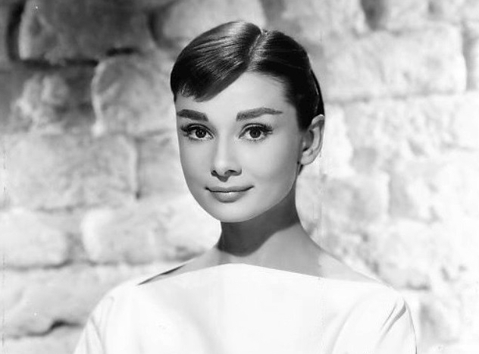
Notes:
Audrey Hepburn, British actress and humanitarian, provides a reflection of beauty. [Facilitator: Read the quote.]
For attractive lips, speak words of kindness.
For lovely eyes, seek out the good in people.
For a slim figure, share your food with the hungry.
For beautiful hair, let a child run his/her fingers through it once a day.
For poise, walk with the knowledge that you never walk alone.
What do YOU think beauty is?
How might this view counterbalance the messages received from the media about one’s own beauty?
__
Reference: Fraker, Bud. “Audry Hepburn.” (1956) https://upload.wikimedia.org/wikipedia/commons/5/5e/Audrey_Hepburn_1956.jpg

Slide 29
Notes:
The Geena Davis institute of Gender in Media and the NextFifty Initiative recently collaborated on a study of Americans attitudes about the representation of older adults in film and television. In the report, Women Over 50: The Right to Be Seen on Screen, they found that television and film viewers want to see more realistic and frequent representations of older men and women, including more diverse characters and roles. Older women, especially, are underrepresented and when they are, the character is often in a minor or supporting role.
What roles could older female actresses portray that would best represent you?
Let’s transition now. We covered the media’s portrayals of women’s roles through our recent history, and we addressed the media’s view of aging and the current representation of older women. Now, let’s look at how we could support younger generations of women on their journey.
[Facilitator: Make group aware there is an area in the participant packet to jot down ideas and notes for the following discussion. Prepare to collect group thoughts on a white board as you ask questions.]
As women of wisdom and experience, do you think there is value in connecting with younger women to compare life roles? Maybe discovering similarities, challenges, and desires across generations?
[If so ask:] What could those opportunities look like? [Facilitator: encourage discussion and note ideas the group suggests such as those listed below]
a simple plan for individual connection with a younger family member to share something they feel is important
create the opportunity to continue conversations around key topics of interest in a women’s group or event
host a meet-and-greet tea with scripted prompts to share experiences between residents and other women
story sharing through written or video media with younger family or students
focus on community wide activities on a specific topic such as recognizing beauty in self and others
model a program for young women around the array of Dove beauty campaign videos (listed in Facilitator Guide)
What next steps do you hope that you as an individual, or us as a group can take toward these ideas?
Thank you for beginning to explore this.
__
References:
The Geena Davis Institute on Gender in Media. Executive Summary (2021) Women Over 50: The Right to be Seen on Screen. https://seejane.org/research-informs-empowers/women-over-50-report/

Slide 30
Kaizen
Notes:
Please look in your participation packet for the kaizen worksheet.
Take a few minutes to consider a small step you could take to support your wellbeing as you continue your own longevity journey. Jot down ideas that come to you. It could be on topics relate to this session, or something else important to you.
[Facilitator: Give the group 3-4 minutes]
Who would like to share some of the thoughts they have for a future kaizen step?
Thank you for sharing.

Slide 31
THANK YOU!
This Photo by Unknown Author is licensed under CC BY
Notes:
I appreciate your attention and participation today. For our next session we’ll address an interesting topic – the “modern crone”. We’ll also discover solutions to issues such as ageism, invisibility and social support. I look forward to seeing you then.

